Slide 1
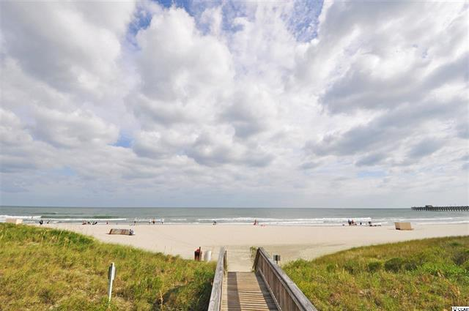
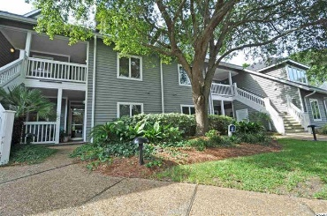
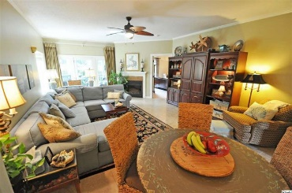
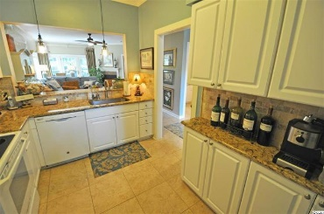
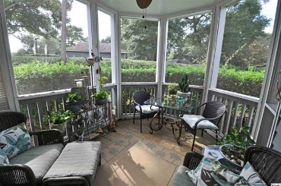
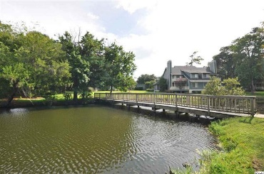
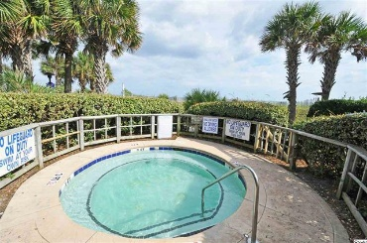
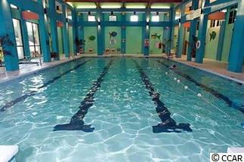
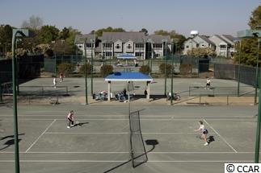


Easy Stroll to Beach & Pool
Priced to Sell!!
726 Windermere by the Sea Circle
Kingston Plantation
Myrtle Beach, SC 29572
MLS: 1519107
$379,000
Kingston commands quality! One of the best of the best, this upgraded, stylish and immaculate 2 bedroom, 2 bath condo is really best described as perfect, perfect Windermere By the Sea Circle quiet and private cul-de-sac location, across from Embassy Suites at Kingston and just a short stroll to the ocean. Plus, the perfect serene screened back porch overlooks a manicured park-like setting and yet is conveniently located to one of the 12 pools. There's even a lazy river! The lazy river is in conjunction with the children’s water park right across the street, just before the ocean. This condo is all on one level with a split bedroom, very livable spacious floor plan. Some of the many impressive upgrades include granite and Travertine throughout, kitchen cabinets and lighting, master bath, ceiling fans, fireplace, refrigerator and new carpet and water heater in May 2015. HVAC was replaced in 2009 and air ducts cleaned in February 2013. Window coverings include only blinds, drapes negotiable. Appliances convey. However, washer and dryer do not convey. Kingston Plantation is one of the most perfect inclusive and amenity-rich resort areas not only in the Carolinas but anywhere, easily accessible to restaurants, shopping and entertainment for kids of all ages. In fact, there are numerous restaurants and lounges featured throughout or near the Plantation itself, such as Croakers, Ocean Annies and in-hotel -- Embassy Suites and Hilton. Apache Pier is the longest wooden pier on the East Coast and offers events and entertainment, great food and fun! Signatures of Kingston are its inclusive Fitness and Tennis Centers. Owners have access to the Fitness Center for a nominal charge. At Kingston you can do it all, or nothing at all and be right at home any season. Kingston schedules building maintenance regularly, and exterior paint is 2 years old and the roof 5 years old. The interior of the condo is also excellently maintained, showing the pride of ownership of a wonderful home, second home or vacation rental in popular Kingston Plantation Resort. PERFECT!
Deborah Collins
843-424-9013
dctidewater@yahoo.com
Connie Ross-Karl
702-306-2643
conniesross@aol.com
NEW WAY PROPERTIES MYRTLE BEACH

