Slide 1
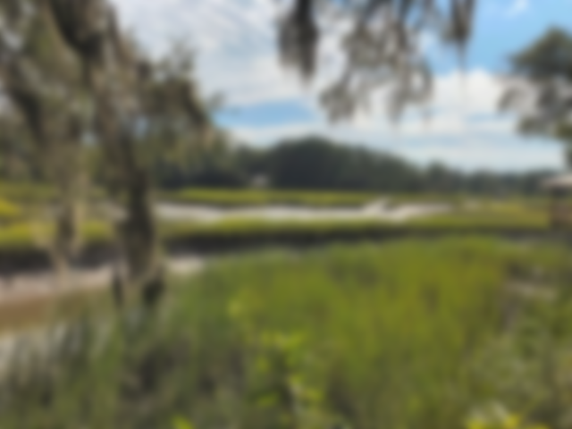
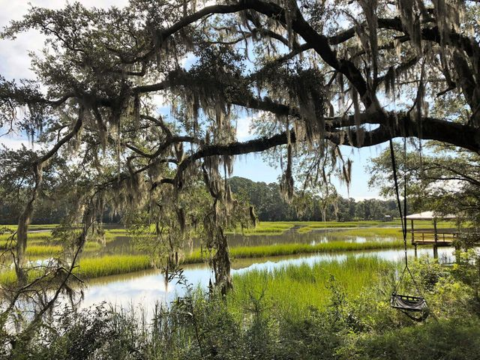
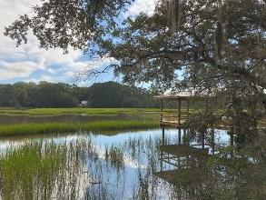
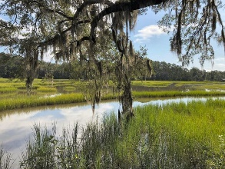
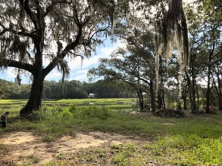
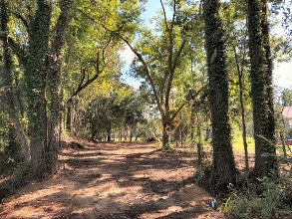
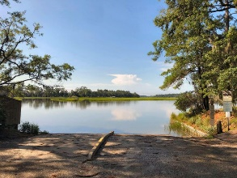


7273 Commodore Road Parish Point | Meggett, SC 29449 | MLS# 20022045 | $179,900
Tidal Creek Lot Ready to Build
SCHEDULE YOUR SHOWING TODAY!
Amazing .8 acre waterfront lot with approx 190ft overlooking Swinton Creek that's connects to the Lower Toogoodoo. Parishville Public Boat Landing right down the road within walking distance! Cleared and ready to build! Septic Permit in Hand! High Land! Lots of hardwoods and live oaks! Mid tide or better you can access the creek right from the bluff/bank! Underground power box on front right corner! Great area only 20 minutes to Edisto Beach and within 45 minutes to the Historic City of Charleston! Unrestricted Area! NO HOA!!! Owner bought a Farm out of state and has relocated. Liquidating SC property! THIS WILL NOT LAST!!
Rhett Brownlee
(843-209-7755
rhett@rhettbrownlee.com
www.RhettBrownlee.com
Edwards & Assoc
6251 Hwy 162 Ste C
Hollywood, SC 29449

