Slide 1

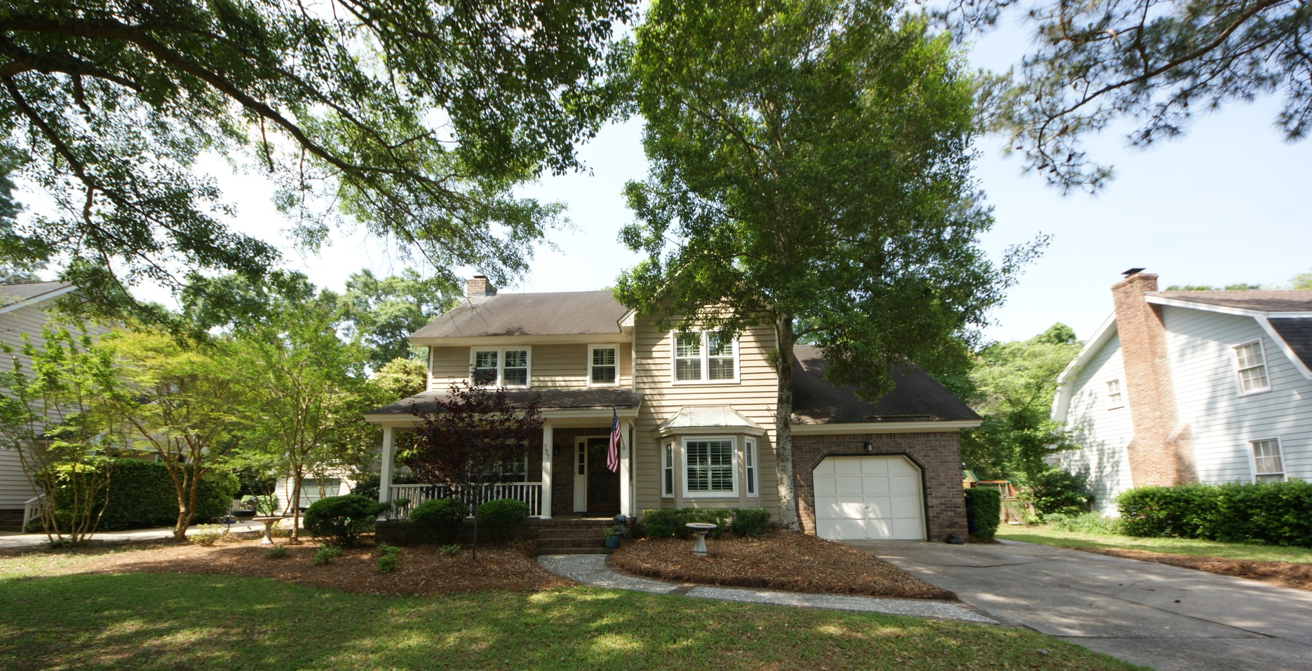
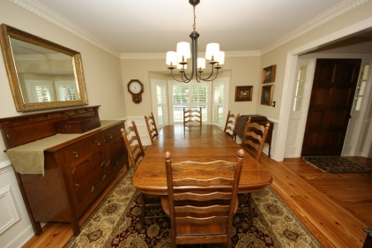
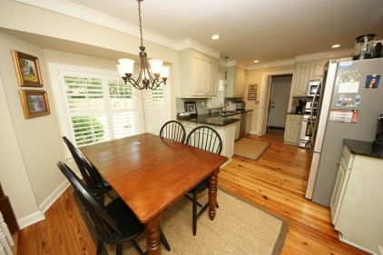
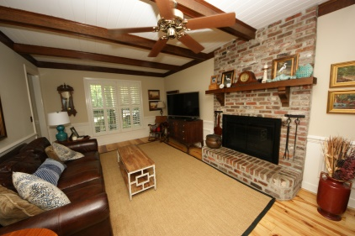
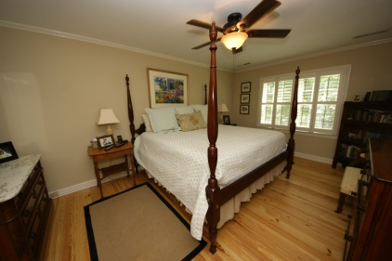
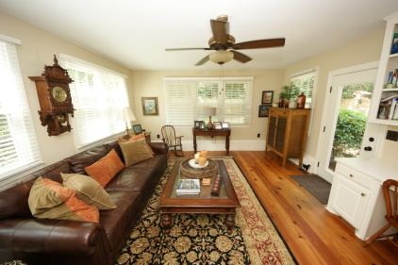
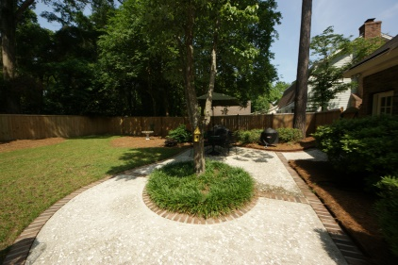


A RARE FIND IN POINT PLEASANT
A rare find to have a meticulously maintained home upgraded with all the right stuff! New, energy efficient windows, updated kitchen and appliances and a home warranty in place that is transferable. These homeowners have not let things slide as they have kept the home and yard in great shape. Many pictures and a tour accompany this listing so let the images speak for themselves. A 2,335 Square Foot Home that enters with a dining room on the right and a den to the left with a step down giving this home great separation where appropriate, but an open kitchen leading to a stepped down enclosed porch/room not included in our square footage. The backyard is newly fenced and squared off for the perfect backyard event or ready for you to consider installing a pool. Smooth Ceilings!
Address: 727 Bradburn Drive
Subdivision: Point Pleasant
City: Mount Pleasant, SC 29464
Listing #: 15012676
Listing Price : $515,000
Area: 42 - Mt Pleasant S of IOP Connector
Bedrooms: 4
Baths - Total: 2.5
Apx. SqFt: 2,335
Year Built: 1981
Acreage: 0.25
Tax Map #: 559-03-00-071

