Slide 1
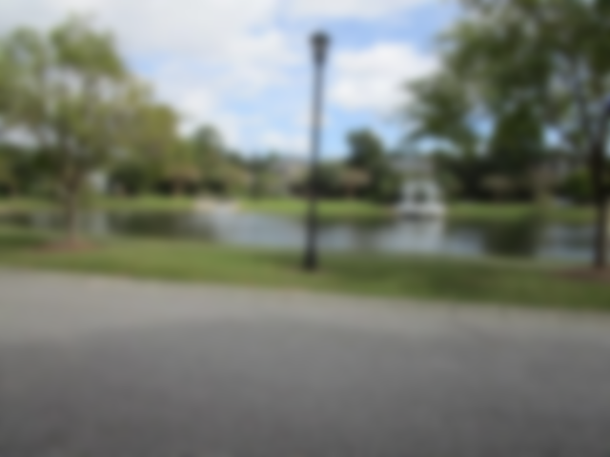
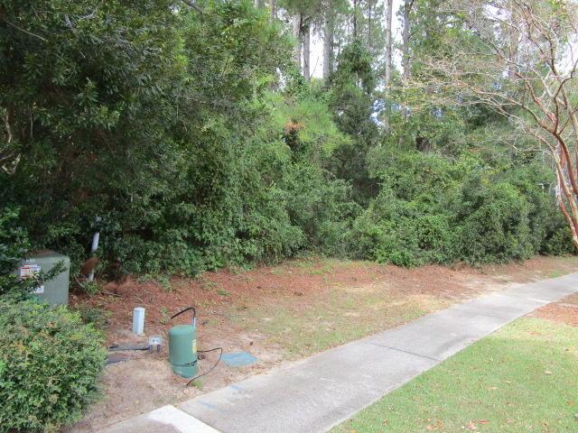
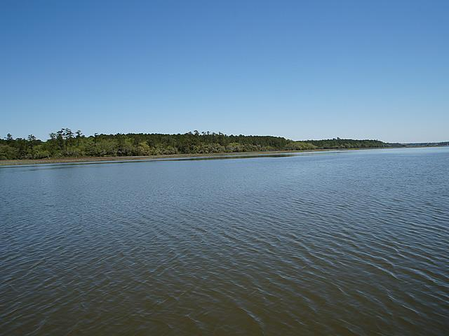
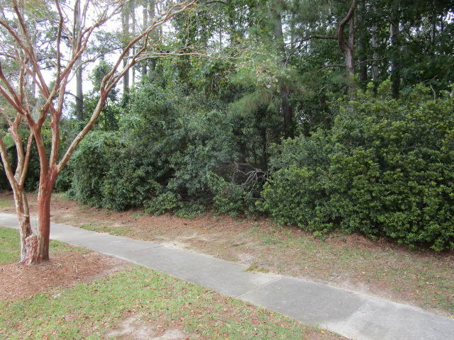
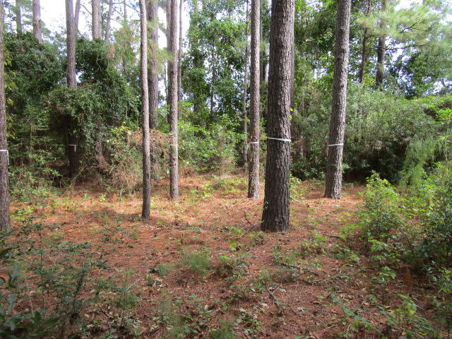
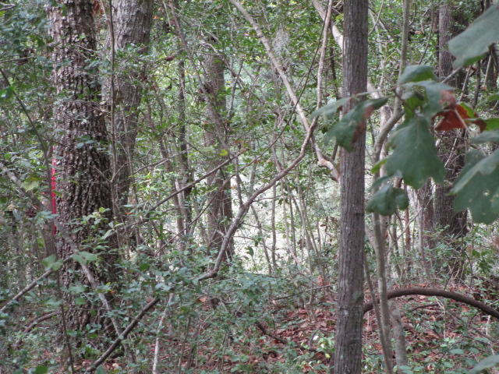
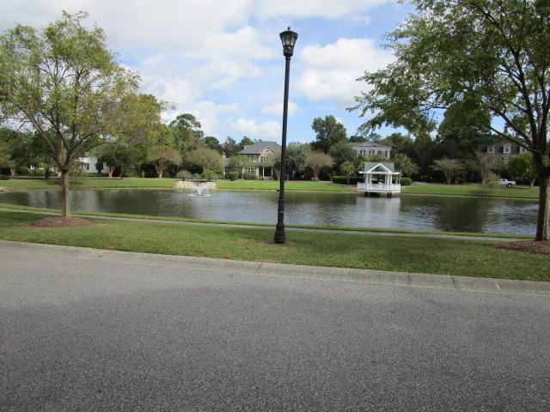
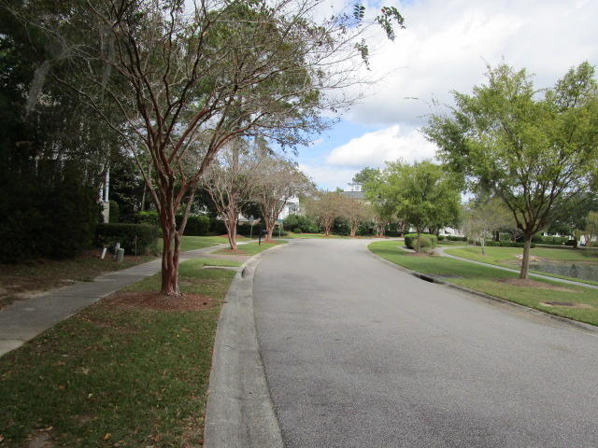
Olde Park Vacant Lot
727 Olde Central Way
Olde Park ~ Mount Pleasant, SC 29464
MLS# 18028512 ~ $750,000
One of the last few beautiful lots with marsh views in the rear & pond views from the front left in the prestigious Olde Park subdivision. Property Owners of Olde Park are welcome to become a member of the I'on Club for amenities (subject to fees).
Charles Salmonsen
M (843) 224-0300 | O (843) 388-6613 | charles@salmonsen.com
Salmonsen Realty | 864 Lowcountry Blvd Ste B | Mt Pleasant, SC 29464

