Slide 1

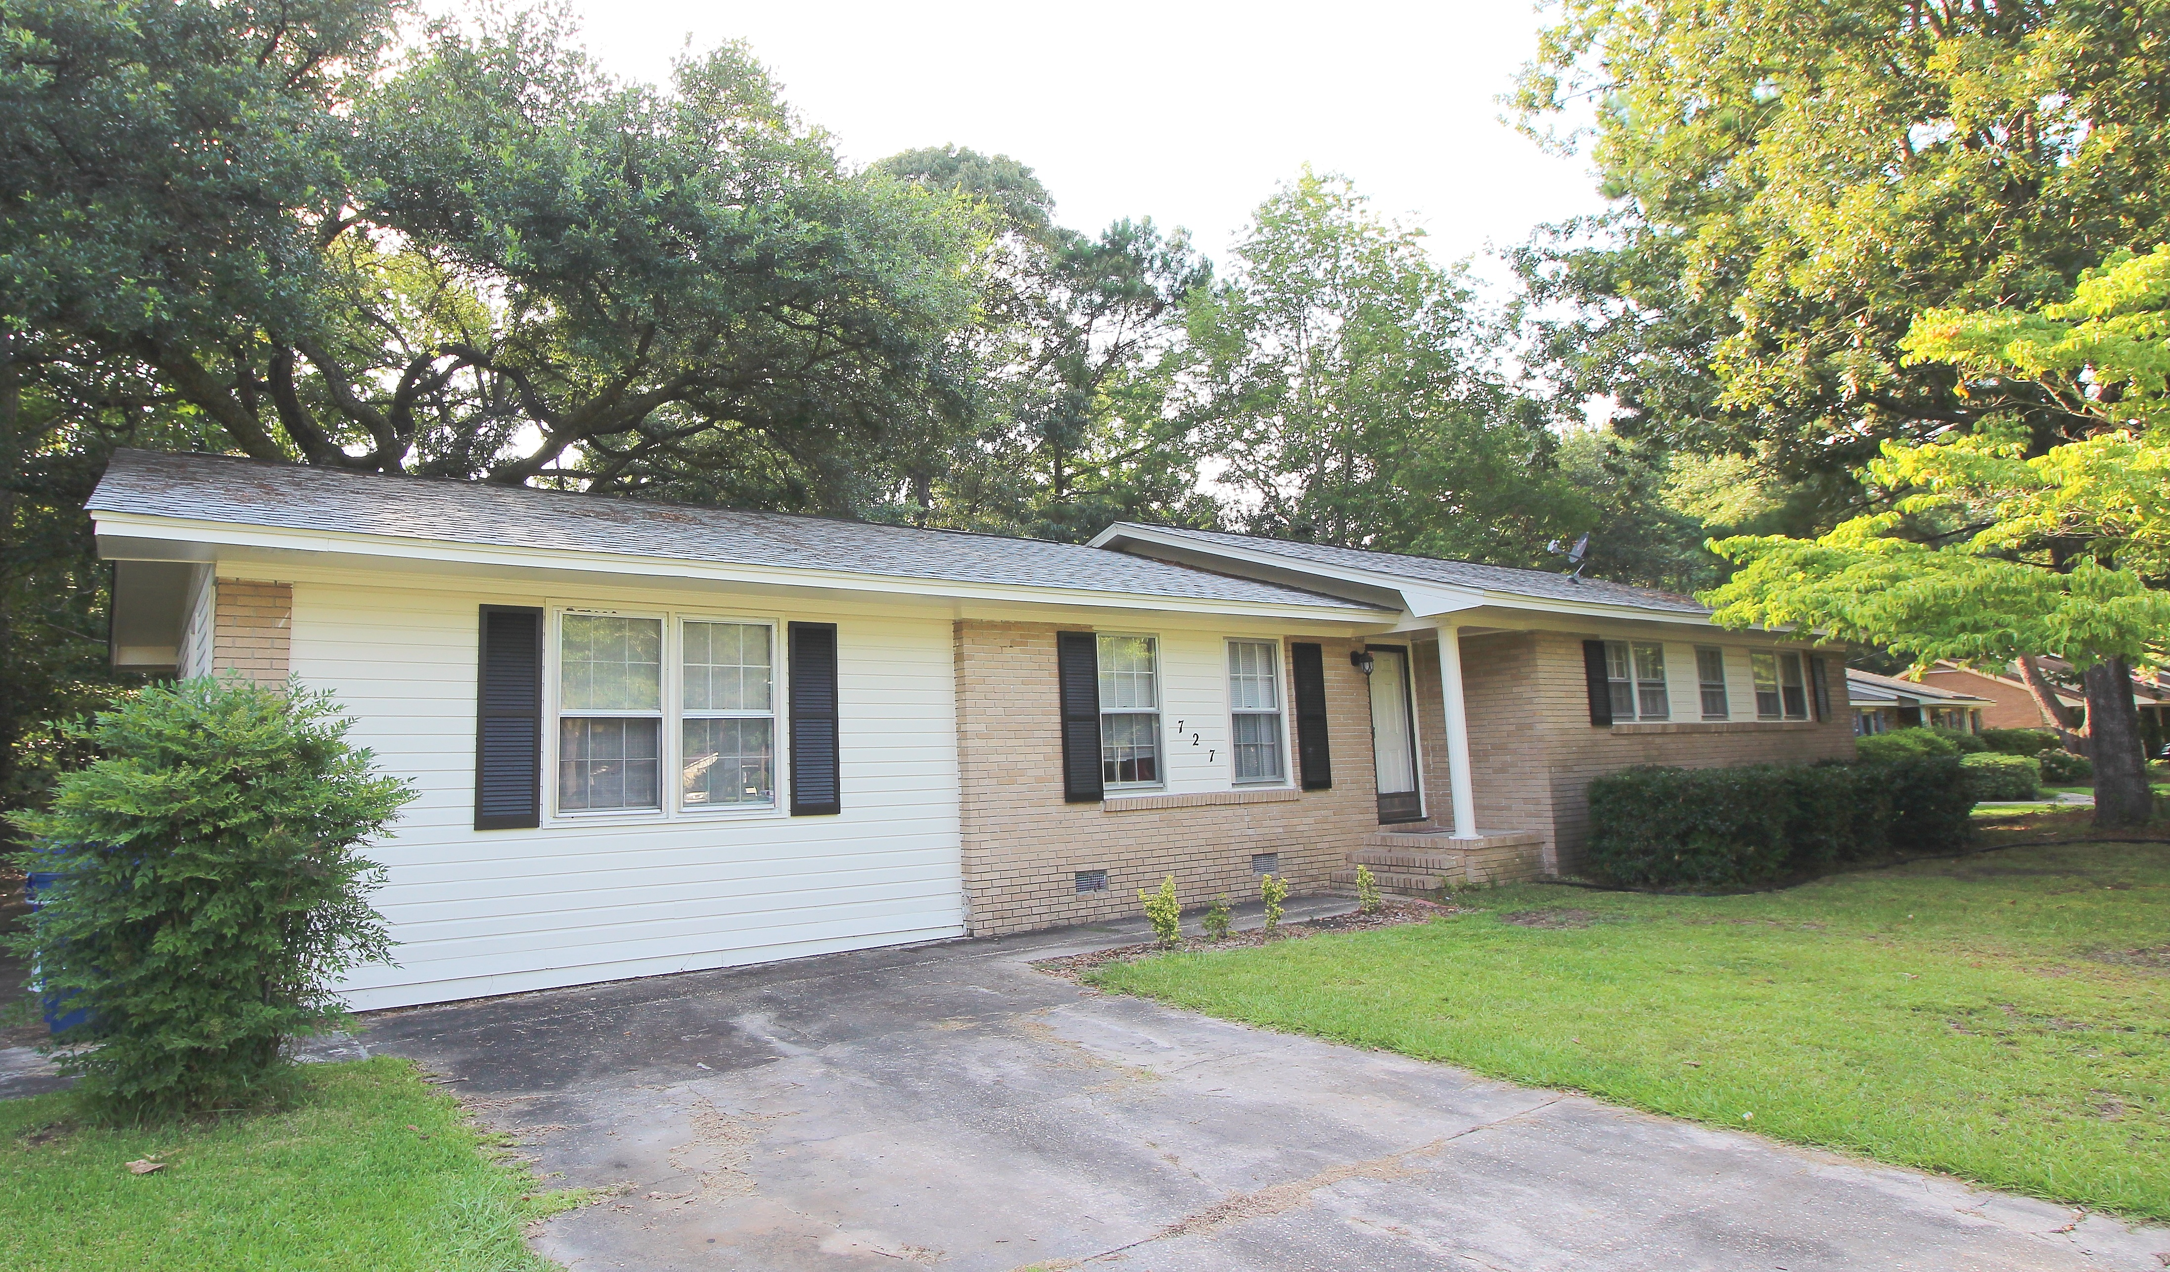
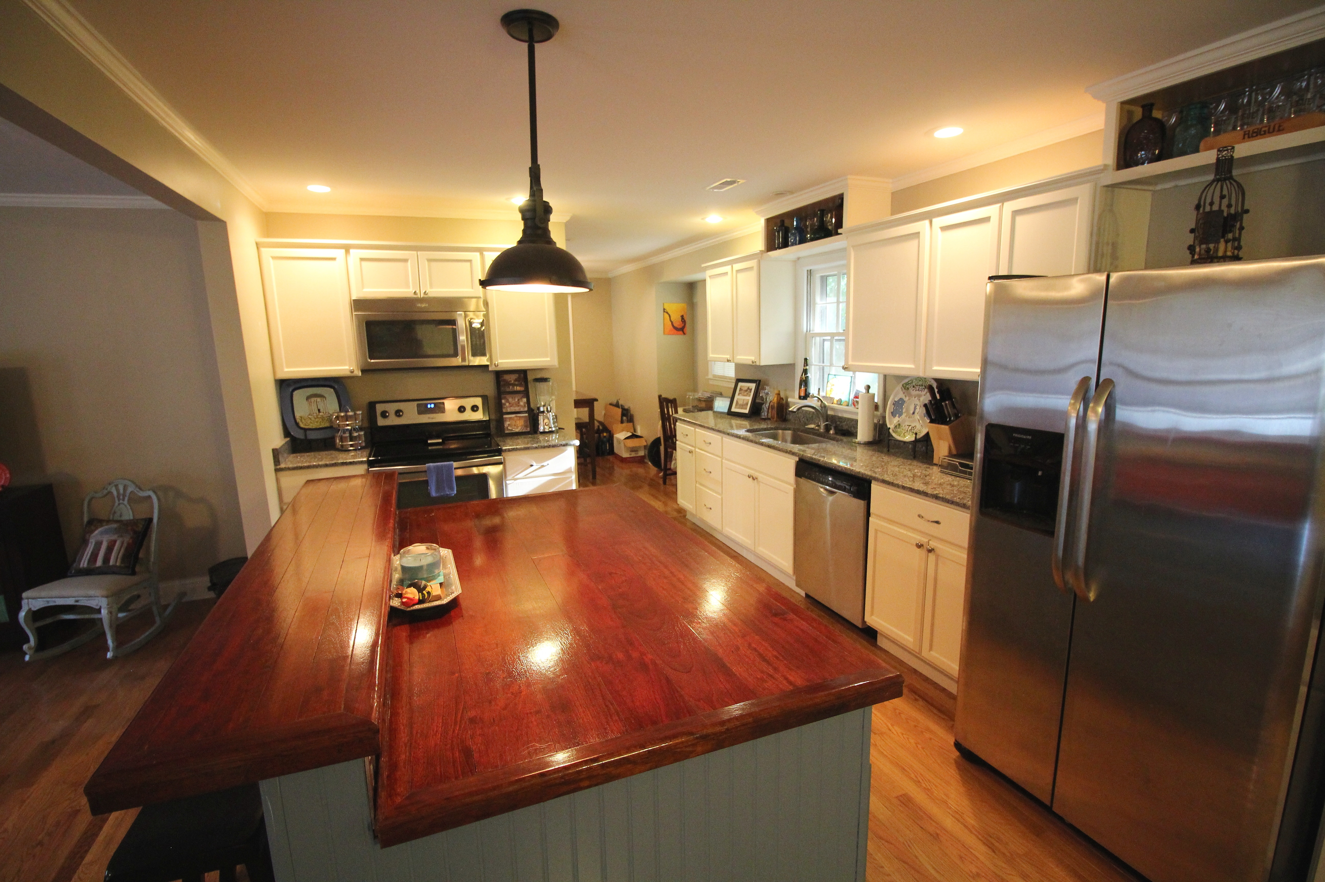
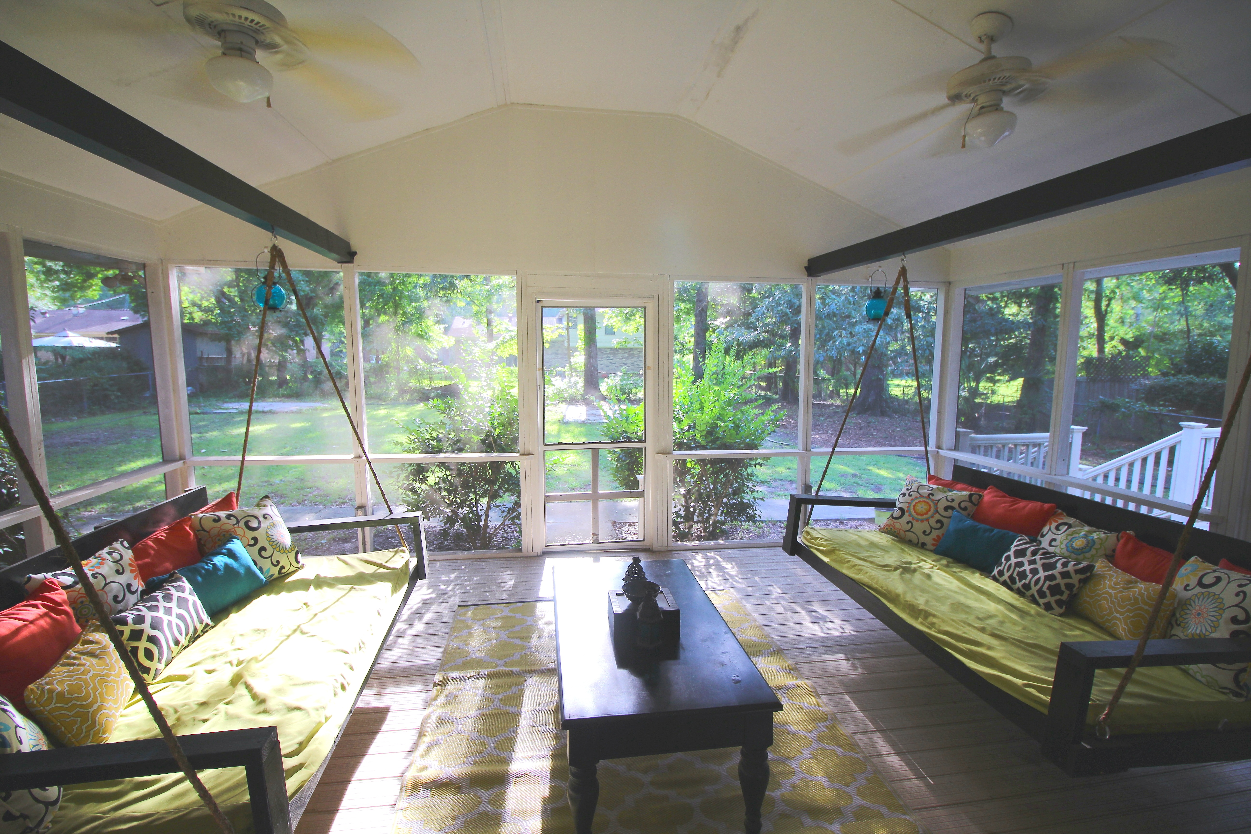
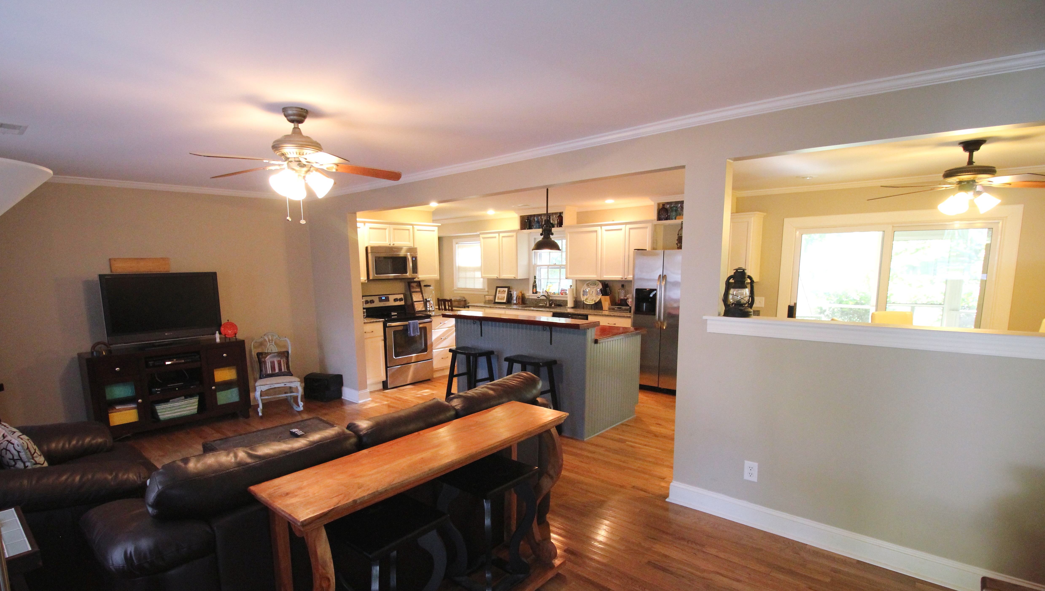
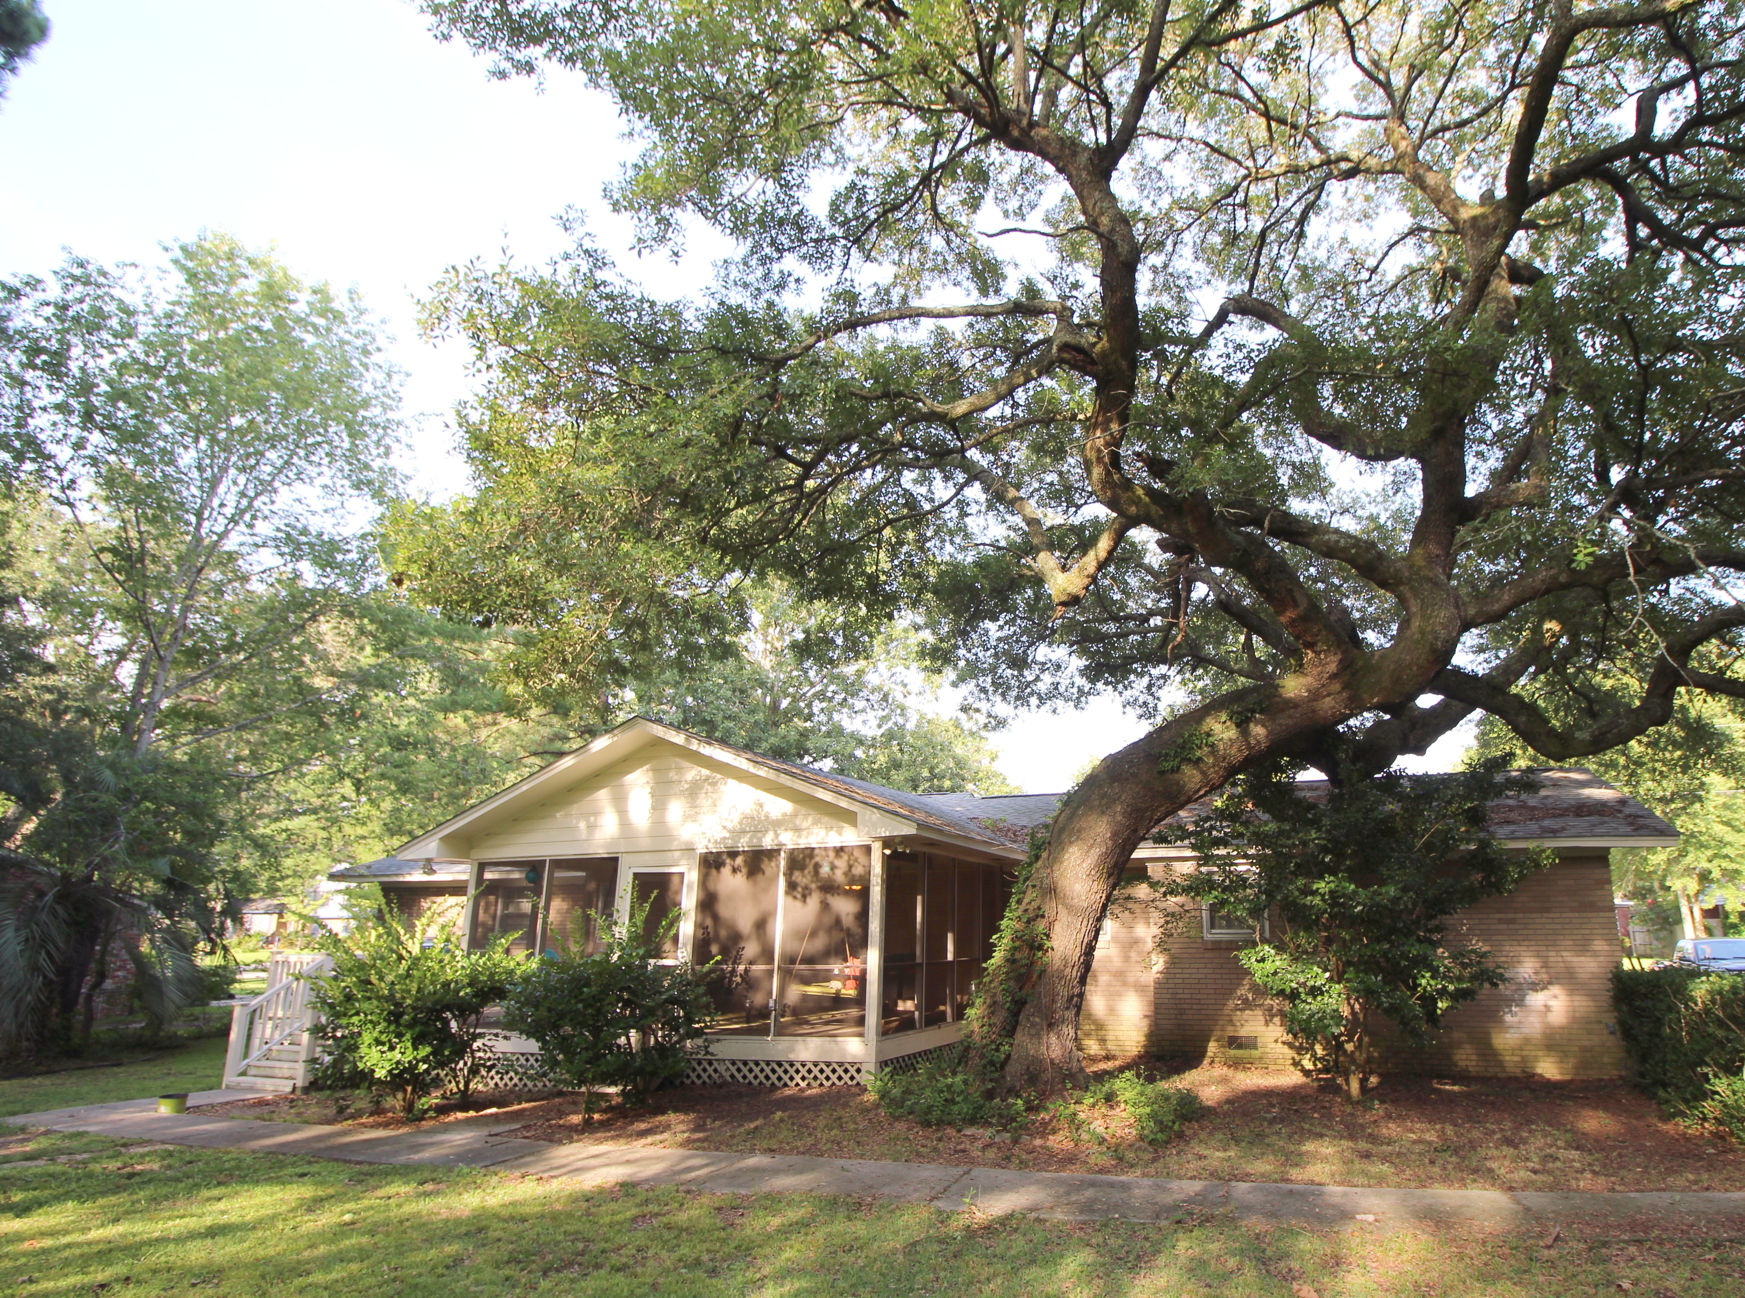


Beautifully renovated home in well-established Longbranch
Open House Saturday
11-3
727 Swan Avenue
Charleston, SC 29414 ~ MLS# 15019008 ~ $240,000
This move-in ready home has every upgrade imaginable from custom porch swing seating, stainless appliances, granite counter tops, crown molding, to the Brazilian Cherry kitchen island. 727 Swan has a true open floor plan that has to be seen to be appreciated. The 3 bed 2 bath layout provides versatile living with ensuite master bath, walk-in closets, Jack and Jill bath, and separate pantry & laundry rooms. The sunken bonus room is situated perfectly to be used as a game room, hobby area, or man cave. Enjoy low country living on this massive lot with mature oaks, new landscaping, screened-in porch, and deck. The property is private and completely fenced in, making it perfect for pets and family get-togethers. New roof and HVAC too!!
Peter Stanley
M 843-300-8251 | O 843-885-6199
petermstanleyjr@gmail.com
Colony & Craft LLC
76-A Spring St
Charleston, SC 29403

