Slide 1
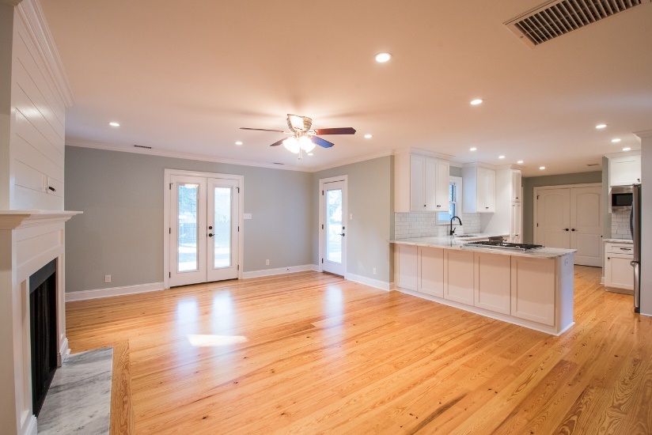
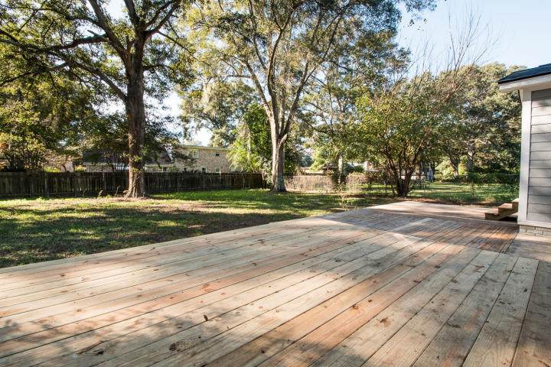
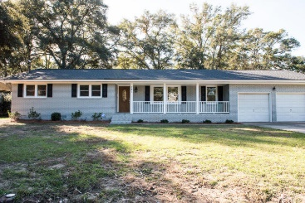
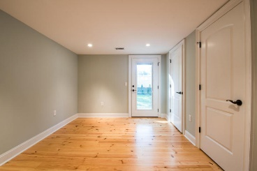
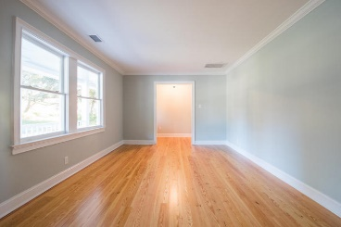
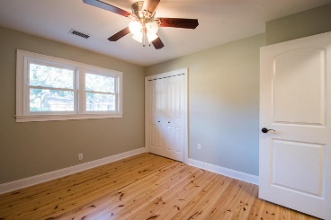
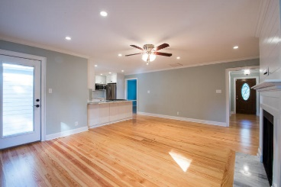
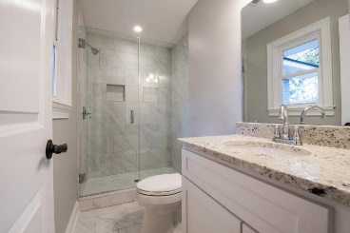
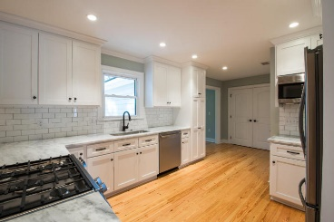
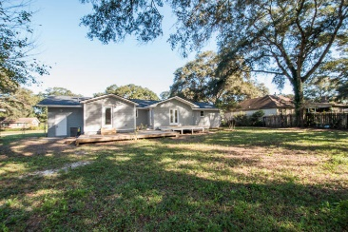

Total Renovation in Clearview on James Island
727 Tennent
Charleston ~ MLS# 15028992 ~ $399,900
Complete Renovation in Clearview Subdivision. Do Not miss this total transformation on a classic brick ranch in this highly desirable James Island location. New everything!!! Roof, HVAC, heart pine floors, smooth ceilings, gas fireplace, all doors, completely rewired, custom kitchen cabinetry, tile backsplash, granite countertops, stainless appliances, back deck, all bathrooms, crown molding, exterior paint, and garage doors. The pictures speak for themselves. This home has been painstakingly and meticulously gone through with no detail was left undone. The lot is over a third of an acre with a fenced in back yard and a huge multi-level back deck perfect for entertaining. Come check it out today!
Will E Freeman
Office - (843) 971-1312
Mobile - (843) 270-5454
wfreeman@thebeachcompany.com
BH&G RE The Beach Company, 1973 Riviera Drive, Suite 7, Mt Pleasant, SC 29464

