Slide 1
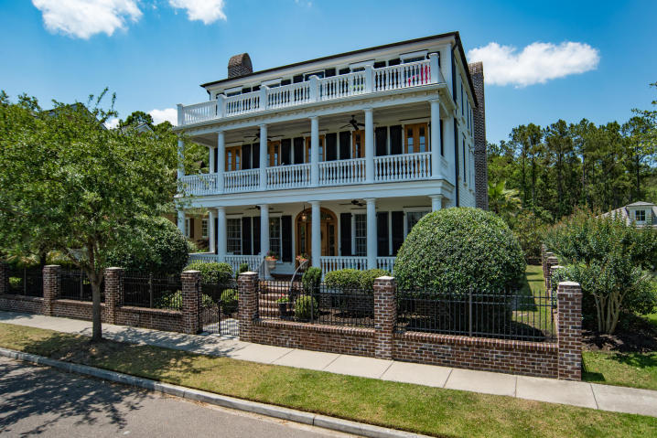

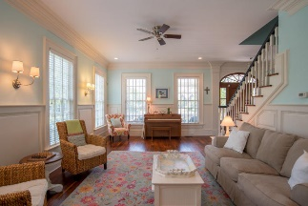
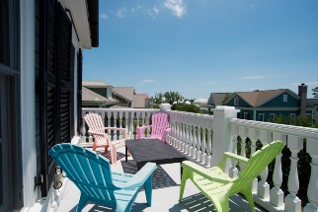
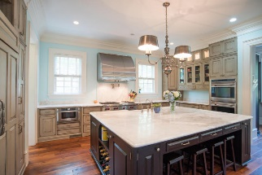
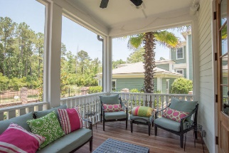
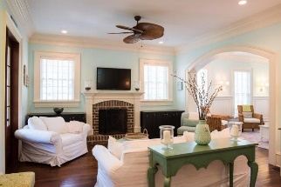
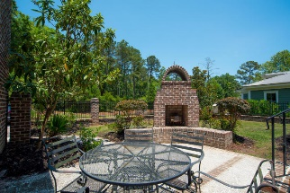


Custom Dream Home
728 Stucco Lane
Belle Hall ~ Mount Pleasant ~ MLS# 16014081 ~ $1,125,000
Stunning Southern style home with attention to detail throughout! Located in the highly desirable Hibben neighborhood of Belle Hall which is conveniently close to shopping, dining & schools. Custom features are abundant throughout this very spacious 5 bedroom, 4.5 bath home. Upon entering from the expansive front porch, you are welcomed by beautiful hand-scraped walnut floors and extensive, detailed trim. Incredible gourmet kitchen with Carrera marble counters, huge island with farm sink and bar seating, high end appliances that include Wolf gas cooktop and double ovens. Also on the first level is the family room with fireplace opening up to the living room. Off the kitchen is a butler's pantry that leads to the formal dining room. The mud room leads to the spacious screened porch along with the fantastic room over the garage that could be a great Mother-in-law or guest suite. The second floor master suite includes a huge walk-in shower, separate vanities with lots of storage, a clawfoot tub, marble counters and a large custom closet. There is a large covered porch off the master for quiet time with a book or cup of coffee. Also on the 2nd floor are two more bedrooms and the laundry room. The third floor boast a flexible floor plan with two more bedrooms, full bath, storage / study and a media / den area. The deck off the 3rd floor has wonderful views as well. You will also enjoy the outdoor areas of this home such as the patio with large brick fireplace and walking trails through the woods out back that lead to a community dock for some fishing & crabbing. This is a beautiful, well maintained home that shows great and is definitely a must see.
Bill Barnhill
843-364-6903
bill@billbarnhill.com
Virtual Tour Available at
https://www.youtube.com/watch?v=B-ZMWzHEJu0&feature=youtu.be
496 Bramson Ct., Suite 200
Mount Pleasant, SC 29464

