Slide 1

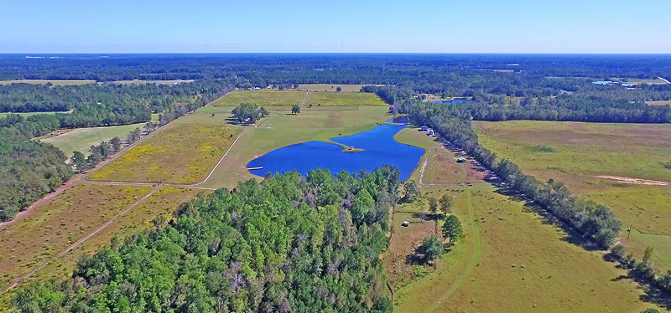
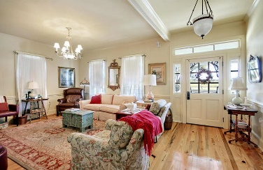
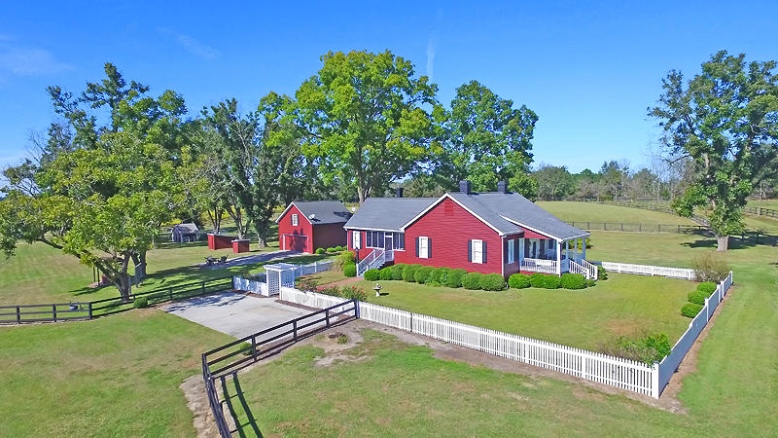
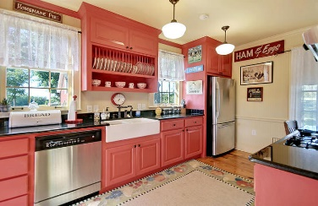
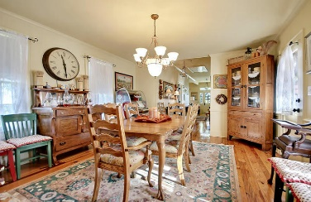
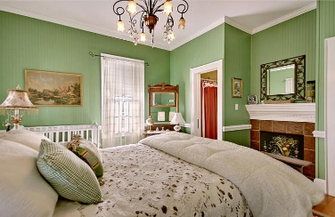
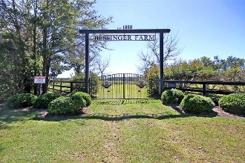
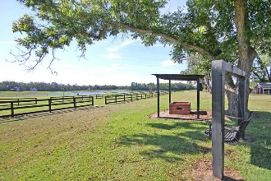
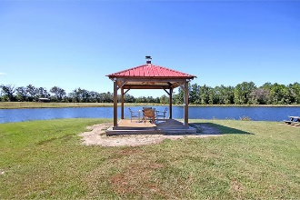
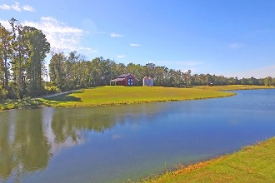
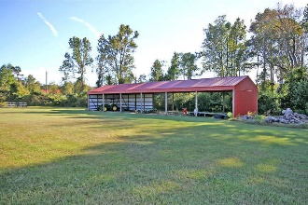
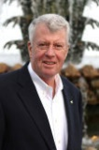
Absolutely Perfect 100 Acre Horse Farm
728 Zion Church Road Orangeburg, SC 29115
MLS# 17030210 ~ $1,000,000
A true southern gentleman's farm, this peaceful property spans across 101 acres and features a quaint farmhouse, well stocked fishing pond, a separate barn, machinery sheds, chicken house, wells, and miles of already installed horse fence. Built circa 1888, the farmhouse has only belonged to the Bessingers, a family well-known in South Carolina for its legendary BBQ. The late Melvin Bessinger renovated the home in 2000 and his son, David Bessinger, has maintained its charm. The land originally belonged to Mack and Lizzy Bessinger of Orangeburg. The resourceful couple built the farmhouse and raised all twelve of their children here. One of the sons, Big Joe, purchased the property and his son, Melvin, later transformed the farm into the tranquil retreat it is today.
Jim Heslep (843) 343-7188
jim.heslep@goldenbearrealty.com
Golden Bear Realty | 654 Coleman Blvd, Suite 100 | Mt Pleasant , SC 29464
Office (855) 352-9088 | Fax (561) 721-3311

