Slide 1
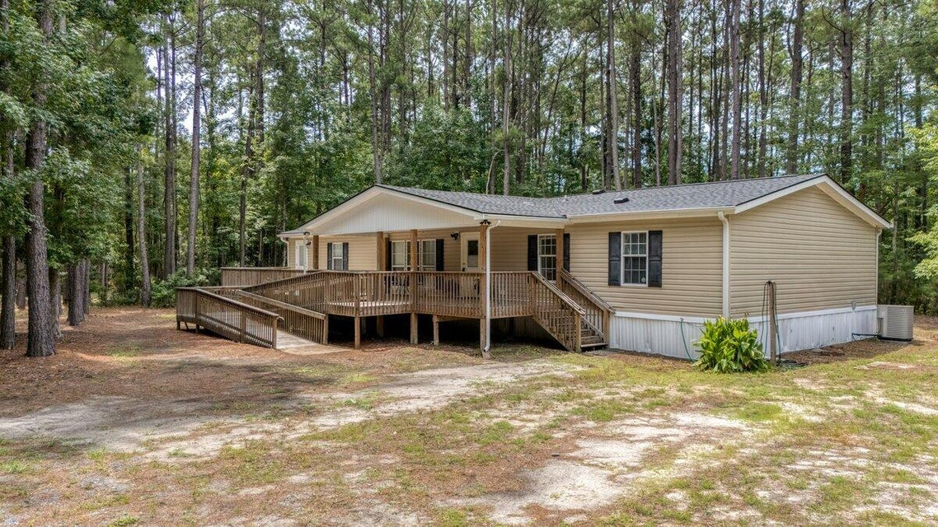
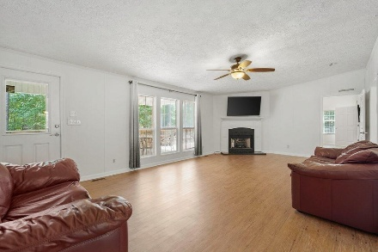
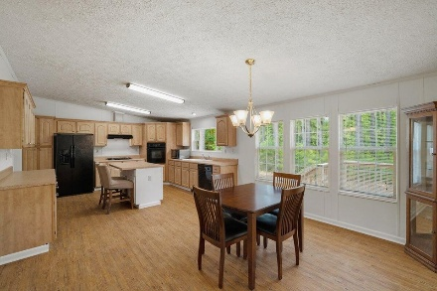
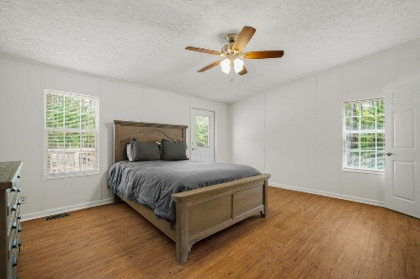
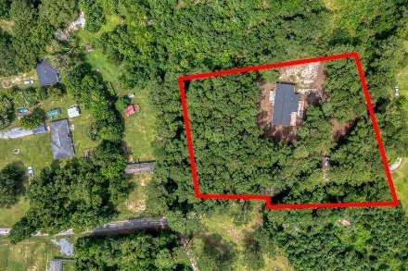

728 Huskie Lane
Saint Stephen, SC 29479 | MLS# 25021822 | $285,000
Darrell Creek Elevated Home With Elevator & Salt Pool
Just Listed: Beautiful Country Home
on almost 2 Acres in St Stephen
Co-hosting with
Lisa Wood from
Crown Home Mortgage
Offering $2500
Lender Credit
Welcome to 728 Huskie Lane — A Private Country Retreat on Nearly 2 acres! If it's peace and quiet you're after, this charming home at the end of a quiet country road might be just what you've been dreaming of. Tucked away on almost two serene acres, this property offers the perfect blend of privacy and nature. Sip sweet tea from the expansive front porch and take in the sounds of the birds and wildlife—your own private haven awaits. Inside, you'll find over 2,000 square feet of living space, freshly painted and fully modified for handicap accessibility. LVP flooring throughout, a new deck, ramp, widened doorways, and a beautifully updated handicap-accessible shower ensure comfort and ease of living for all. The heart of the home is the oversized family room, perfect for gatherings or cozy nights in front of the gas log fireplace. The kitchen is a bright, welcoming space for the home chef, featuring a large island, ample counter space, and an adjoining dining area ideal for entertaining.
On one side of the home is a spacious primary suite, complete with an enormous walk-in closet and a completely renovated bathroom boasting a luxurious spa-style shower. On the other wing, you'll find two additional well-sized bedrooms and a full guest bath, offering plenty of space and privacy for family or visitors. Set in an optimal location for outdoor lovers, this home is a dream for wildlife enthusiasts. With deer and birds frequently passing through, your property is like a front-row seat to nature. And for boating or fishing fans, you're just 10 minutes from both Lake Moultrie and the Santee River - ideal for weekend adventures on the water.
In addition to its peaceful setting, you're still conveniently located under 45 minutes from the Volvo plant and the vibrant town of Summerville, SC, giving you easy access to work, dining, and shopping when you want it.
This serene country home is truly one of a kind. Don't miss your chance to experience the privacy, beauty, and comfort of 728 Huskie Lane. Schedule your showing today - and call this slice of paradise your Home Sweet Home!
House Tour
Elissa Campbell
843-853-1433 | elissa.campbell@agentownedrealty.com
AgentOwned Realty Preferred Group | 824 Johnnie Dodds Blvd | Mt Pleasant, SC 29464

