Slide 1
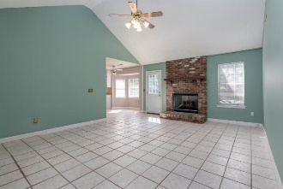
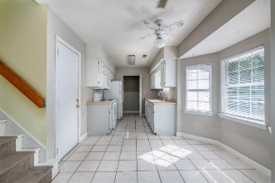
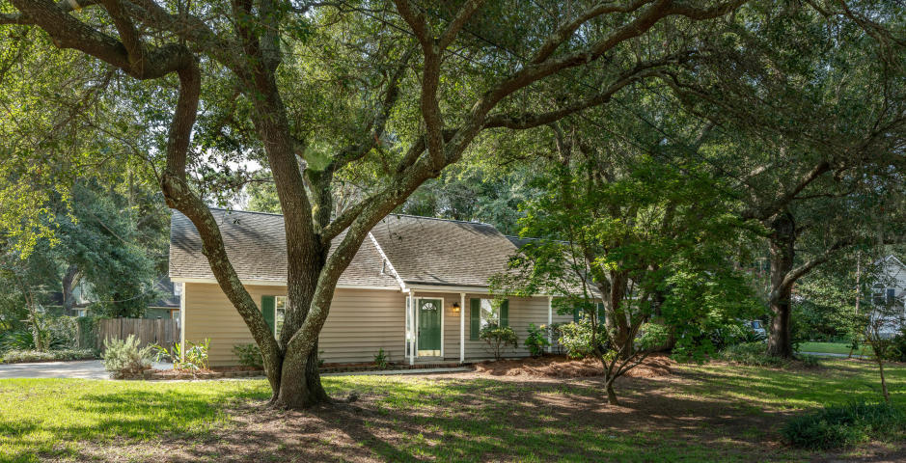
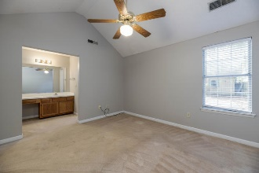
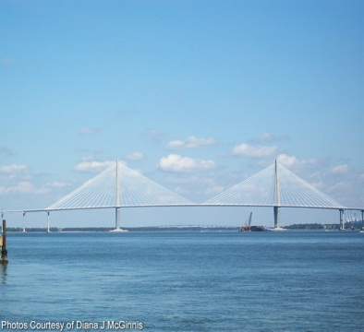
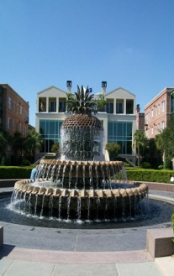
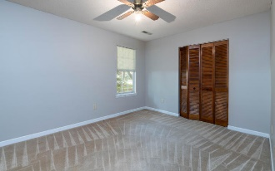
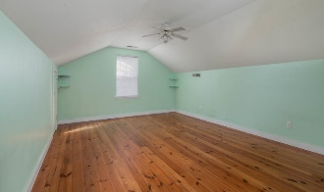
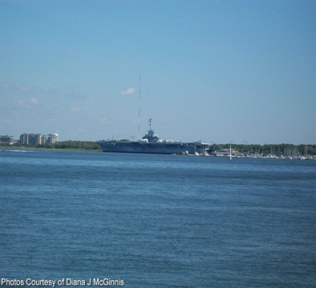
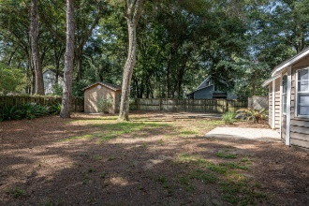


OPEN HOUSE
Saturday Sept 28th 11:00 - 2:00
$450,000
729 Gilmore Court
Dellwood · Charleston, SC 29412 · MLS# 19023545 · $324,900
This beautiful 3 bedroom, 2 bathroom home is perfectly situated on James Island. You are within walking distance to schools and playgrounds and just a minute drive from shopping, the beach or downtown Charleston! This lot is perfect, nestled between gorgeous oaks and the privacy fence makes it perfect for grilling with family and friends on the deck multiple decks and an outdoor shower too. You will be amazed at all the space this property has to offer. The handy man will appreciate the large workshop to store all of the landscaping tools and a 2 car garage! The bonus room over garage is just the added space you want for office or 4th bedroom and has gorgeous heart pine floors and plenty of attic space as well. The kitchen receives lots of natural light and views into your back yard. The living area has vaulted ceilings and a gas fireplace. Down the hallway are two rooms that share a bath and the master bedroom with walk-in closet. This home has been a rental for several years and is in need of some cosmetic updating. Home is priced accordingly.
$450,000
Rodney Hancock
(843) 437-1347
rodneyhancock08@gmail.com mortgageprofessionalsonline.com
AgentOwned Charleston Group
902 Savannah Hwy
Charleston, SC 29407
Real Estate ● Mortgage Insurance ● Business Brokerage

