Slide 1
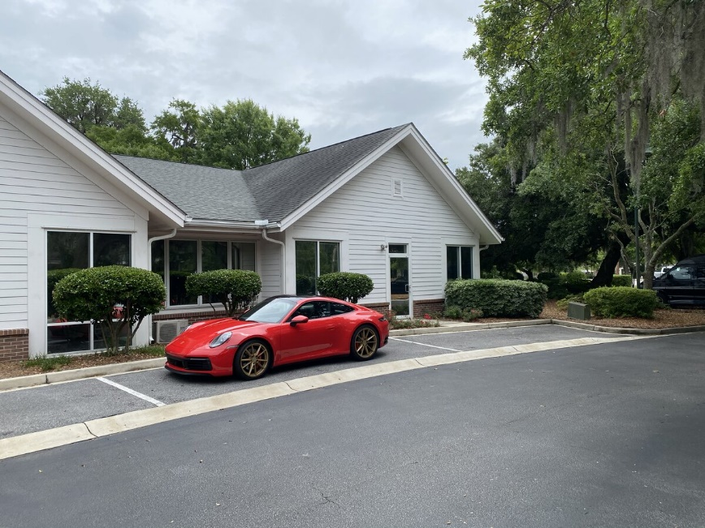
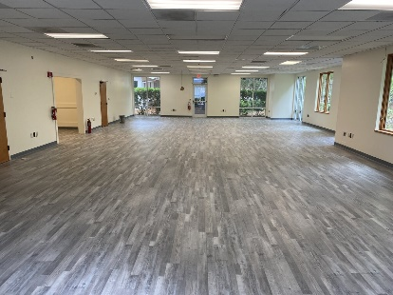
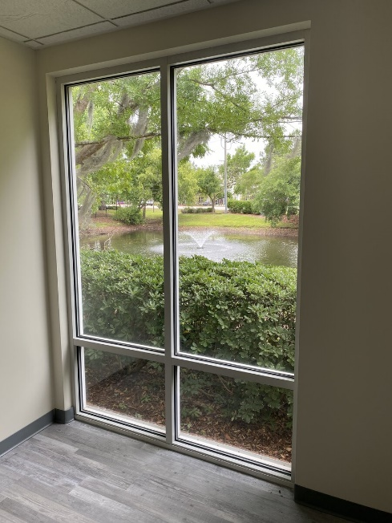
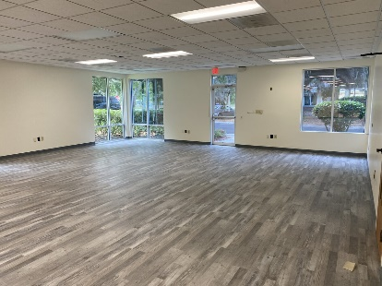


2,000+SF Office Space Available Now!
729 Long Point #601
Mount Pleasant, SC 29464
Beautiful bright open space ready for your office needs. Fronting thriving Long Point Road with beautiful views of ponds and century old live oaks. Come plant your business roots here!
MLS ID: | 30736586 | County: | Charleston
Property Subtypes: | Business Park, Office Building | Submarket/Township: | 42 - Mt.Pleasant South of IOP Connector
Contiguous Space: | 2,100 SF | Tax ID/APN: | 5560000475
Lease Rate: | $27 PSF (Annual) | Zoning: | GB - General Business
Base Monthly Rent: | $4,725 | Highway Access: | I-526 Highway 17
Lease Types: | NNN | Year Built: | 2003
Ceiling: | 10 ft. | Parking Description: | Shared
Building Name: | Long Point Office Park | Internet Access: | Cable, T1/T3, Fiber Optic
Nearest MSA: | Charleston-North Charleston | Interior Description: | Open And Ready To Divide To Suit
David H Seay
CCIM, BIC, CCIM, REALTOR®
843-364-6720
david@seaydevelopment.com
The Brokerage, LLC
3404-202A Salterbeck Street
Mt. Pleasant, SC 29466
thebrokerageyouwinhere.com
John Teffeau
REALTOR®/Co-Owner
843-813-1228
l.johnteffeau@gmail.com

