Slide 1
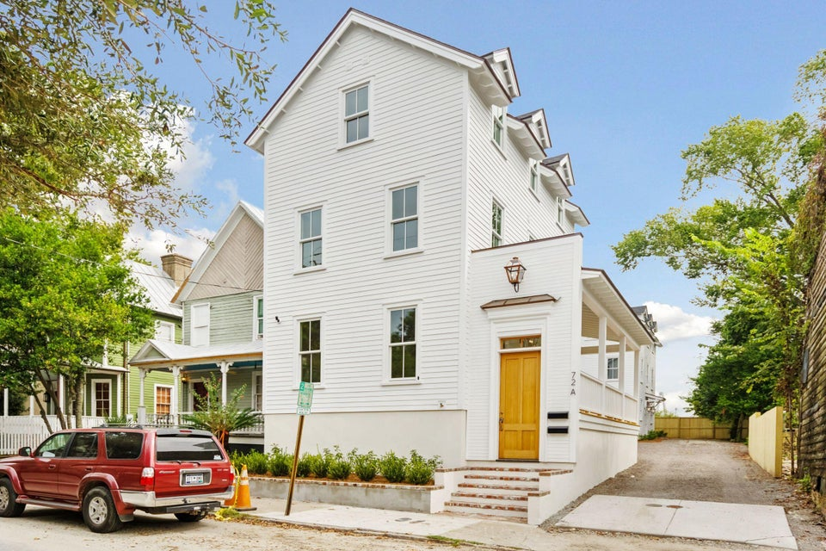
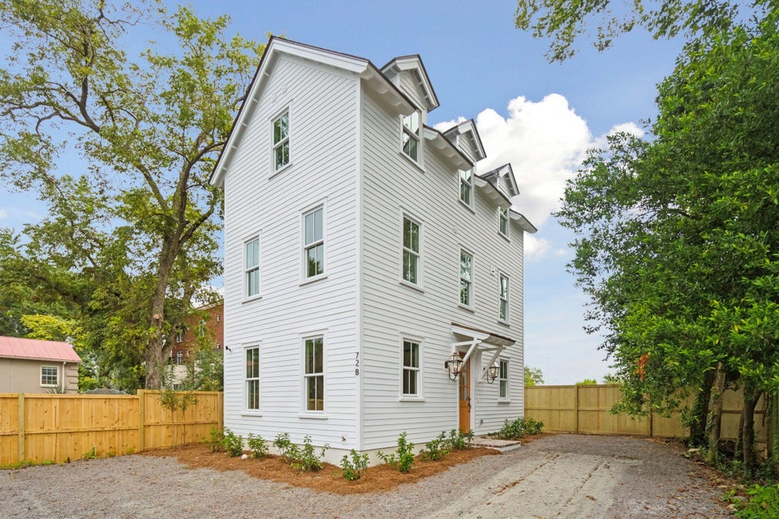
Price Drop & Rate Drop to the 5's!!
72 Drake Street A
Eastside
Charleston, SC 29403
MLS# 24018992
$929,500
VIEW MLS LISTING
View List & Lock Options
72 Drake Street B
Eastside
Charleston, SC 29403
MLS# 24024014
$899,500
VIEW MLS LISTING
View List & Lock Options
Mortgage rate in the 5’s!
3% Commission offered with ratified contract by 1/31
Call for more details!
Nathan Delpino
843-200-2721
nathan.delpino@gmail.com
www.makingcharlestonhome.com
Harbourtowne Real Estate
672 Marina Drive, Ste 110
Daniel Island, SC 29492

