Slide 1
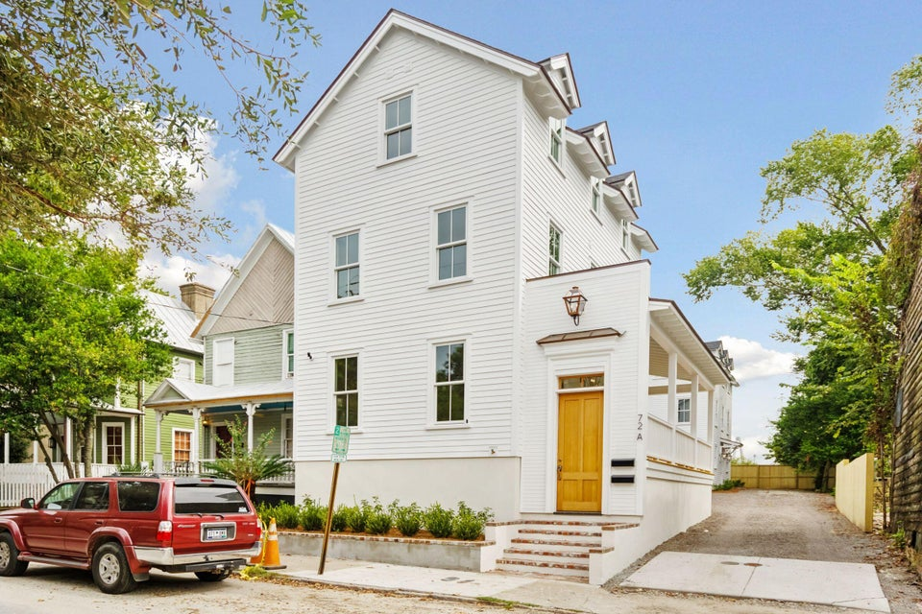
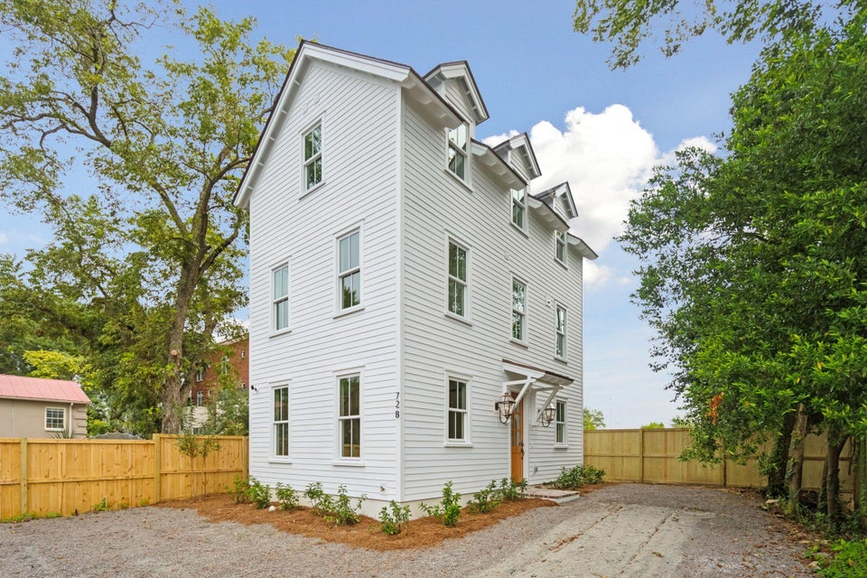
Price Drop & Rate Drop to the 5's!!
72 Drake Street A
Eastside | Charleston, SC 29403
MLS# 24018992 | $989,000
View Listing
72 Drake Street B
Eastside | Charleston, SC 29403
MLS# 24024014 | $949,000
View Listing
Mortgage rate in the 5’s!
3% Commission offered with ratified contract by 12/31
Call for more details!
Nathan Delpino
843-200-2721
nathan.delpino@gmail.com
www.makingcharlestonhome.com
Harbourtowne Real Estate
672 Marina Drive, Ste 110
Daniel Island, SC 29492

