Slide 1
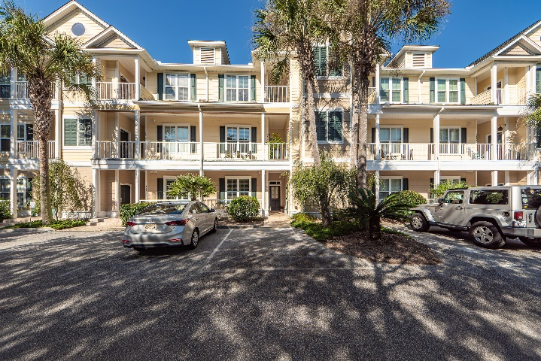
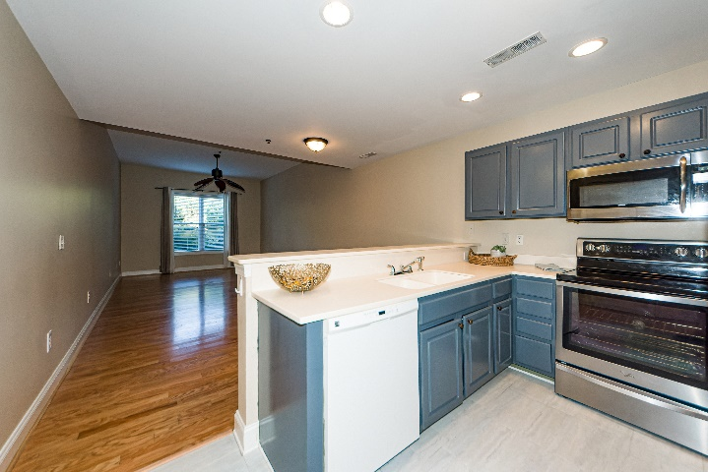
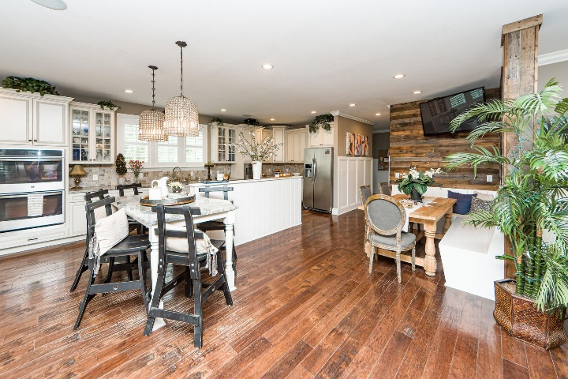
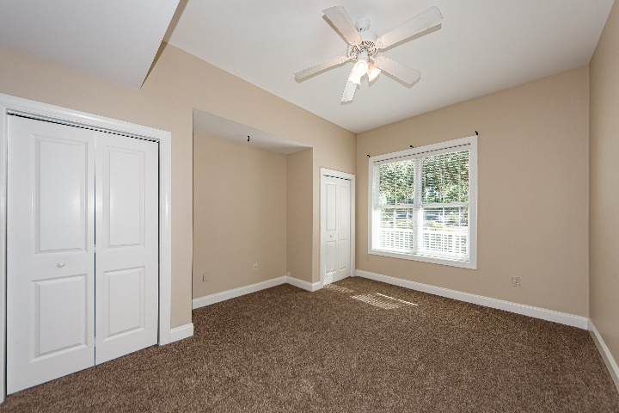
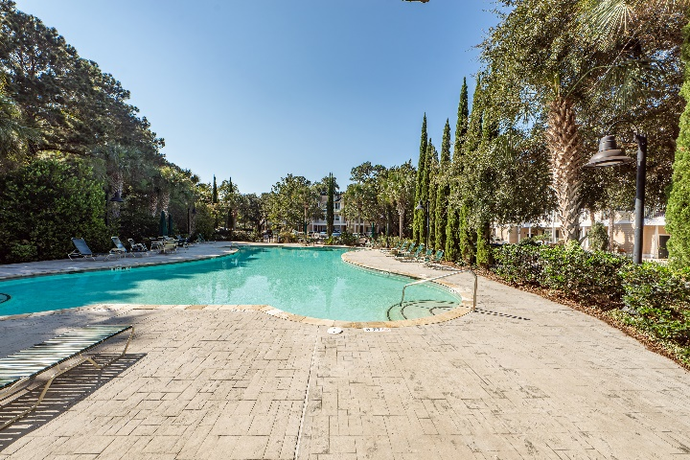


RECENT PRICE DROP MOTIVATED SELLER ~ FABULOUS LOCATION!!!
7313 Indigo Palms Way
Indigo Hall at Hope Plantation
Johns Island, SC 29455
MLS# 22024769
$349,900
Prime LOCATION! Don't miss out on your opportunity to own this tastefully updated LOWER LEVEL unit situated in the sought after Indigo Hall! A perfect full time home, rental, 2nd home or vacation destination for your family. With 2 Bedrooms and 2 full baths it is a simple and convenient retreat to enjoy everything this desirable area has to offer.
This spacious property just had new carpet installed and features a bright and airy feel, and all solid surface countertops! Just a short 5 minute drive to Kiawah Island, Freshfield Village, Kayaking, Beachwalker County Park, Seabrook Island, and Bohicket Marina! The Indigo Hall neighborhood pool is conveniently located just steps away for your relaxing enjoyment!
Make an offer today to call this home yours!
Virtual Tour: https://www.charlestonvirtualhomes.com/2220382/
Chrissy Strickland 843-906-5553
chrissyresiderealestate@gmail.com www.residerealestatellc.com
Reside Real Estate LLC
155 Wingo Way Unit 421 Mt. Pleasant, SC 29464

