Slide 1

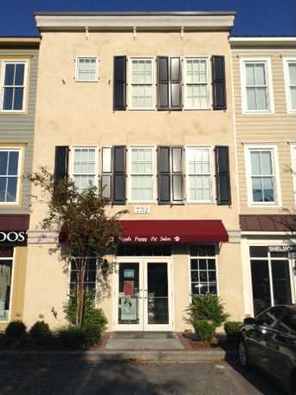
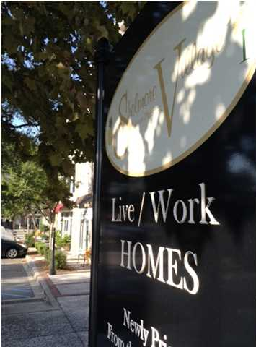
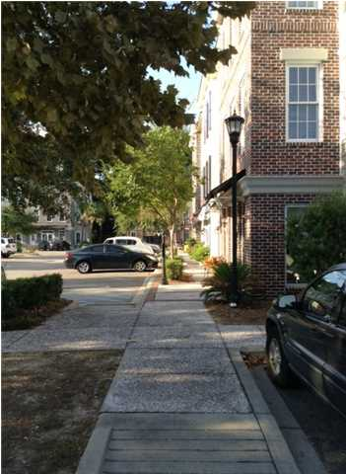
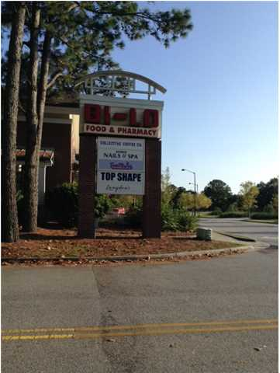
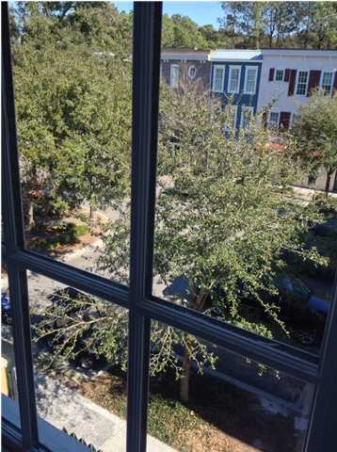
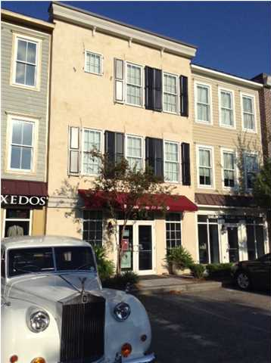
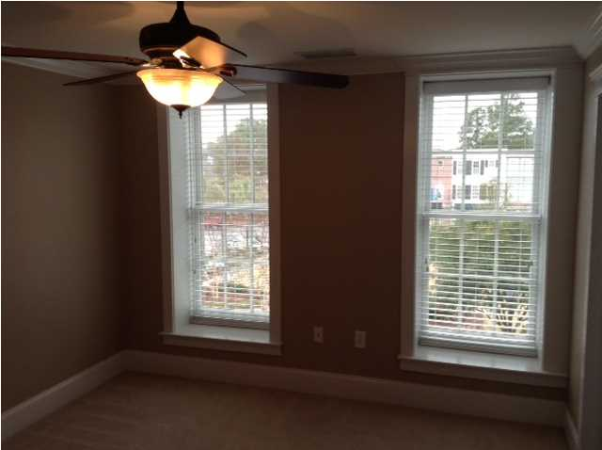
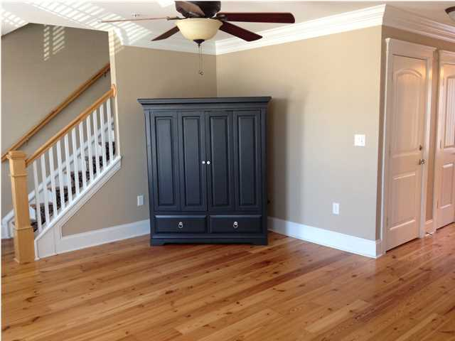
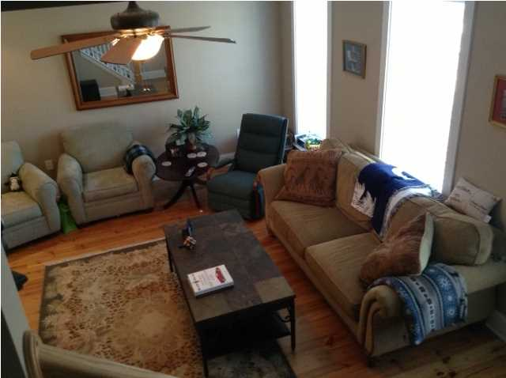
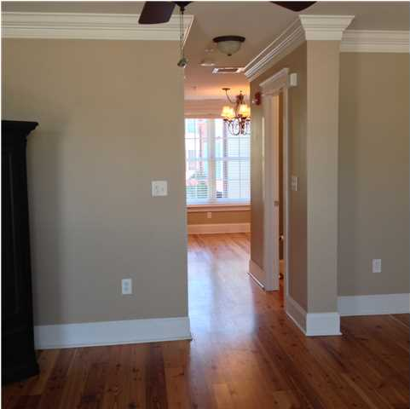
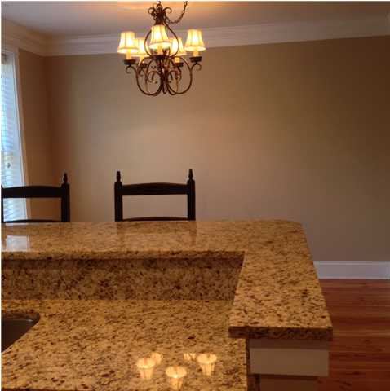
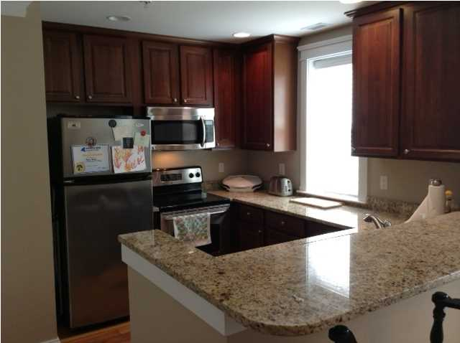
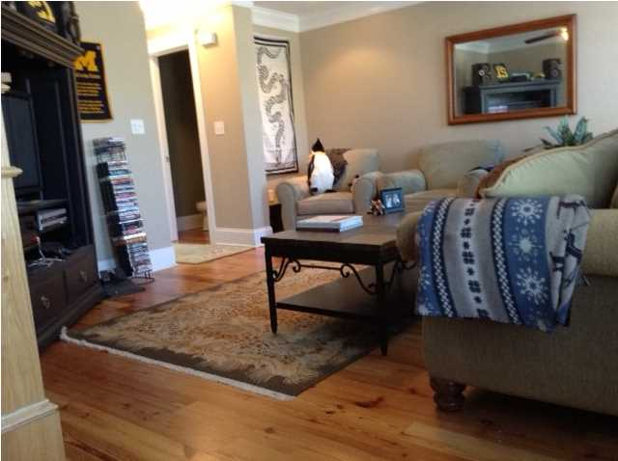
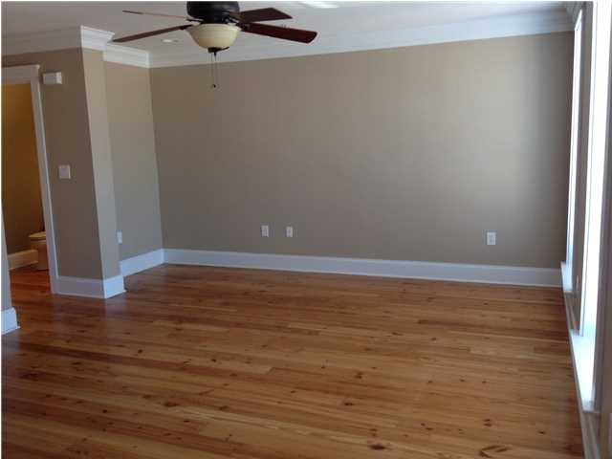

FULLY OCCUPIED
INVESTMENT PROPERTY
If you missed the boat to purchase recently, here is your second chance. Mount Pleasant's newest work-live development with presence, personality and location. These units were recently sold quickly before they even made it into the MLS and now one is available for sale with or without a Commercial Tenant in Place (Yuppie Puppy). Comprised of both residential and commercial, this 2 bedroom unit has hardwood floors and a nice kitchen with granite countertops. GE appliances, a deep kitchen sink and a kitchenette seating area. At the time of construction, this unit received ALL available upgrades. A large family room or entertaining area leads you to the second floor where two bedrooms await. (Owner converted to two bedrooms, but could be converted back to three). The master bathroom has two sinks and a walk in closet. The second bedroom has a very large walk in closet perfect for anyone with a large wardrobe that could also double as a seating or makeup area. On the first floor you will find the Yuppy Puppy. The tenant is willing to sign a lease or they will vacate if you would like. All parking is shared and many wonderful tenants will be your neighbors. A grocery store, liquor store, Chinese restaurant and Triple AAA Four Diamond Award Winning Langdon's Restaurant and Wine Bar are yards away. The famous O'Quinn's school is across the street so drop the kids or grandkids off and go to work. I'On is right across the street along with O'Brion's Pub among others. Jog or bike on Mathis Ferry or to the Waterfront Park. You can be Downtown Charleston in minutes. Call today for an appointment to see this property. This building is a fully occupied investment property. If you would like to live in the residential portion of the property, the current residential lease expires on June 30, 2015. The commercial tenant will lease the ground floor for up to three years.
Address: 732 S SHELMORE BLVD 102
Area: CHS-Mt. Pleasant South of IOP Connector
City: MOUNT PLEASANT
County: Charleston
Subdivision: SHELMORE VILLAGE
Bed/Bath: 2/3
Square Feet: 2,175
Listing ID: 1325695
Listing Price: $459,900

