Slide 1
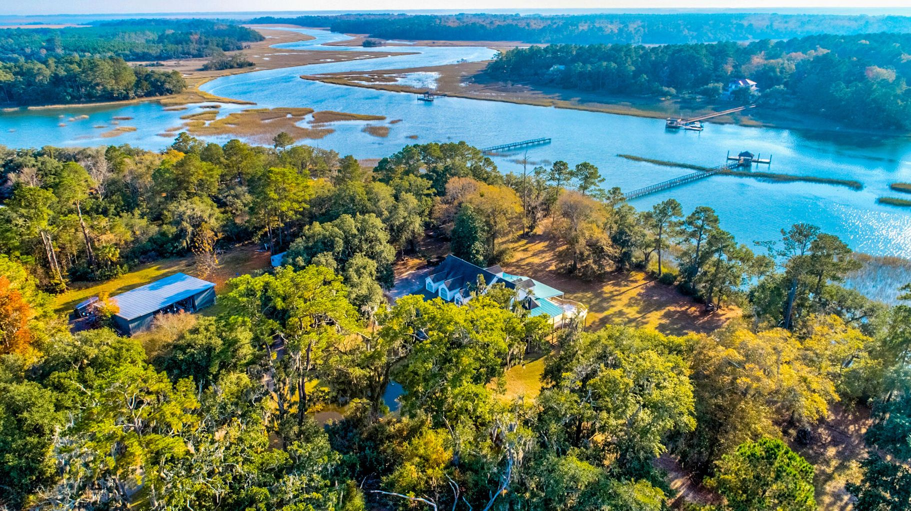
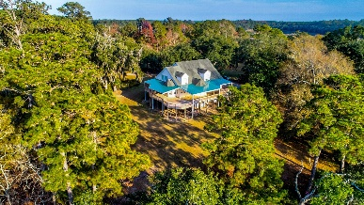
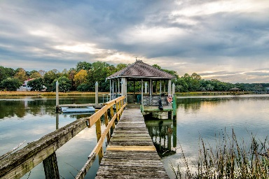
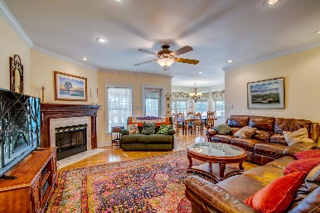
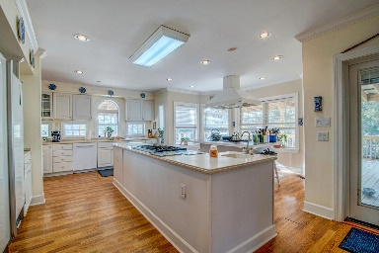
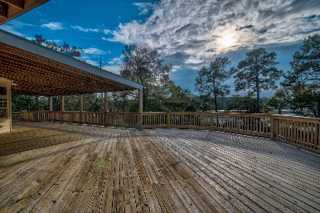
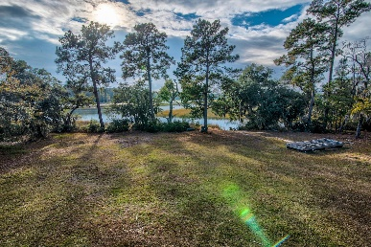


7437 Little Britton Road Yonges Island, SC 29449 MLS# 21032477 | $1,400,000
Deepwater Estate
Extraordinary Low Country estate that sits on 3 acres w/ true deep water on Tom Point/McCloud Creek. This property has a short 345ft dock w/ a 50ft floater coupled w/ a huge covered pier head perfect for boating, shrimping, crabbing, & fishing. 7437 Little Britton Rd offers beautiful views of Tom Point/McCloud creek which is only minutes to the INTRACOASTAL WATERWAY. The three story home which is 4,800 sqft offers a master bedroom suite with 2 walk-in closets and sitting/office room on the main level and 3 bedrooms with sitting rooms & 3 full ensuite baths upstairs, an elevator that goes to all 3 floors, smooth ceilings, double ovens, 2 gas cooktops, eating in kitchen, walk in pantry, gas fireplace in the family room, dining room, library and sitting room. Huge deck that runs along the whole back and right side of the home with metal roof, 3 geothermal HVAC units, laundry room, corian countertops, reverse osmosis water system, whole house generator, brand new tankless water heater, 2 in-ground propane tanks 100 gal. for the house & 500 gal. for the generator. Under house is enclosed garage area with two storage rooms. Also included onsite is a 2400 sq. ft. Pole barn and a shallow and deep well.
Drake Herrin 843-729-4692
dherrin@carolinaone.com
www.DrakeHerrin.com
Carolina One Real Estate
873 Orleans Road, Ste 102
Charleston, SC 29407-5753

