Slide 1


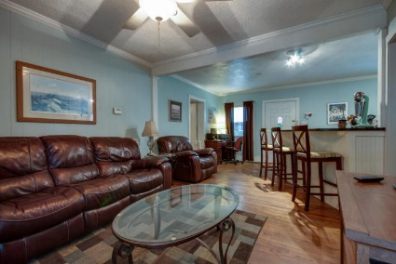
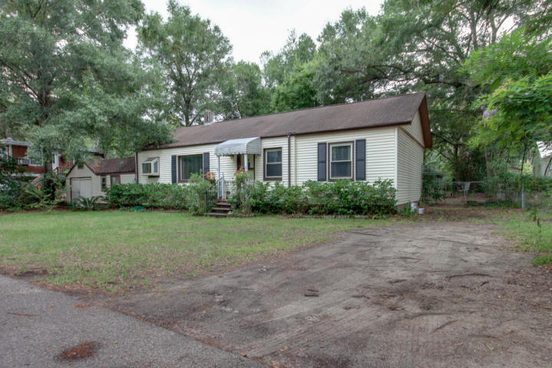
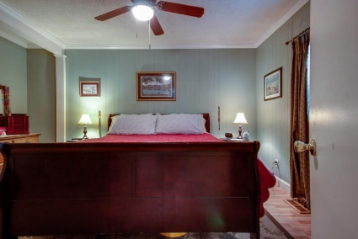
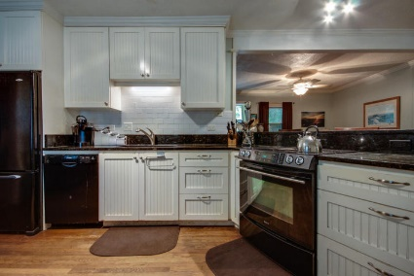
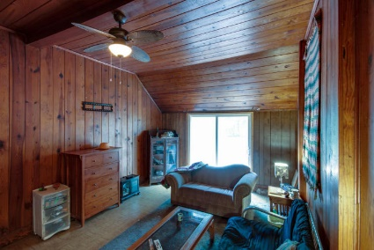
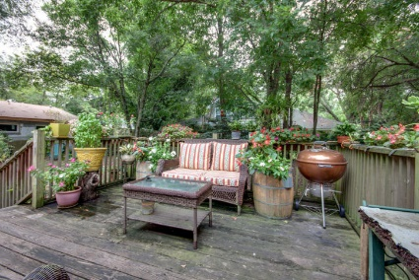
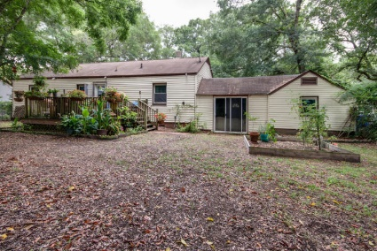
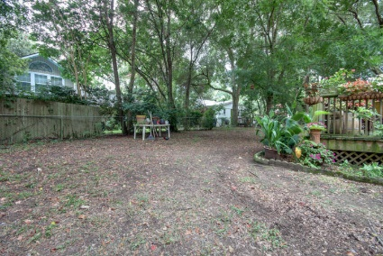
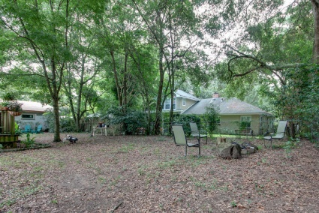

Location, Location, Location! Just Reduced to $365,000
733 Atlantic Street
Old Mount Pleasant
MLS# 15022035
Just Reduced to $365,000
Throw back cottage with NO FLOOD INSURANCE located on a quiet, tree lined street in Mt. Pleasant Academy and Moultrie Middle school zones. Make this home your own, kitchen and one bath have been updated. A large room next to garage w/ central heat and air has been used as a third bedroom or can be a large family room with real wood paneling and vaulted ceiling. Master bedroom is roomy with generous size bath and dressing area.
A nice relaxing deck looks out over the fenced in yard and a one car garage is attached for storage. Sellers are providing a one year home warranty, home is sold in "as is" condition. Enjoy the convenience of living in old Mt. Pleasant, walk to schools, Farmer's Market, restaurants, shops, Christmas Parade or ride over to the beach.
*Also listed as MLS# 15022036 (Vacant Land) if buyer chooses to demolish home and build a new home, as others on the street have recently chosen to do.
Lori Claussen loric@goldenbearrealty.com
www.GoldenBearRealty.com
Golden Bear Realty | 654 Coleman Blvd, Suite 100 | Mt Pleasant , SC 29464
Cell (843) 224-8506 | Office (855) 352-9088 | Fax (561) 721-3311

