Slide 1


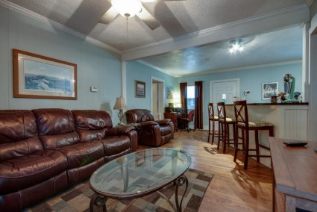
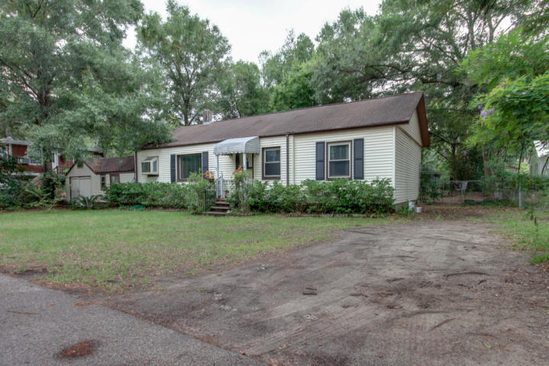
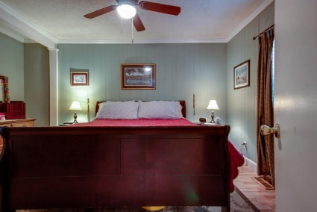
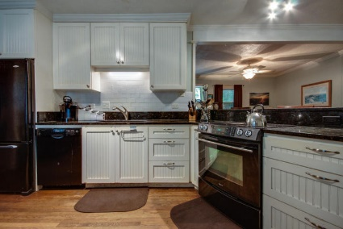
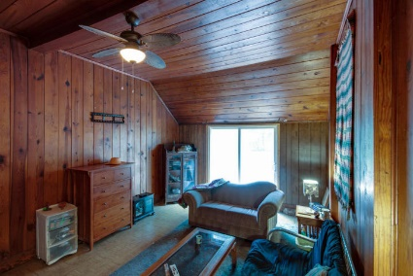
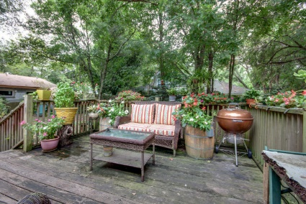
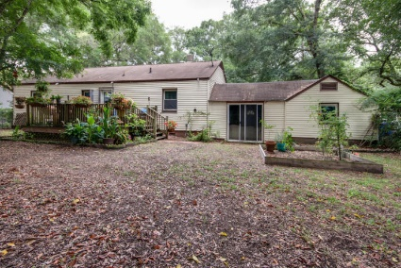
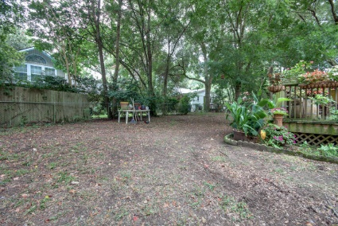
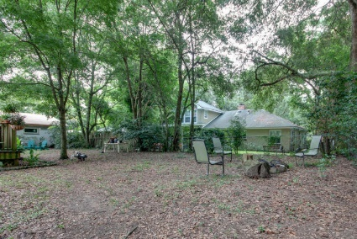

Location, Location, Location!
733 Atlantic Street
Old Mount Pleasant
MLS# 15022035
Just Reduced to $385,000
Just Reduced!
Throw back cottage with NO FLOOD INSURANCE located on a quiet, tree lined street in Mt. Pleasant Academy and Moultrie Middle school zones. Make this home your own, kitchen and one bath have been updated. A large room next to garage w/ central heat and air has been used as a third bedroom or can be a large family room with real wood paneling and vaulted ceiling. Master bedroom is roomy with generous size bath and dressing area.
A nice relaxing deck looks out over the fenced in yard and a one car garage is attached for storage. Sellers are providing a one year home warranty, home is sold in ''as is'' condition.* Enjoy the convenience of living in old Mt. Pleasant, walk to schools, Farmer's Market, restaurants, shops, Christmas Parade or ride over to the beach.
*Also listed as MLS# 15022036 (Vacant Land) if buyer chooses to demolish home and build a new home, as others on the street have recently chosen to do.
Lori Claussen loric@goldenbearrealty.com
www.GoldenBearRealty.com
Golden Bear Realty | 654 Coleman Blvd, Suite 100 | Mt Pleasant , SC 29464
Cell (843) 224-8506 | Office (855) 352-9088 | Fax (561) 721-3311

