Slide 1

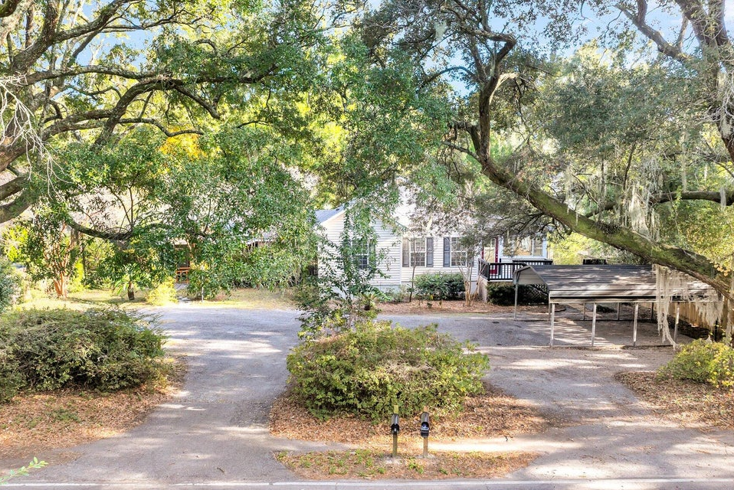
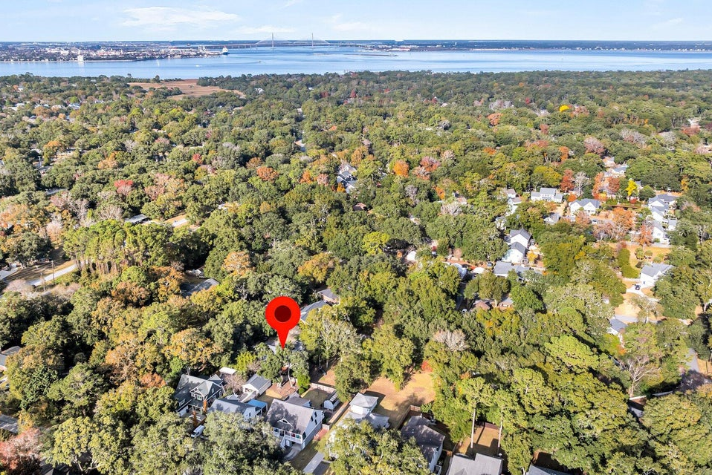
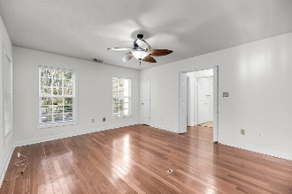
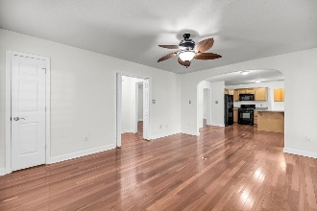
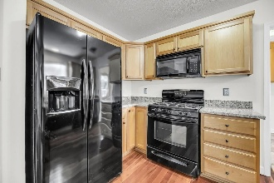
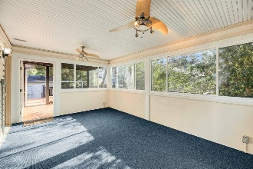

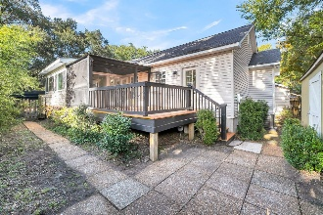
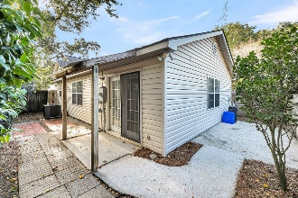
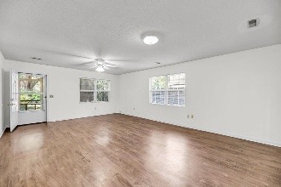
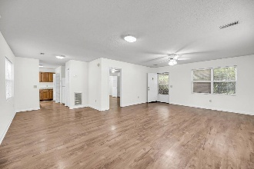
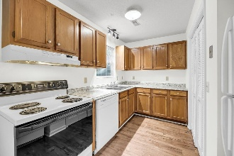
Debbie Cromer
ABR, RSPS, REALTOR, CRS
(843) 437-6342
debbie@debbiecromer.com
www.debbiecromer.com
Perfect Property for Multigenerational Living,
Rental Income, or Sort-Term Rental Opportunities!
733 Fort Johnson Road
Charleston, SC 29412 | MLS# 24030916 | $694,000
Unique James Island home w/ incredible features! This property is perfect for multigenerational living, rental income, or short-term rental opportunities. Square footage: Main house - 1,535 sq. ft.; Cottage - 864 sq. ft. The main house boasts 3 bedrooms, 2 bathrooms, & hardwood floors throughout the living areas, kitchen, & bedrooms. Recently updated w/ brand-new granite countertops in the kitchen, this home has been freshly painted throughout & includes a heated and cooled four seasons room, a separate laundry room, a screened porch, a sunny deck, & a landscaped, privacy-fenced yard w/ a workshop. The detached cottage, connected only by the roofline & separated by a walkway, is equally impressive w/ 1 bedroom, 1 bathroom, a spacious living area, a screened porch, and fenced backyard. The cottage has been freshly painted, making it move-in ready. This property requires no flood insurance &, w/ no HOA, offers flexibility & freedom. Don't miss this rare find!
TAKE A VIRTUAL TOUR
Century 21 Properties Plus | 1090 Park West Blvd; Ste 103 | Mount Pleasant, SC 29466

