Slide 1
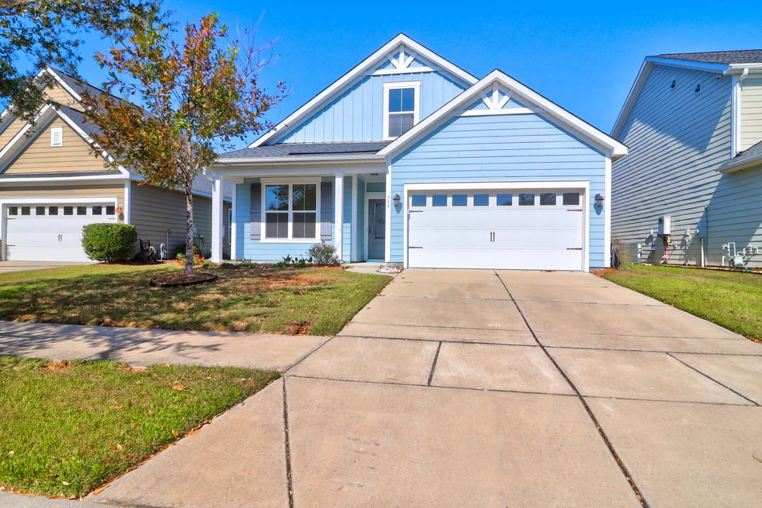
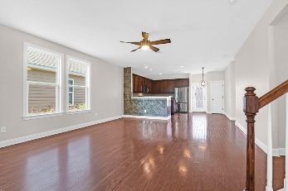
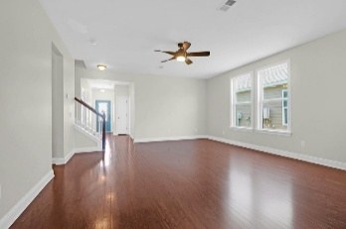
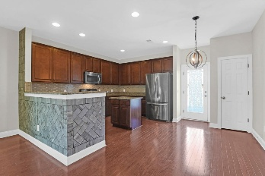
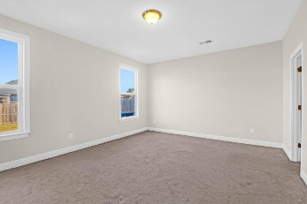
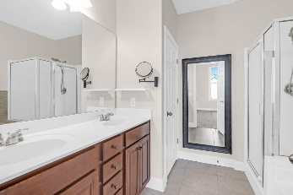
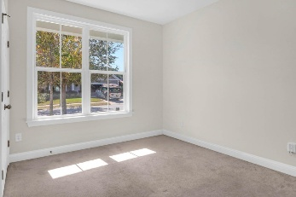
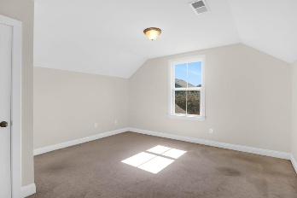
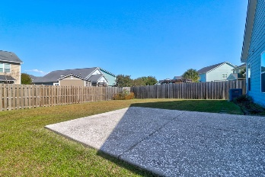
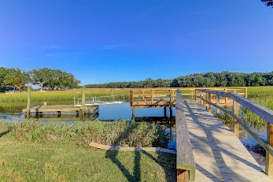
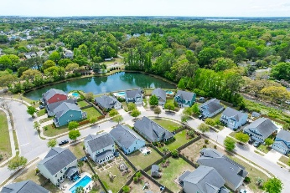

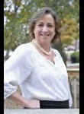

NEW YEAR…NEW PRICE!
733 Goodlet Circle
Seaside Plantation
Charleston, SC 29412
MLS# 24029908
NOW OFFERING AT $670,000
Welcome to your dream home! This beautiful, freshly painted residence features an inviting open floor plan that seamlessly blends style and functionality. With three spacious bedrooms and two full baths conveniently located downstairs, you'll enjoy easy living and entertaining. The gleaming hardwood floors lead you into a light-filled great room, perfect for gatherings or quiet evenings at home. Upstairs, discover two additional bedrooms, a full bath, and a versatile loft space—ideal for a home office or play area. Energy efficiency is at your fingertips with solar panels reducing your monthly expenses. Step outside to a large, fenced backyard, a perfect oasis for outdoor fun, gardening, or relaxation. Located in a fantastic neighborhood, you'll be just minutes from the beach and nearby shopping, and downtown Charleston, combining convenience with coastal charm. Don't miss your chance to own this exceptional home! Residents of this neighborhood enjoy access to a community boat ramp, ideal for water enthusiasts and outdoor adventurers.
A $2,500 Lender Credit is available and will be applied towards the buyer's closing costs and pre-paids if the buyer chooses to use the seller's preferred lender. This credit is in addition to any negotiated seller concessions.
Leesa Northrup
Office: 843.884.1622
Mobile: 843.442.0987
Fax: 843.746.4994
lnorthrup@carolinaone.com
Carolina One Real Estate 628 Long Point Road Mount Pleasant SC 29464

