Slide 1
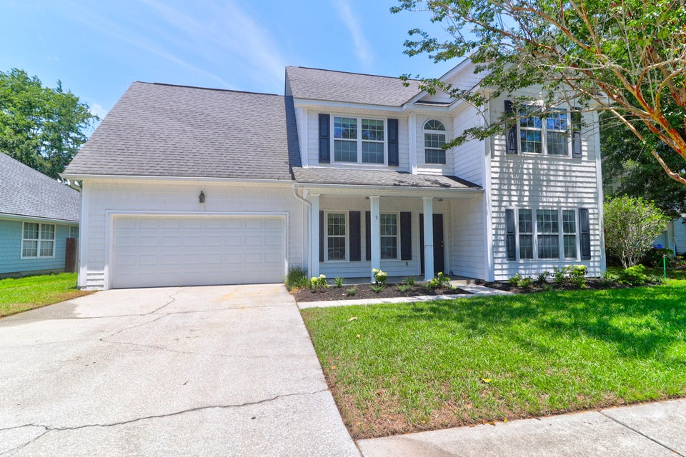
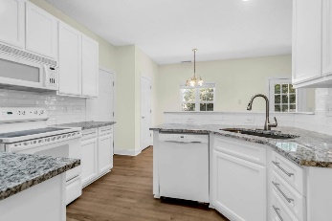
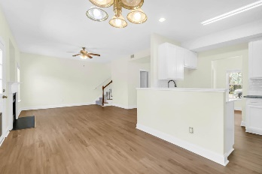
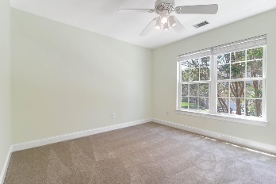
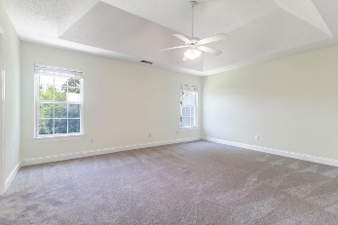
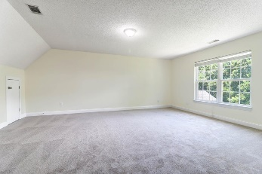
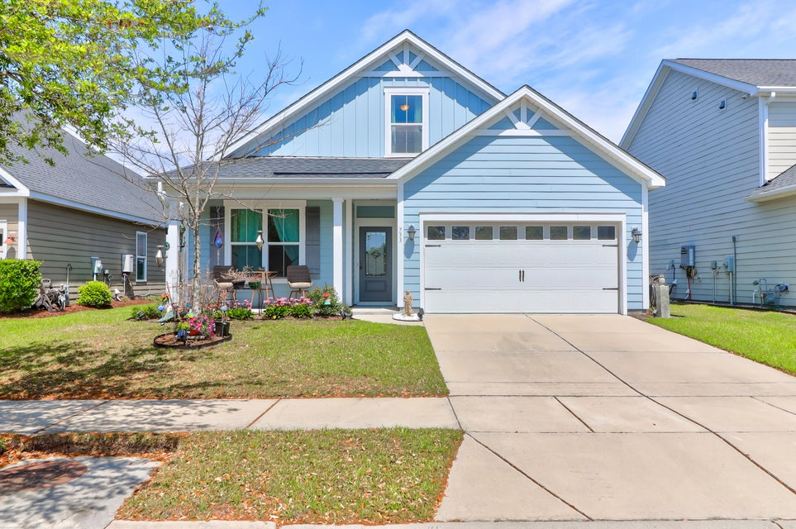
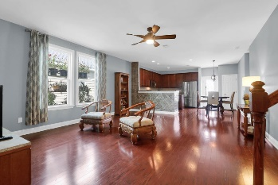
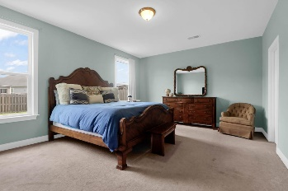
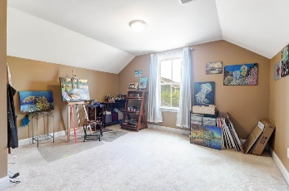
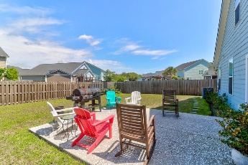
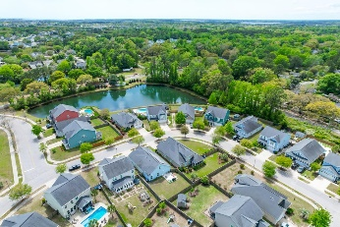

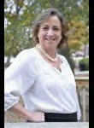

Double Down on James Island
506 Cecilia Cove Drive
Lawton Harbor
Charleston, SC 29412
MLS# 24017062
$700,000
733 Goodlet Circle
Seaside Plantation
Charleston, SC 29412
MLS# 24009120
$700,000
Leesa Northrup
Office: 843.884.1622
Mobile: 843.442.0987
Fax: 843.746.4994
lnorthrup@carolinaone.com
Carolina One Real Estate 628 Long Point Road Mount Pleasant SC 29464

