Slide 1

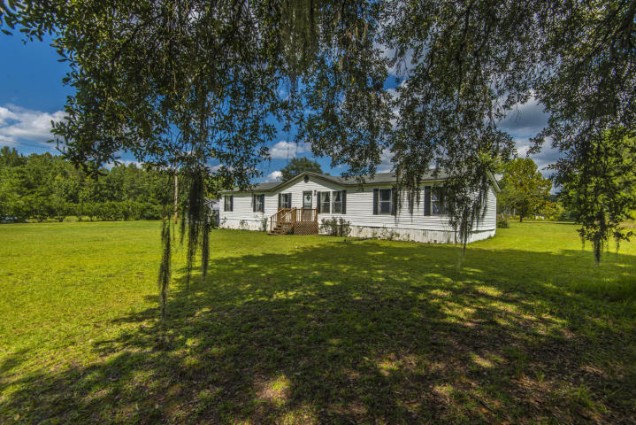
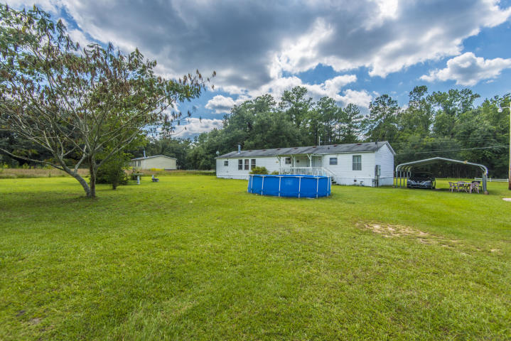
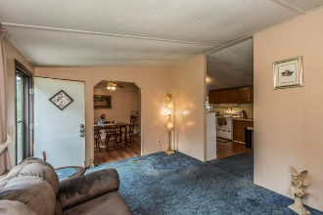
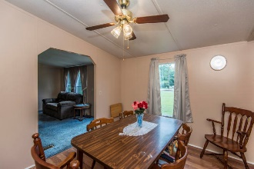
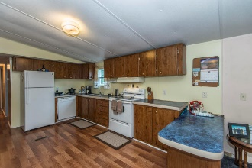
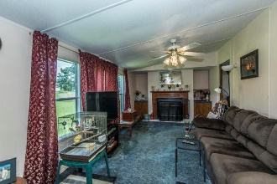
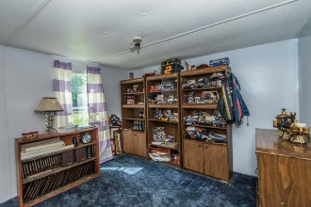
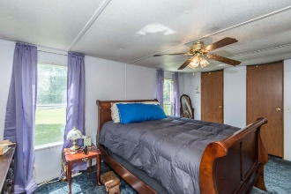
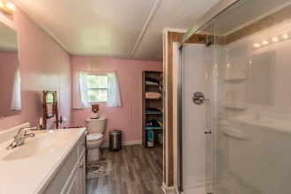
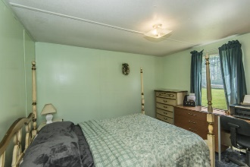
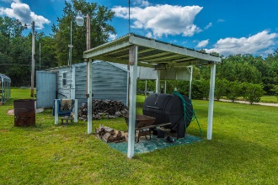
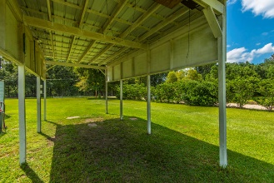


7340 Jacksonboro Road Presidential Estates ~ Round O, SC 29474 ~ MLS# 19025257
Price Adjusted!
Now $135,000 + Agent Bonus of $2000
Enjoy country living at it's best, while only being 5 minutes from Cottageville and 20 minutes to Summerville! Spacious 4 bedroom 2 bath home on a fully landscaped 1.70 acres! Freshly painted inside and well maintained the floorplan is perfect for everyday living and entertaining. You will love the cozy wood burning fireplace in the family room, that is open to the large kitchen. The kitchen boasts a breakfast bar, tons of counter and cabinet space, newly installed stove & dishwasher and a new laminate wood floor that continues into the Dining Room. The Master Bedroom offers his and hers closets, and newly renovated ensuite bath with a dual vanity, and large step-in shower. The 3 additional bedrooms are a generous size with large closet space and are conveniently located near Full Hall Bath. Laundry room has built in cabinets for added storage and the washer and dryer are to convey. Enjoy a cup of coffee while relaxing on your back deck overlooking the serene scenery watching hummingbirds and animals frolic. Cool off on a hot day in your above ground pool. Cook outs are made easier with the covered hog smoker. The backyard also has 2 sheds, a covered two car carport, an additional car port big enough for a travel trailer, pontoon boat, boat, etc...Car and Boat Ports have electrical and lighting, cameras too convey to buyer with closing. Just some of the updates are new range, & dishwasher, vinyl wood floors in dining room, kitchen, laundry room and bathrooms. Newly upgraded double walkin shower, vanity in master bath, Newly replaced front steps and porch. Conveniently located just off of Highway 17A, it is just minutes to Walterboro and less than 30 minutes to Summerville. A Must see, schedule your appointment today!
Jacqui Swain (843) 295-9484 jacqui.swain@carolinaone.com www.jacquisellscharleston.com
Carolina One Real Estate
1530 Old Trolley Road
Summerville, SC 29485

