Slide 1
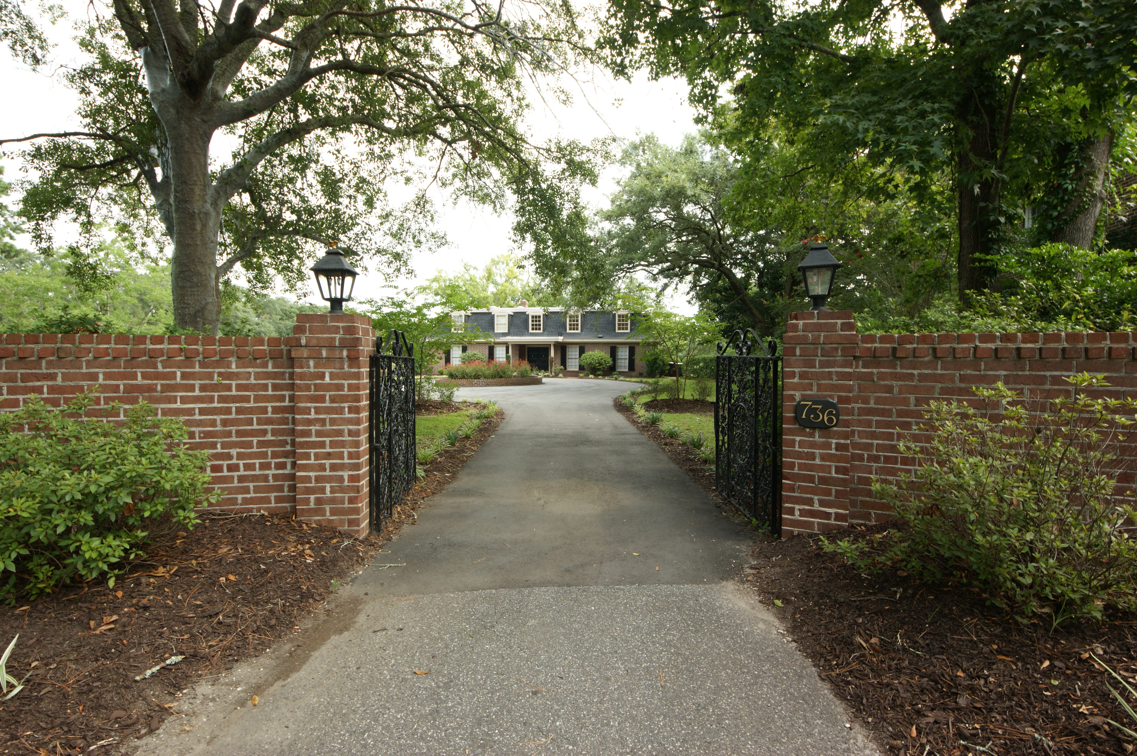
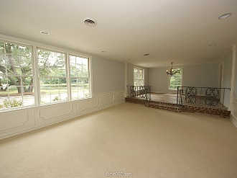
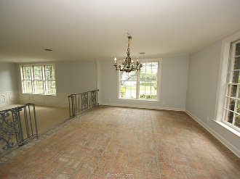
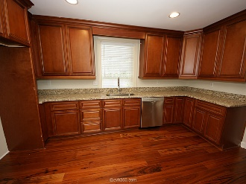
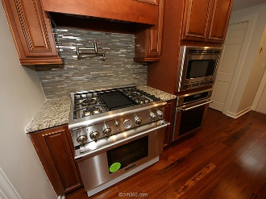
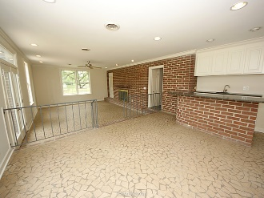
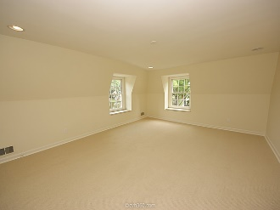
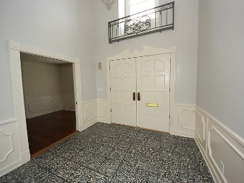
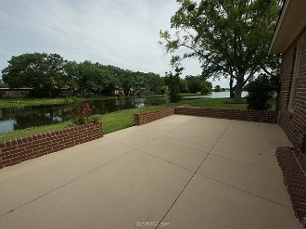
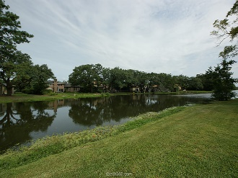
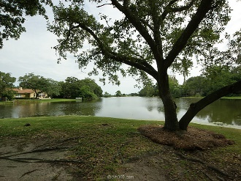
Lake Front Estate… Close to Downtown
736 N Godfrey Park Pl
Moreland :: Charleston
MLS# 15021605 :: $749,500
Renovated brick lakefront home close to town in highly desirable Moreland neighborhood!! At the end of a quiet street behind the brick wall and iron gates this house is surrounded by water on 3 sides. Great lake views from almost every room. Walk into your 2 story entry with direct views of the lake. Upgraded plumbing, electrical, new cabinets, new granite counters, new appliances in gourmet kitchen, new carpet, new wood floors, brick wet bar, real wainscoting, crown molding, brick floor in dining room, large pantry with room for additional fridge, and new high efficiency 3 phase HVAC system. This never listed before home has to many features to list please view the virtual tour. Listed by Owner/Agent
Martin Stewart, GRI
(843) 971-7979 - O
(843) 568-3333 - M
Charleston Coastline Realty
782 Johnnie Dodds Blvd.
Mount Pleasant, SC 29464
Be sure to check out the virtual tour for more photos and panoramic scenes!

