Slide 1
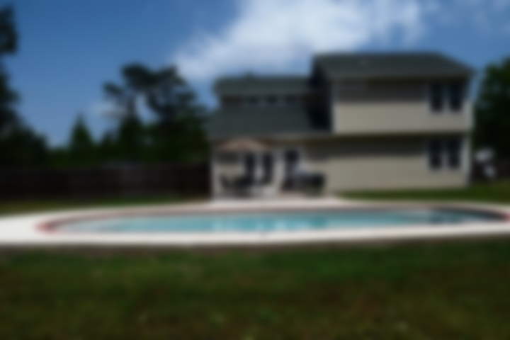
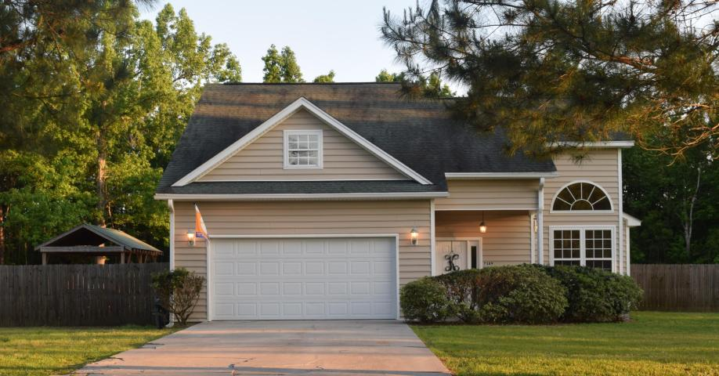
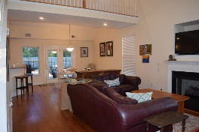
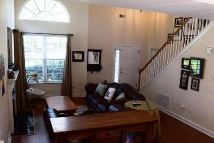
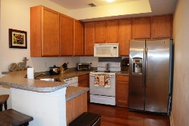
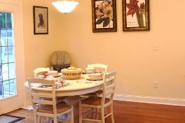
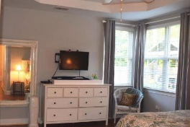
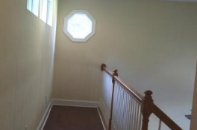
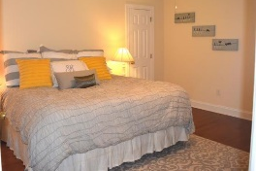
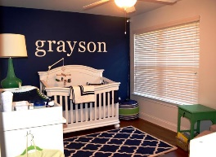

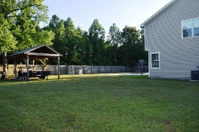


Agent Open House and Luncheon Tues, June 6 11:30-1:00 ~ $50.00 Outback Steakhouse gift card drawing
7389 Commodore Road
Parish Point • Meggett, , SC 29449 • MLS# 17011765 • $260,000
Summertime fun time! Splash around in the big In-ground pool. Entertain in the extra large privacy fenced yard. Put your boat in at Toogoodoo boat landing 1/2 mile from your new home. Bright and spacious open floor plan with gas fireplace. 1st floor master bedroom, walk in closet and full bath. 2 more large bedrooms upstairs. Hardwood floors throughout home. Tile flooring in bathrooms. Quiet country living doesn't get any better than this! Close to Edisto Beach and not too far from Downtown Charleston.
Christina Garvin
(843) 270-7667 | cgarvin63@gmail.com
Elaine Brabham and Associates, LLC • 1890 Sam Rittenberg Boulevard, Suite 217 • Charleston, SC 29407

