Slide 1
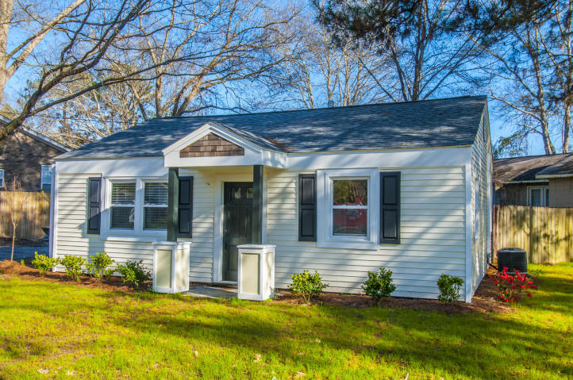
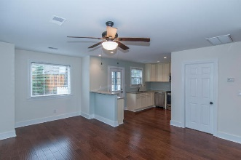
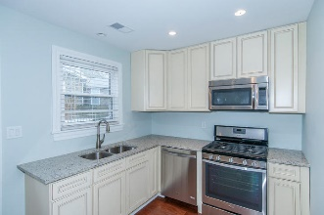
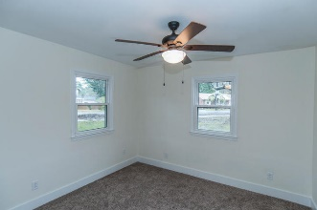
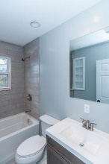
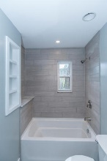
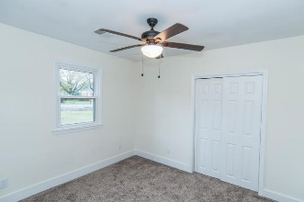
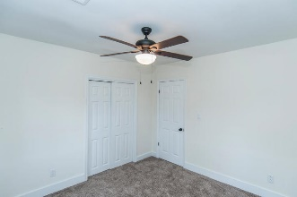

Completely renovated top to bottom
Open House Saturday 12-3 Refreshments Provided
738 Anita Drive
Magnolia :: Charleston, SC 29407 :: MLS# 16007279 :: $235,000
Magnolia cottage style home in the popular and bustling Avondale corridor of West Ashley. This home features new exterior siding, new roof, new HVAC and ductwork, new tankless water heater, new flooring, kitchen cabinets, granite counters, recessed lighting, smooth ceilings, storage shed, and huge gravel driveway for parking. Walk next door to the community garden and city park, down the street to the shops and restaurants of Avondale or to the dog park and soccer fields, and have easy access to downtown Charleston, the beaches, I-26, I-526, and more. Very central location and an updated, better-than-new house. Come see it today!
Scott Baskin
843-324-4139 M | 843-972-2400 O scott.r.baskin@gmail.com | www.scottbaskin.com
RE/MAX Advanced Realty
311 Johnnie Dodds Blvd
Mt Pleasant, SC 29464

