Slide 1
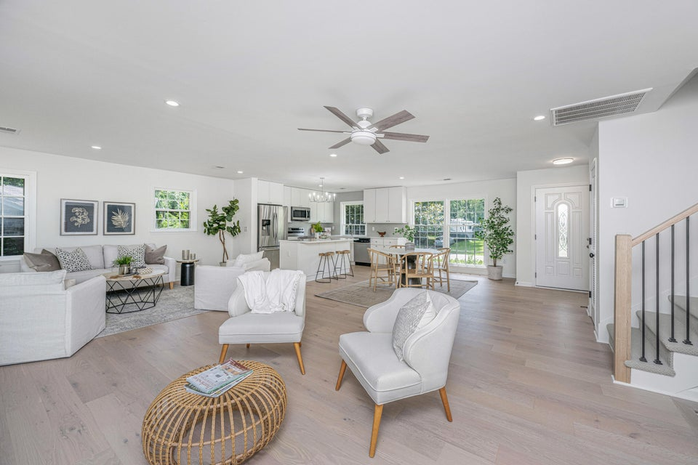

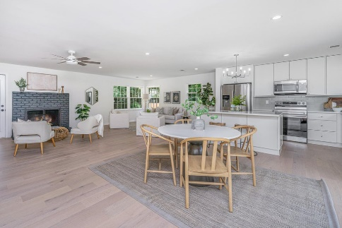
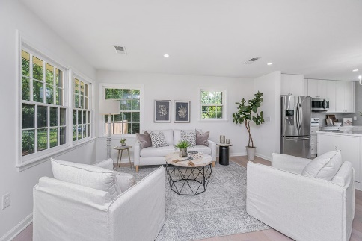
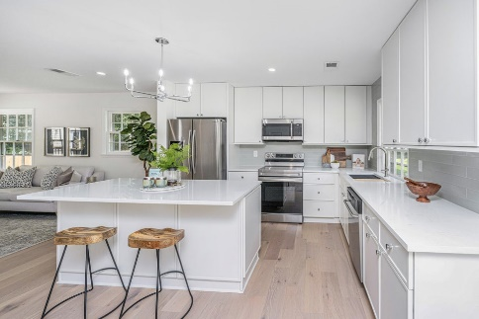
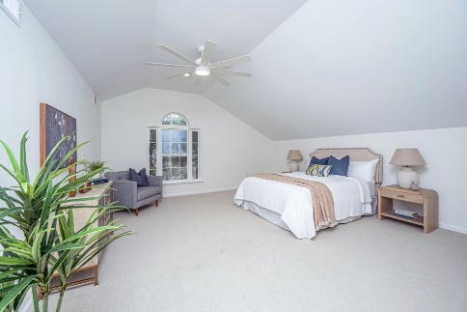
Remodeled 4BD/3BA with 1BD/1BA APT
738 Olney Road
Long Branch On The Creek
Charleston, SC 29414
MLS# 24017872 | $650,000
Large 4BR/3BA house at the end of a cul-de-sac, close to downtown, with an attached 1BR/1BA mother-in-law suite, with a separate entrance. Great for your relatives or help with paying your mortgage! Total of 5BR, and 4BA. Solar panels also help keep your expenses low! All new flooring, new kitchen in main house, and new bathrooms. Turnkey property!
Nancy Staggs
843-442-7456 | staggsn@yahoo.com
www.theblvdcompany.com
The Boulevard Company, LLC | 806 Johnnie Dodds Blvd Ste 100 | Mt Pleasant, SC 29464

