Slide 1
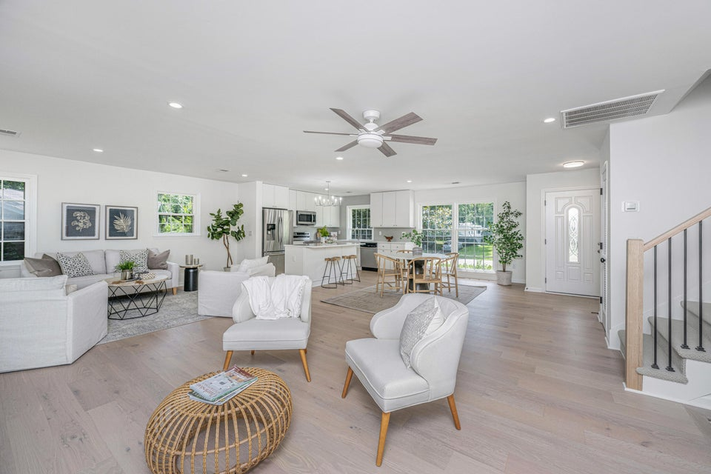

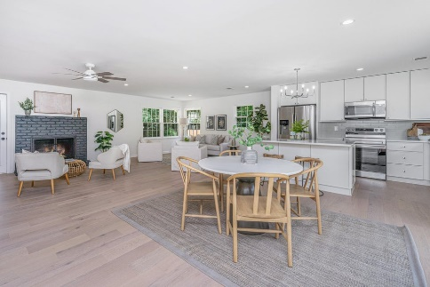
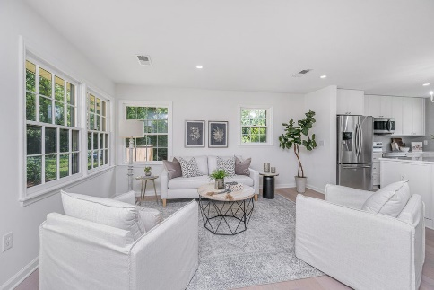
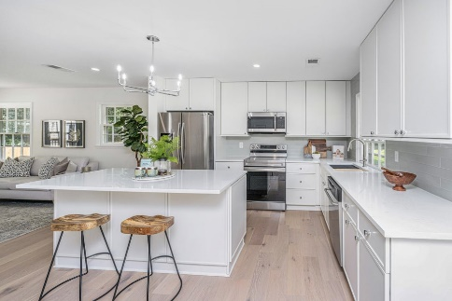
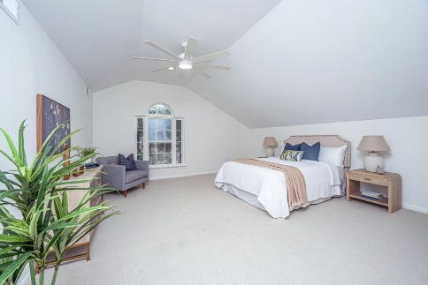
WEST ASHLEY - Remodeled 4BR/3BA with 1BR/1BA APT
738 Olney Road
Long Branch On The Creek
Charleston, SC 29414
MLS# 25025029 | $575,000
Large 4BR/3BA house at the end of a cul de sac, close to downtown, with an attached 1BR/1BA mother in law suite, with a separate entrance. Great for your relatives, or help with paying your mortgage! Total of 5BR, and 4BA. Solar panels are owned and not leased! All new flooring, new kitchen in main house, and remodeled bathrooms. House is priced below replacement cost, and is one of the lowest prices per sf in West Ashley.
OWNER WILL LOOK AT ALL OFFERS ON 9/26/2025.
Nancy Staggs
843-442-7456 | staggsn@yahoo.com
www.theblvdcompany.com
The Boulevard Company, LLC | 806 Johnnie Dodds Blvd Ste 100 | Mt Pleasant, SC 29464

