Slide 1
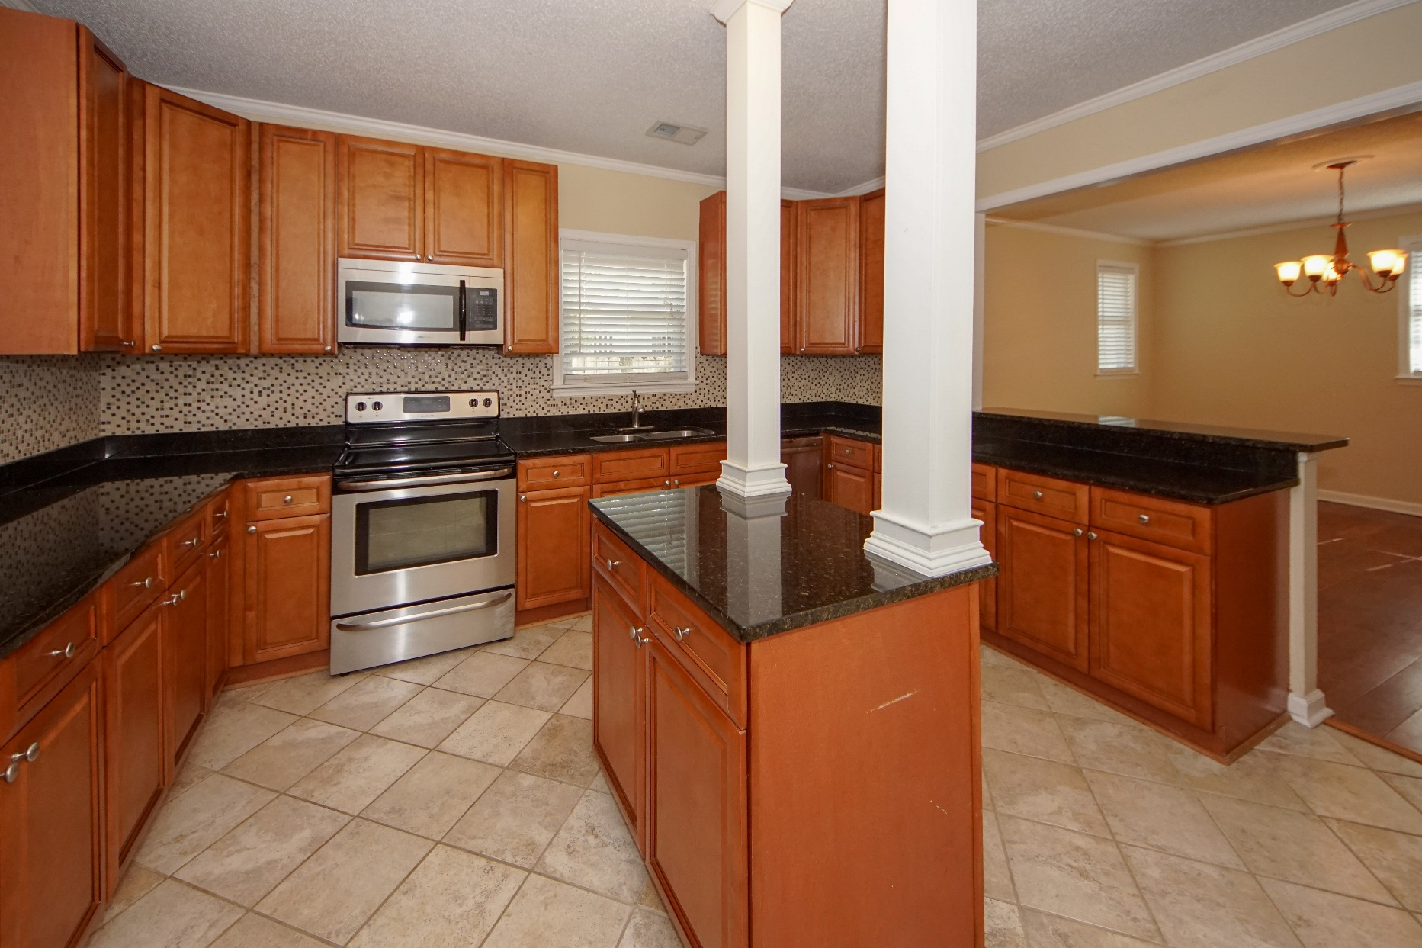
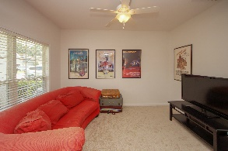
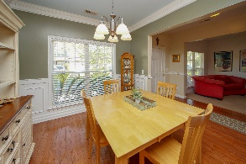
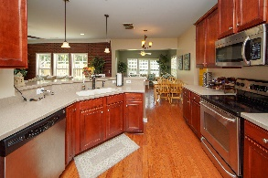
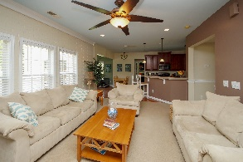

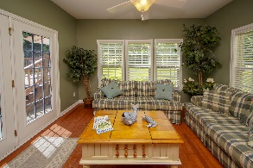

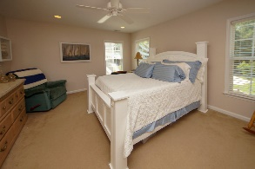
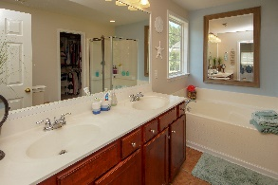
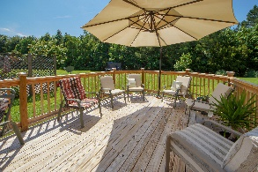
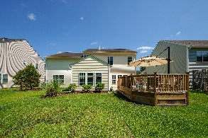


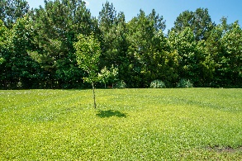
739 Spark Street Hobcaw in Mt Pleasant MLS #19009592 3 bed / 2 bath
PRICE REDUCED
$385,000
Greg Flanagan
Broker/REALTOR/CLHMS
843-952-4444
greg@flanaganhometeam.com www.FlanaganHomeTeam.com
Location, lack of an HOA and value pricing are a winning combination on this 2122 sf 3 bedroom 2 bath home just 3 minutes from the Ravenel Bridge. Located just one house in from Mathis Ferry Rd, this classic block and masonry home features a fully fenced yard, garage, parking for a boat, and quick convenience to Remley's boat launch, walking distance to the library, grocery, restaurants and personal services. The kitchen has newer appliances, tiled flooring and lots of natural light. The family/gathering room is tremendously large, central to the entire house and opens into the private courtyard where you can let your imagination go wild with endless possibilities of making your own private getaway.
Greg Flanagan
Broker/REALTOR/CLHMS
Luxury Marketing Specialist
843-952-4444
www.FlanaganHomeTeam.com
Keller Williams Realty Charleston | 496 Bramson Ct Ste 200 | Mt. Pleasant, SC 29464

