Slide 1
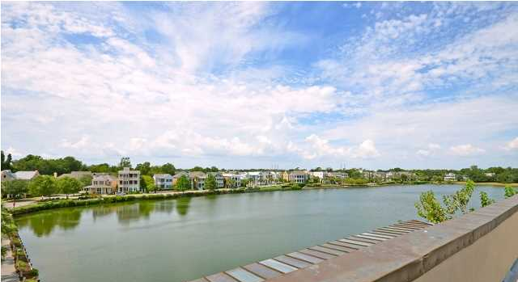
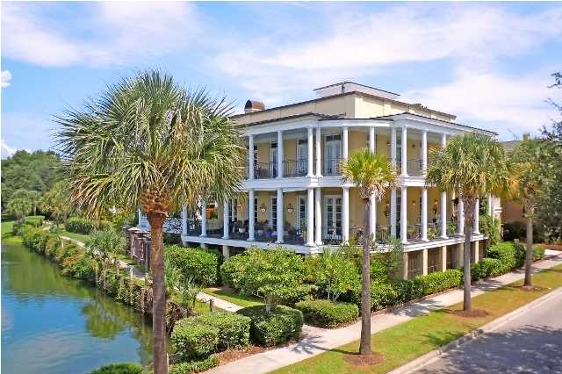
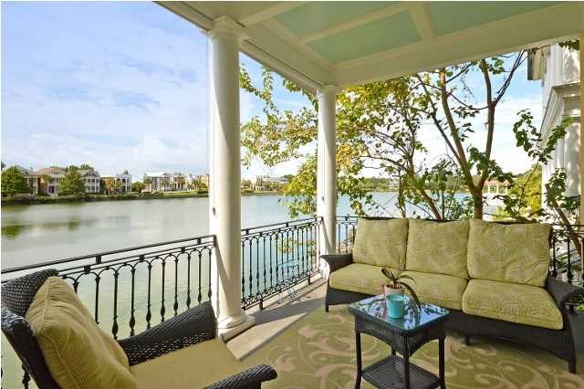
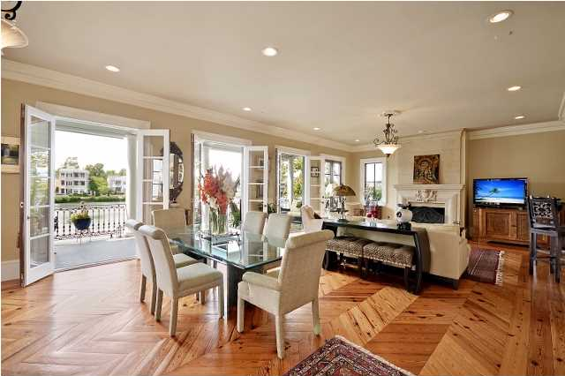
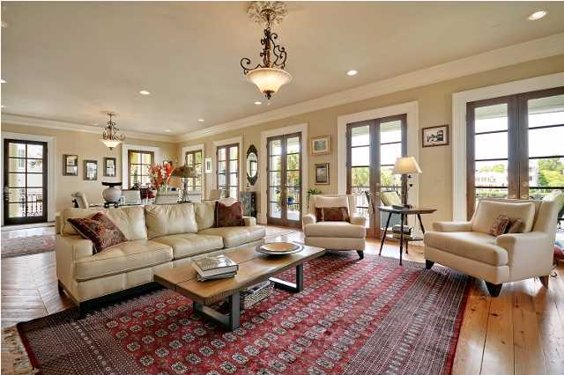
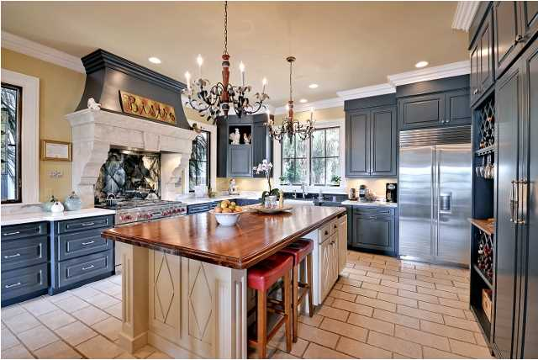
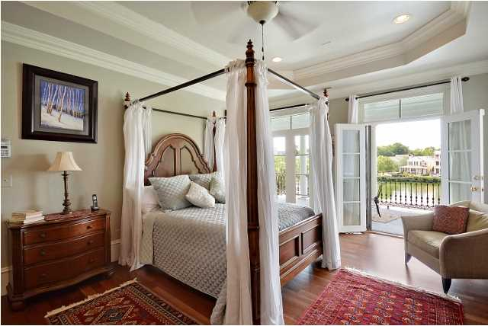
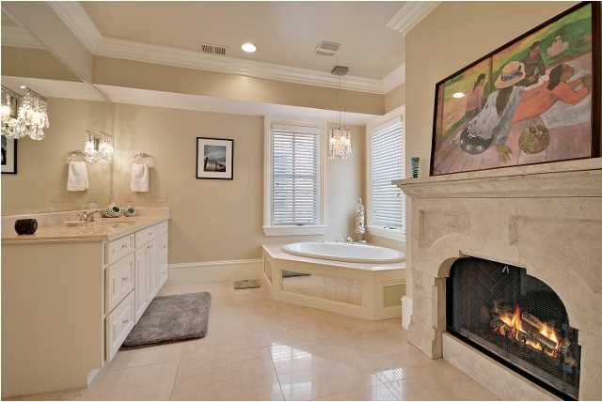
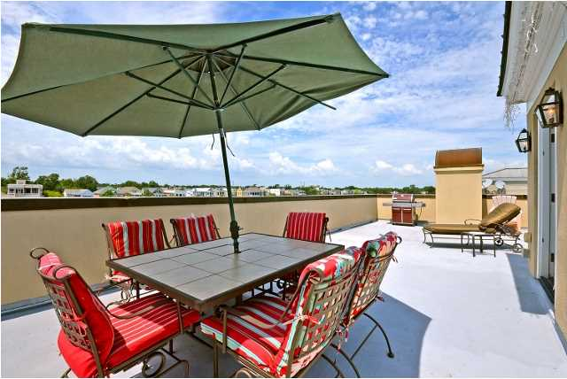
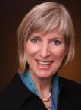

I'ON OPEN HOUSE Wednesday, September 17 11:30-1:30 and 4-6 at Sunset
The Villa at 73 Sowell
$1,647,000
4 Bedrooms · 4½ Bathrooms · 3 Car Garage
House: 4,681 approx sq ft
FROG: 660 approx sq ft
Roof Terrace: 1,600 approx sq ft
Kay Kennerty MBA, ABR, CRS, GRI
843-345-5011
Kay@agentownedrealty.com
www.KayKennertyHomes.com
The AgentOwned Realty Company
824 Johnnie Dodds Blvd
Mt. Pleasant, SC 29464

