Slide 1
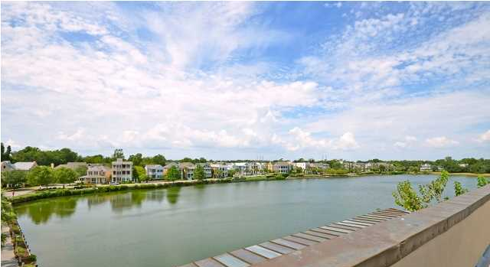
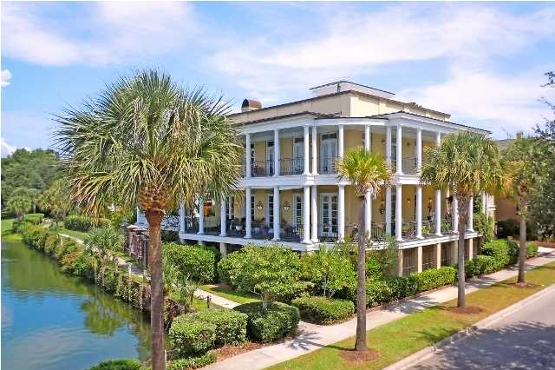
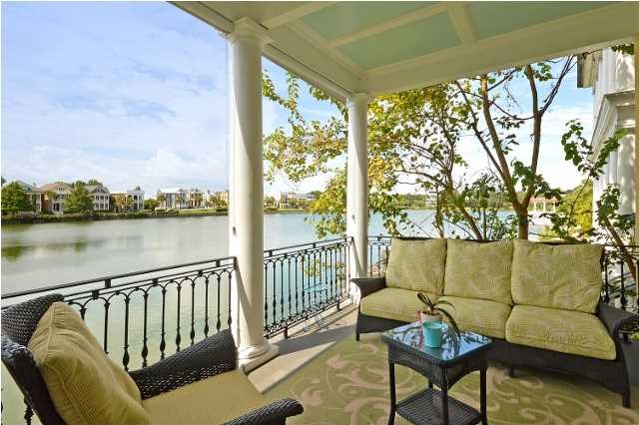
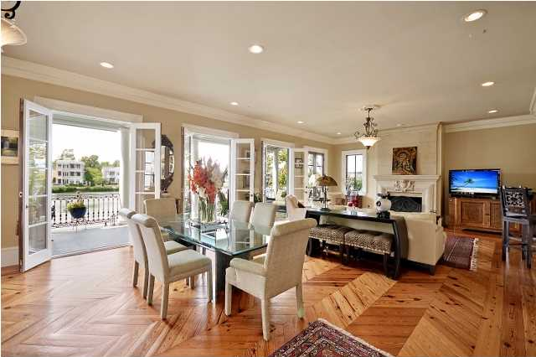
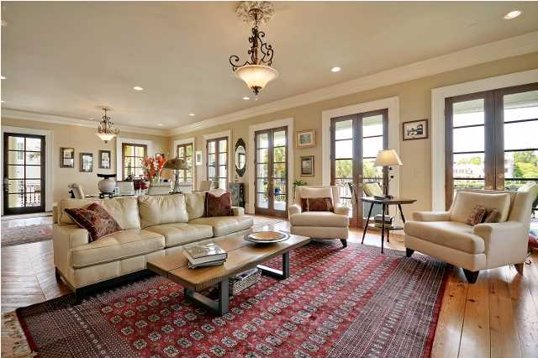
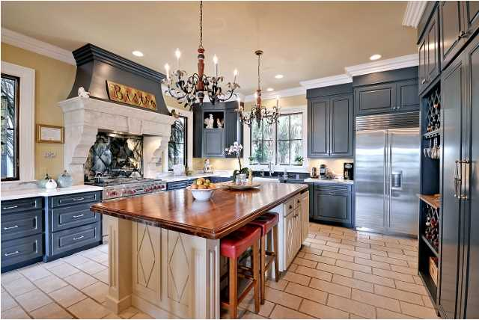
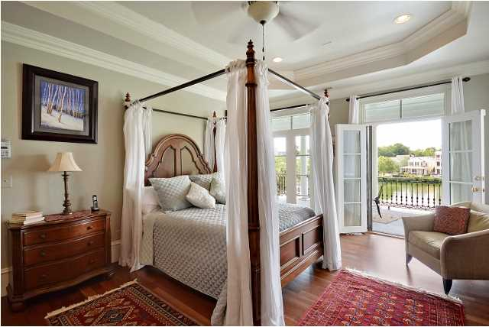
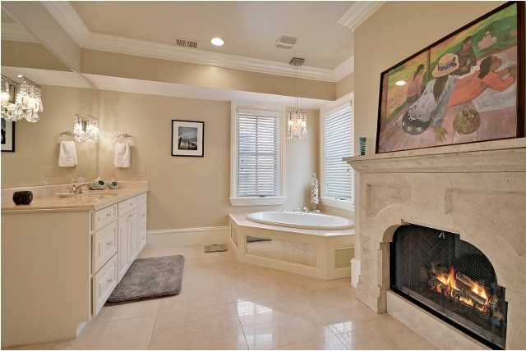
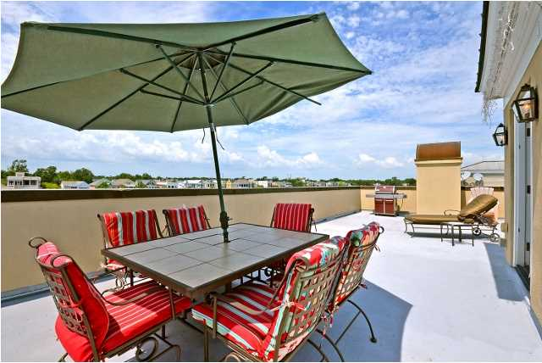


Iconic Lakefront in I'On The Villa at 73 Sowell $1,647,500
The Villa at 73 Sowell is one of the most photographed landmarks in Charleston of I’On. I’On is the USA’s premier neo-traditional community with its unique sense of place. I’On attracts diverse people who are interested in creating a full life with clubs, organizations, athletic pursuits that promote friendship among neighbors. The Villa at 73 Sowell has an inspired classical exterior design with an open floor plan for its up-to-date interior design. The Roman classical architecture is fused with the charm of wide Charleston piazzas at The Villa at 73. The design of the home is to share the natural world as experienced on the three stories of piazzas with the interior by encouraging the flow of people, air and energy through its 18 French doors. The Villa at 73 has a layout that is perfect for entertaining with the ease of circulating from the piazza to the family room, to the bar, to the kitchen, to the dining room, to the Grand piano and a return to the piazza. The main gathering room easily accommodates the family room, the casual eating area and a baby Grand piano. The stone fireplace adds to the old world feel while complimenting the up-to-date styling. The marble bar brings nectar’s juice to all as well as a place to enjoy a quick meal. The kitchen has a South of France flair and is outfitted with the top-of-the-line appliances such as a Wolf stove and a Sub-Zero refrigerator. The island in the kitchen is the meeting place for this family. The owner is a professional chef and has produced some of the finest meals in Charleston. And you can too! The gracious dining room is set-off with white and gray marble flooring and it overlooks the piazza. The top floor has the Owner’s Suite with its private entrance to the piazza. The Owner’s bath seems to be inspired by Architectural Digest with its fireplace, 24” Travertine flooring and 16” Travertine shower walls. The His and Her vanities and closets are a useful design. Two guest bedrooms are also on this floor with private baths and French doors to the piazza. The large laundry room completes this floor. Continuing up the staircase with its wrought iron balustrades, there is a surprise. The roof terrace has the best view of the lake, the stars and the fireworks. Charleston’s mild weather offers roof top dining and entertaining for most months of the year. The ground floor is surrounded by the broad piazzas. Currently, this floor has a private guest area with a casual family room incorporating the office. Adjoining is a large bedroom, dressing area and private bath. There is a large third room which is currently used for storage; convert it into a recreation room, a workout room, an office/study, or it can be converted to a kitchen and dining area for live-in relatives. To complete The Villa, there is a three car garage with a large finished room of about 655 SF with a bath over the garage. Again, the list of uses for this room is lengthy and varied.
Kay Kennerty MBA, ABR, CRS, GRI
843-345-5011
Kay@agentownedrealty.com
www.KayKennertyHomes.com
The AgentOwned Realty Company
824 Johnnie Dodds Blvd
Mt. Pleasant, SC 29464

