Slide 1
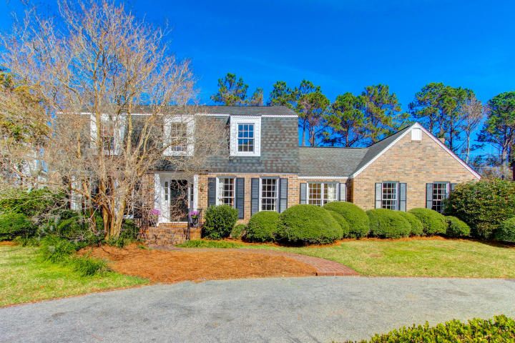
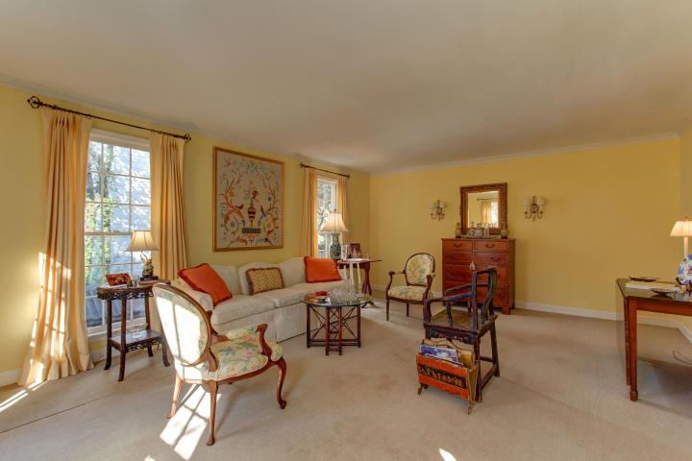
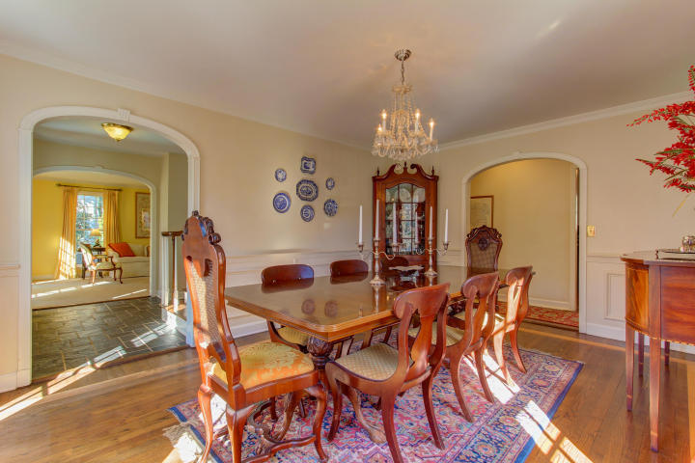
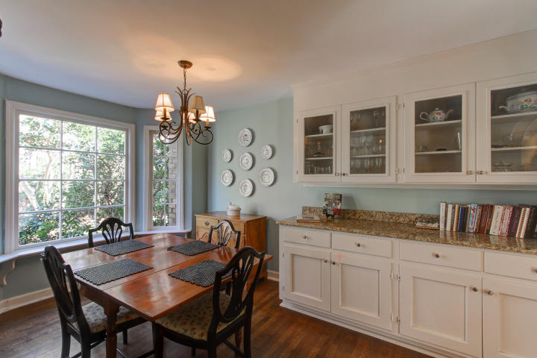
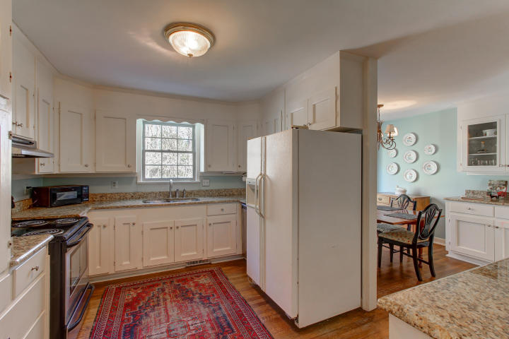
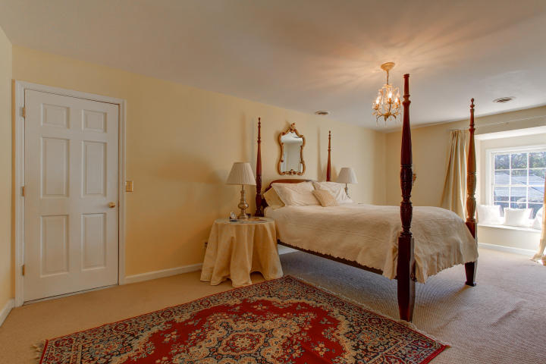
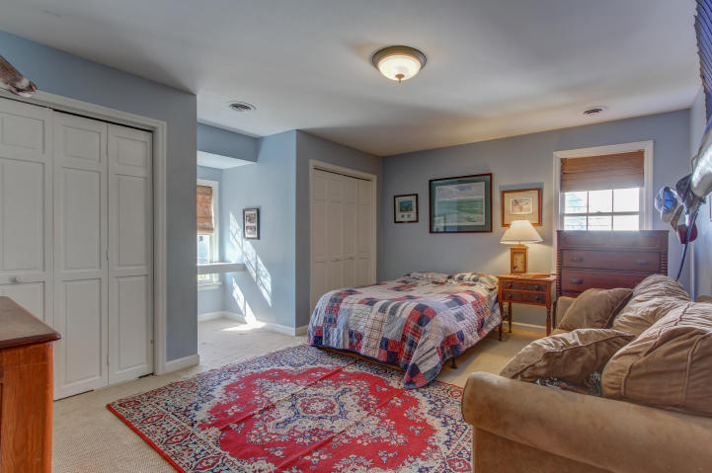
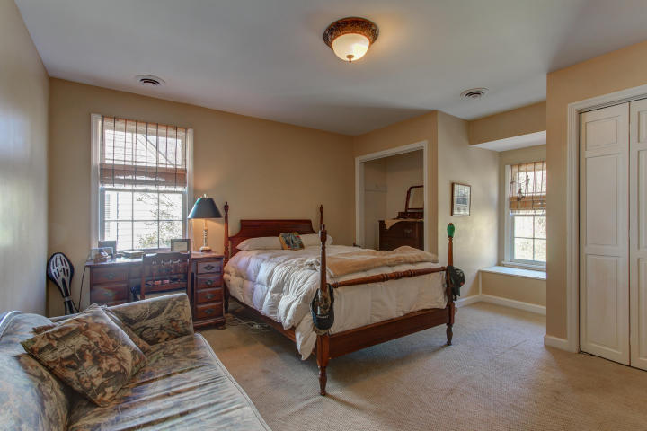
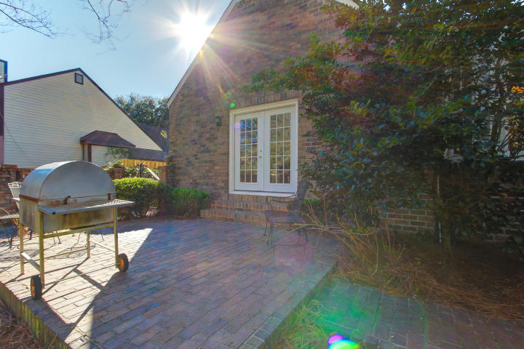
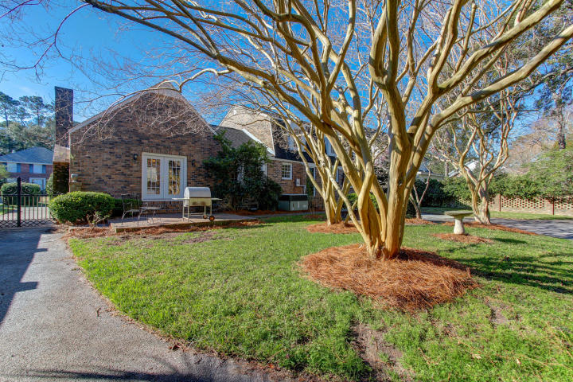


Price Reduced in Creekside Park!
742 Dragoon Drive
Mt Pleasant ~ MLS# 17004958 ~ $697,000
Classic and charming define this traditional home located in one of the most desirable neighborhoods in Mount Pleasant - Creekside. This four bedroom 3 1/2 bath two story house has a welcoming foyer flanked by a well appointed formal living room and an elegant separate formal dining room. Crown molding adorns the walls and floor to ceiling windows flood the rooms with light. In addition on the main level, enjoy a second master or guest bedroom and bath, a powder room, an updated kitchen with eat-in dinette, a laundry and utility room, an office and a handsomely paneled great room graced with a grand brick fireplace, wet bar, built-in bookcases and French doors which open onto the gracious brick patio.
Upstairs is the spacious master suite and bath as well as two sizable bedrooms and a shared bath. Ample closet space is found in all the bedrooms including two walk-in closets in the master and access to a large attic which includes a cedar closet.
The yard is beautifully landscaped with a circular drive in front with wrought iron gates and stately brick fence that leads to an enclosed backyard. Once you drive through the gates, there is a two car parking area behind the house along with a 12' x 12' shed. Relax on the back patio on a warm Lowcountry evening while your children play under the grand old crepe myrtles.
Don't miss your opportunity to live in Creekside, one of the most sought out neighborhoods in Mount Pleasant. Enjoy tennis, swimming pool and your own private boat landing on Shem Creek. Your New House Awaits!
Keller Williams Realty
Charleston West Ashley
1180 Sam Rittenberg Ste 105
Charleston, SC 29407
Andrea Woodfield
Realtor
(843) 442-7442
andrea@andreawoodfield.com

