Slide 1
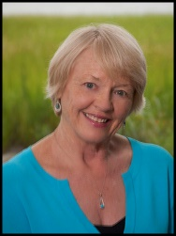
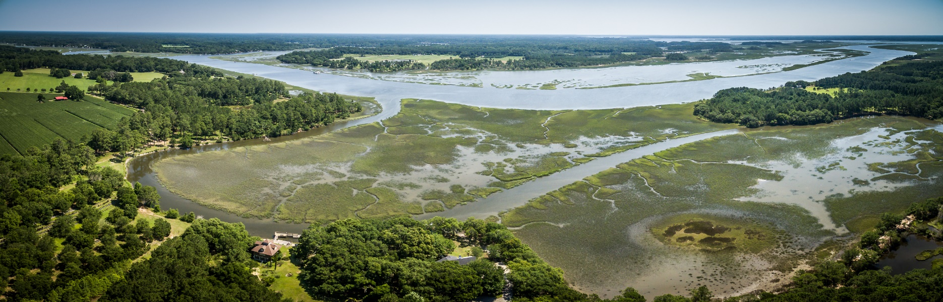
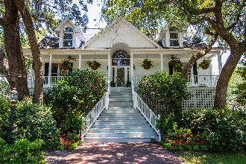
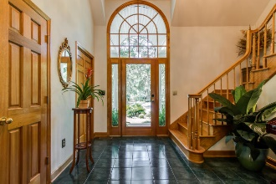
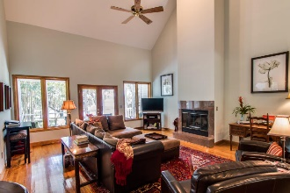
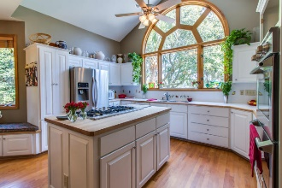
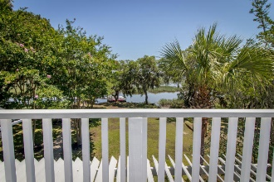
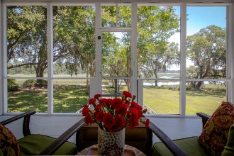
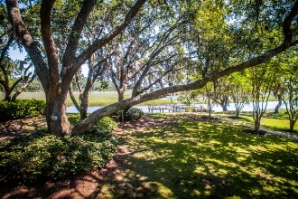
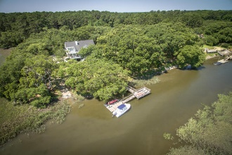

Carla Garbarini, Realtor
M (843) 814-6332
cmschultz@nstech.us
www.century21properties.com
Agents’ Open House
August 17th from 11-2
7432 Little Britton Rd
Ashe Point | Hollywood | MLS# 17014140 | $999,000
Elegant Deepwater Estate
Garden Creek/Toogoodoo off ICW
Elegant 4BR, 2.5 BA home
Deep water/new floating dock/boat ramp
Nearly 8 acres
Panoramic river views
Professional landscaping
Abundant forest and wildlife
Agents’ Open House, Thursday, August 17, 2017, 11:00 am – 2:00 pm. Light lunch.
Send your clients with your business card!
Century 21 Properties Plus | 2000 Sam Rittenberg Blvd #118 | Charleston, SC 29407

