Slide 1
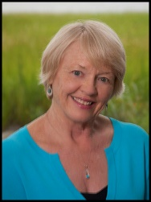
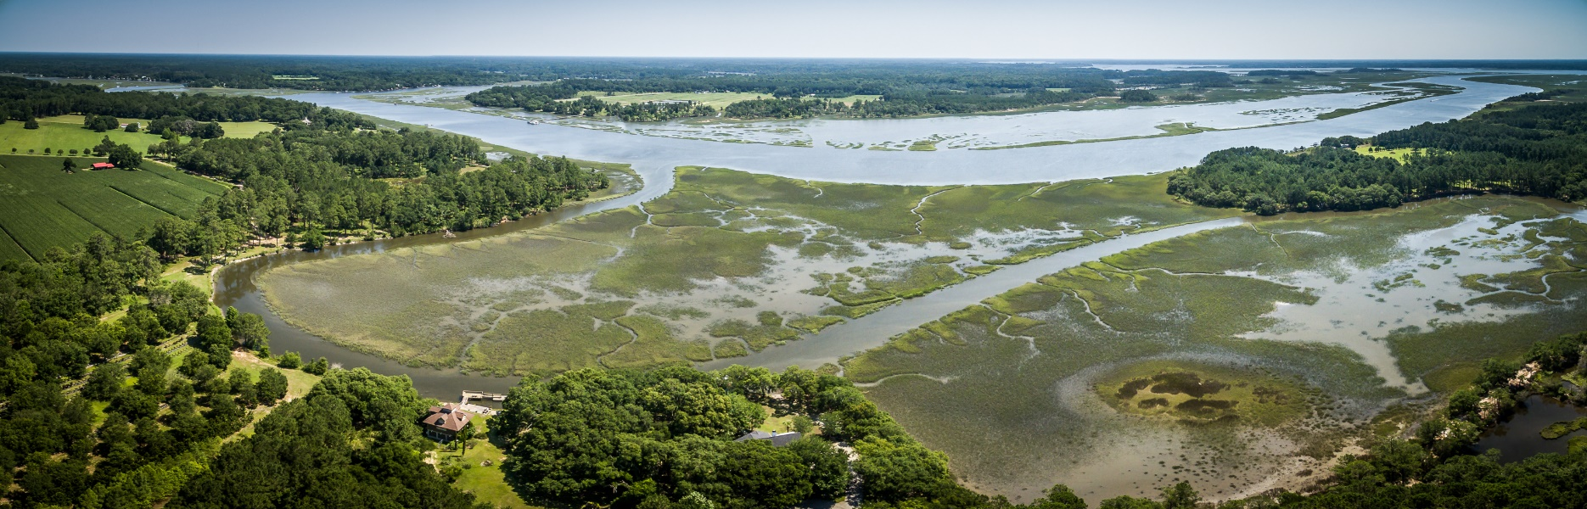
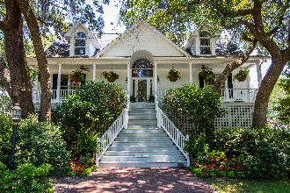
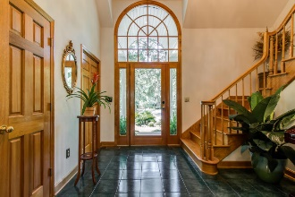
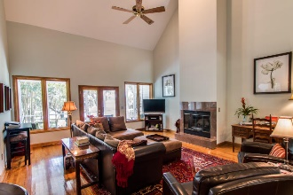
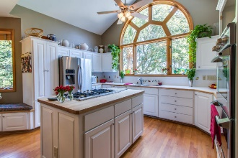
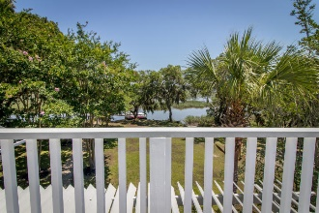
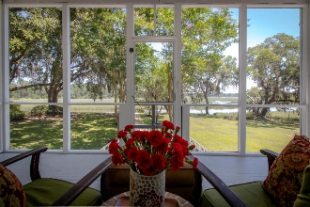
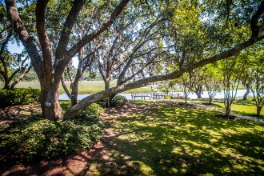
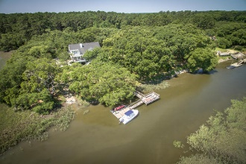

Elegant Deepwater Estate
With Access To ICW
Carla Garbarini, Realtor
M (843) 814-6332
cmschultz@nstech.us
www.century21properties.com
7432 Little Britton Rd
Ashe Point | Hollywood | MLS# 16016968 | $999,000
Beautiful Lowcountry Retreat
Garden Creek/Toogoodoo off ICW
Elegant 4BR, 2.5 BA home
Deep water/floating dock/boat ramp
Nearly 8 acres
Panoramic river views
Professional landscaping
Abundant forest and wildlife
This property will be featured in the Hollywood/Meggett Agents’ Tour of Homes
to be held Wednesday July 27, 2016, from 11:00 until 2:00
Century 21 Properties Plus | 2000 Sam Rittenberg Blvd #118 | Charleston, SC 29407

