Slide 1
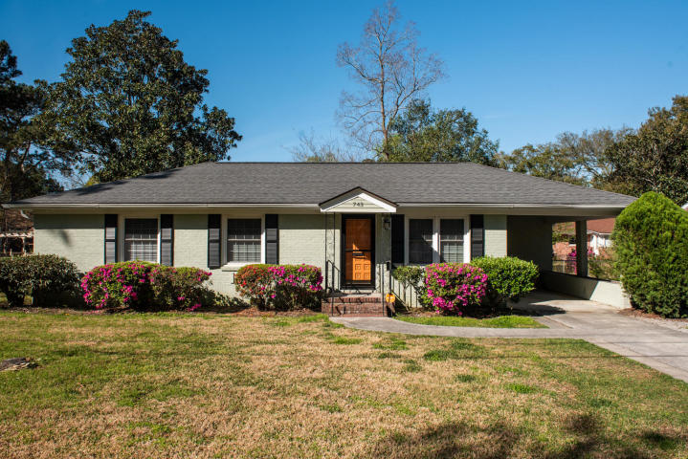
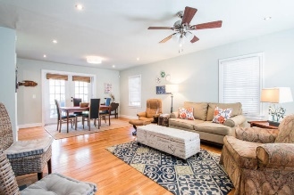
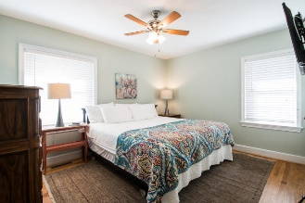
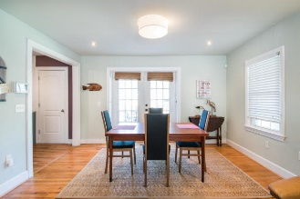
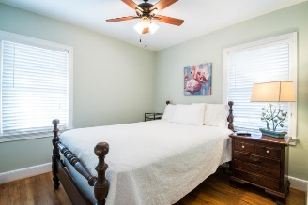
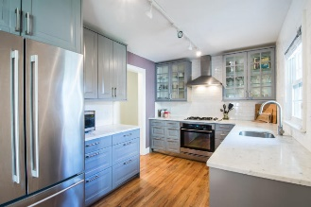
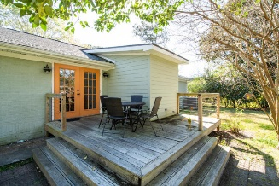
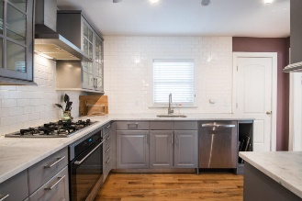
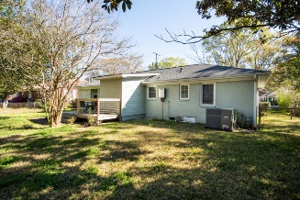


743 Magnolia Road
East Oak Forest ~ Charleston ~ MLS# 19008214 ~ $338,000
Price Reduced To $1,075,000!
Plus Sellers Offering A $25,000
Allowance To Buyer
W/ Acceptable Offer!
Open House
Sunday, April 7th
1:00-3:00PM
This charming brick home has been wonderfully renovated and is in a great location! The kitchen has quartz counter tops, stainless appliances and updated cabinetry. A half bath and laundry area were added off of the kitchen. The living/dining area open with French doors onto a deck and spacious backyard. There is an enclosed storage room off of the carport and extra, off street parking.
Hardwood floors are in all rooms with the exception of tile being in the full bath. The price point is attractive for first time buyers or those scaling down! Only 5 minutes to MUSC...so, a perfect home for medical professionals. It is 2 minutes away from great restaurants and shopping and 20 minutes away from Folly Beach!!
Bring your buyers!!!
Mac Jenkinson
M (843) 224-0210
mac@carolinaone.com
Beth Moore
M (843) 532-4892
bmoore@carolinaone.com
www.jenkinsonandmoore.com
Jenkinson & Moore, LLC | Carolina One Real Estate | 1503 Palm Blvd | Isle of Palms, SC 29451-2280

