Slide 1
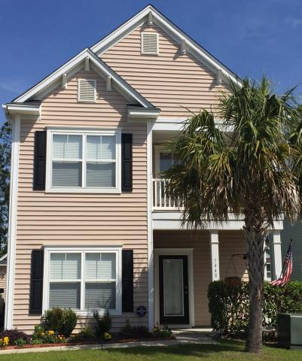
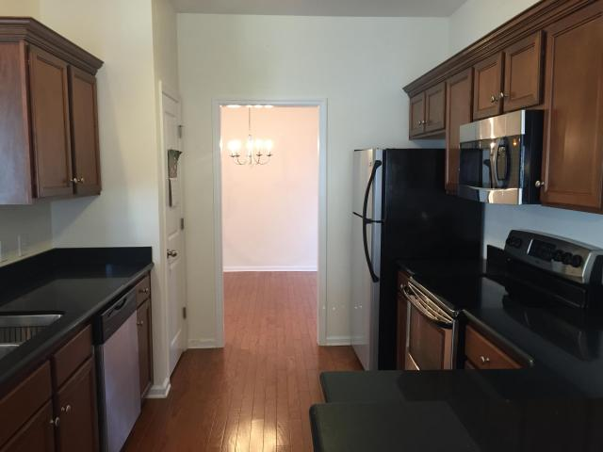
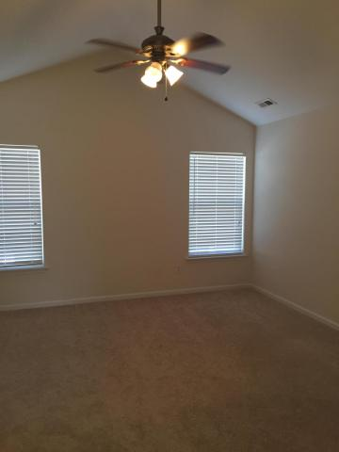
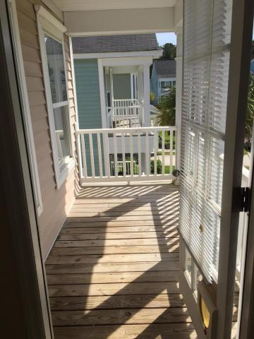
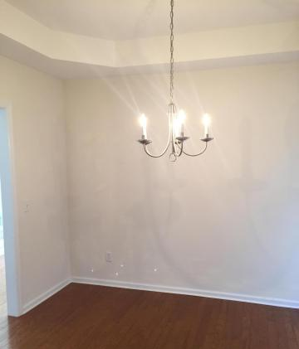
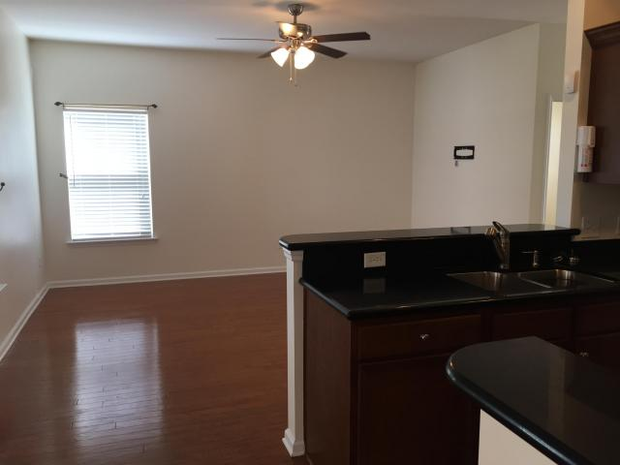
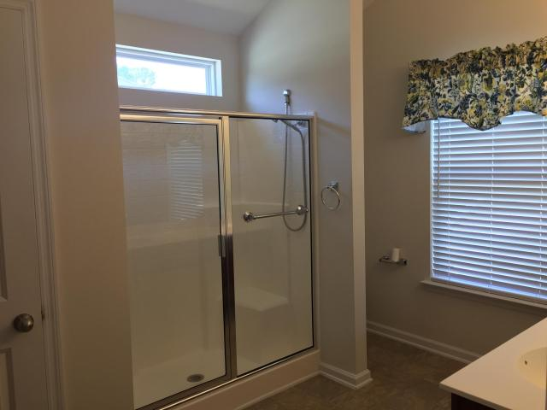
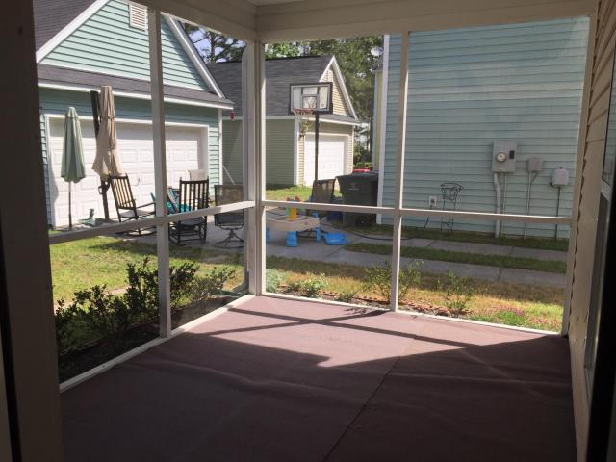

Just Listed in Tanner Plantation
7448 Northgate Drive
Hanahan, SC 29410
MLS# 18012847
$248,000
Fabulous family home in Tanner Plantation's South Cove community. 2-story home with lots of charm.
Hard wood flooring throughout downstairs and NEW carpet on stairwell and 2nd floor. Tray ceiling in dining room. Spacious kitchen with stainless steel appliances and granite counter tops. Large screened porch.
Hot water heater replaced in 2017. New Elementary School opening this year right around the corner! Home has been freshly painted with new carpet and is easy to show!
Elizabeth Chase
Dargan Realty & Associates
(843) 813-5050
Elizchase@hbrtwn.com
www.elizabeth.hbrtwn.com

