Slide 1
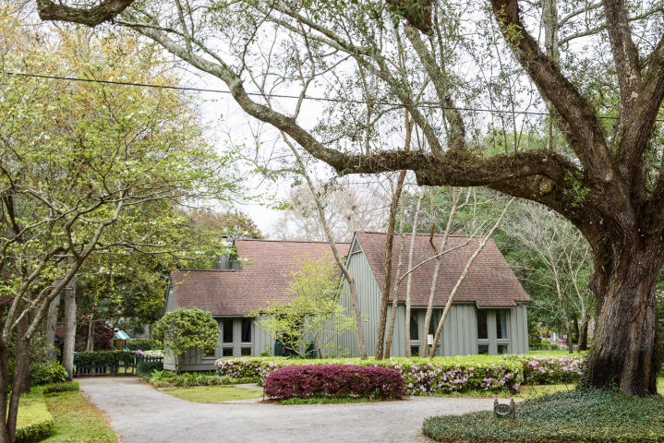
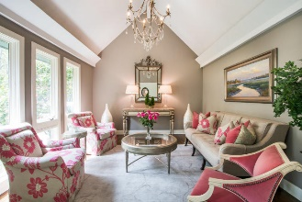
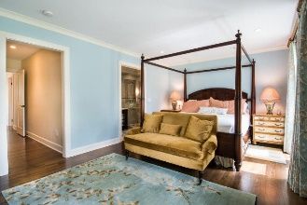
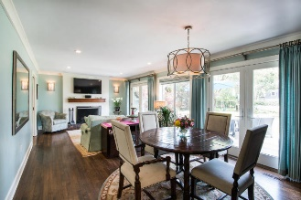
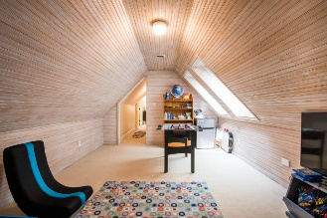
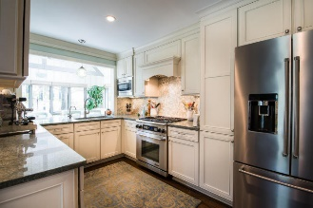
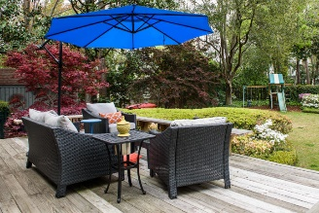
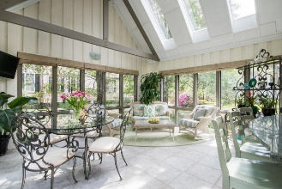
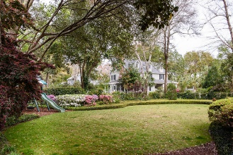


744 Pitt Street Mount Pleasant, SC 29464 ~ MLS# 18009541 ~ $1,149,000
Price Reduced
in the Old Village!
Old Village
Priced to Sell!
Exemplary renovation for this classic contemporary home in Mt Pleasant's finest neighborhood. Originally designed by a local architect for his personal home. The many windows flood the home with light and seemingly bring the magnificent yard into the home! Upon entering there is a vaulted living room, once a music room. Across the rear is a living-dining room with a wall of multiple glass doors and a cozy fireplace. Adjacent is an efficient kitchen which has a pull-up bar connected to the most gorgeous Sunroom/Den you'll ever find! The generous sized master suite with two walk in closets and another bedroom and bath finish off the downstairs. Upstairs are two bedrooms, a bath and a game room with a bead board ceiling for your entertainment! Lot in rear can be purchased separately.
Mac Jenkinson
M (843) 224-0210
mac@carolinaone.com
Beth Moore
M (843) 532-4892
bmoore@carolinaone.com
www.jenkinsonandmoore.com
Jenkinson & Moore, LLC | Carolina One Real Estate | 1503 Palm Blvd | Isle of Palms, SC 29451-2280

