Slide 1
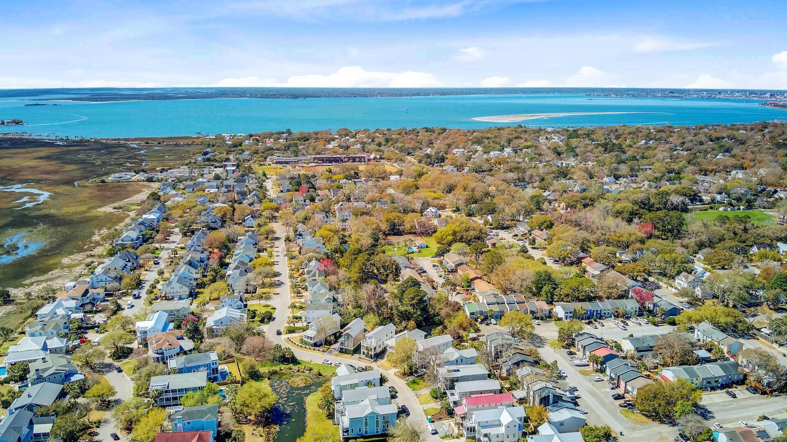

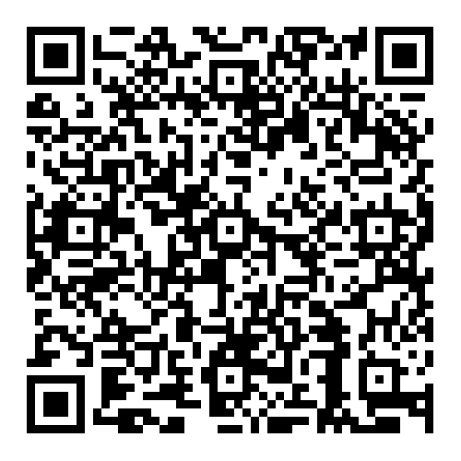


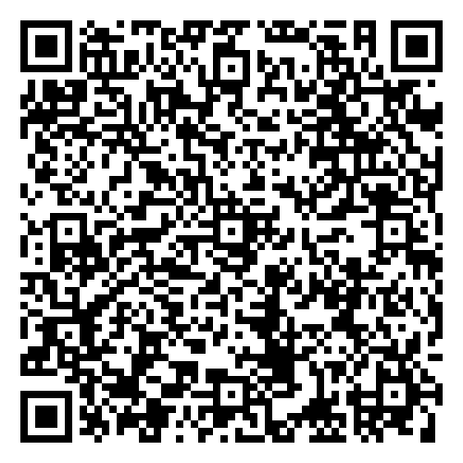

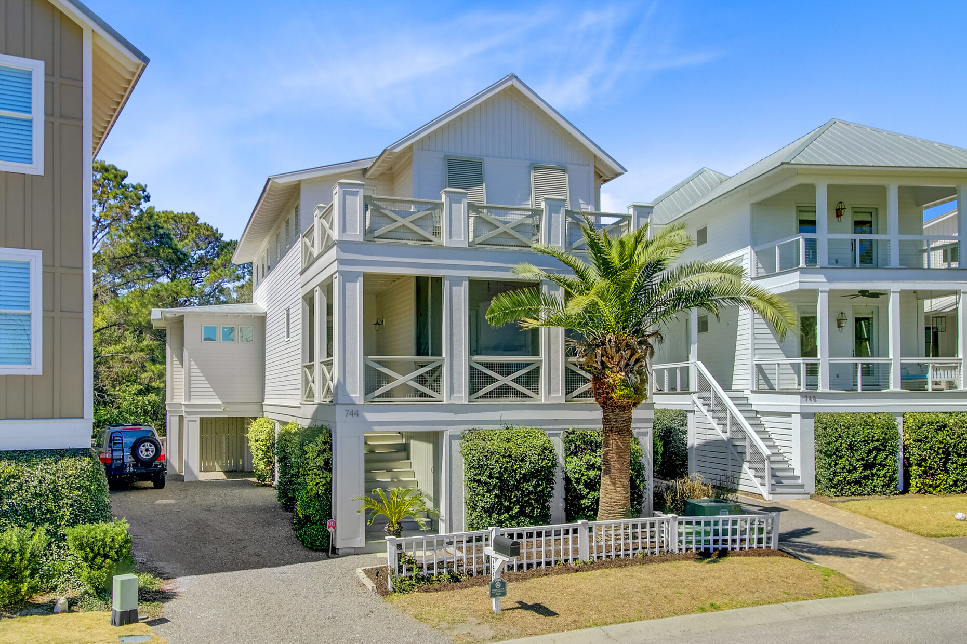



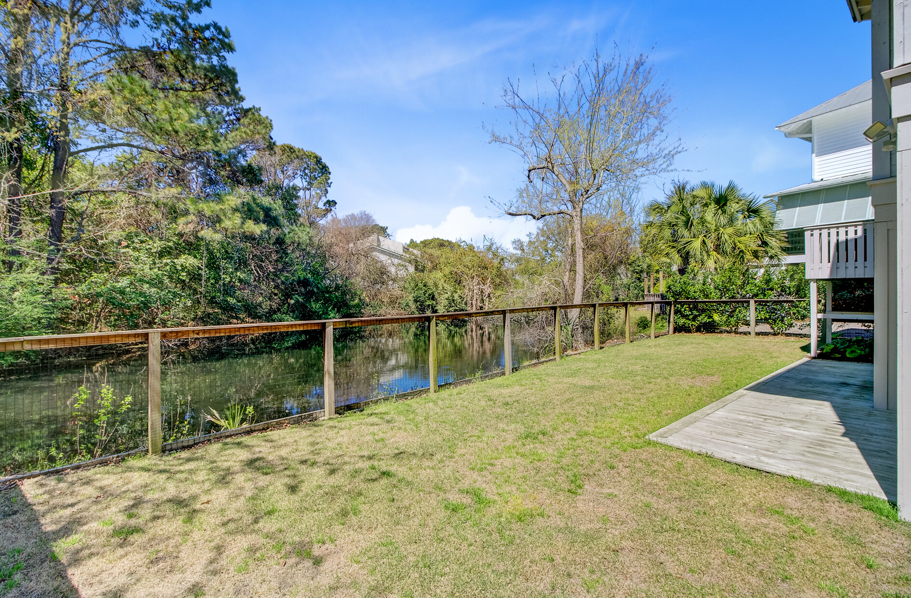



NEW REDUCED PRICE!!
744 Gate Post Drive
Old Village Landing | Mount Pleasant, SC 29464 | MLS# 25006882 | $1,625,000
Video Tour
Virtual Tour
🔥 HUGE PRICE DROP!
Sellers are ready to go—this is your chance to get into coveted Old Village Landing at a great price! This stunning 5BR custom home features dual primary suites, updated finishes, porches galore, and tranquil pond views—just minutes to Sullivan’s Island and downtown Charleston, and a short golf cart or bike ride to Pitt Street Bridge and all of the attractions on Coleman Blvd.
📍 744 Gate Post, Mt. Pleasant
Schedule your private tour today—this one won’t last!
Video Tour
Ellen O'Neil
Broker/Owner, ABR, e-PRO, CNE
Charleston Realtor of Distinction
843-300-8530
www.EllenONeilProperties.com

