Slide 1
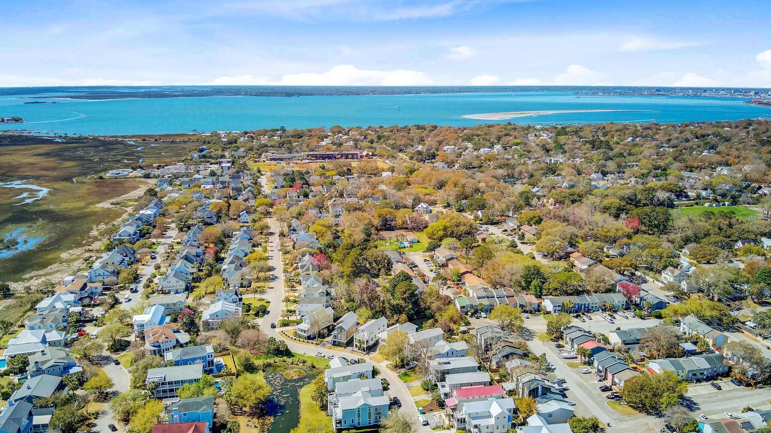

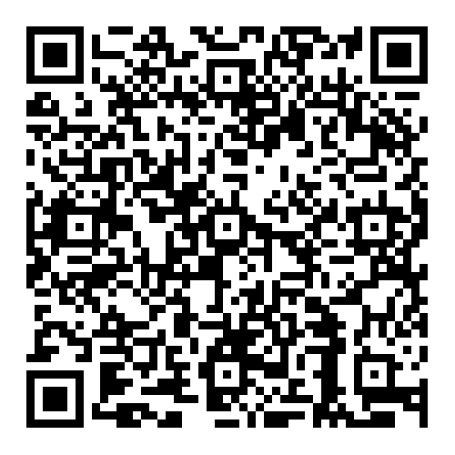


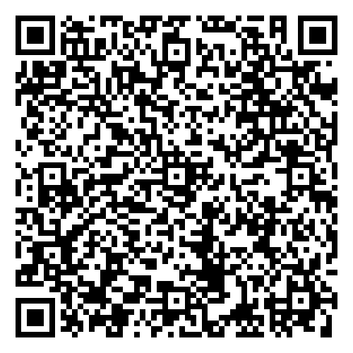

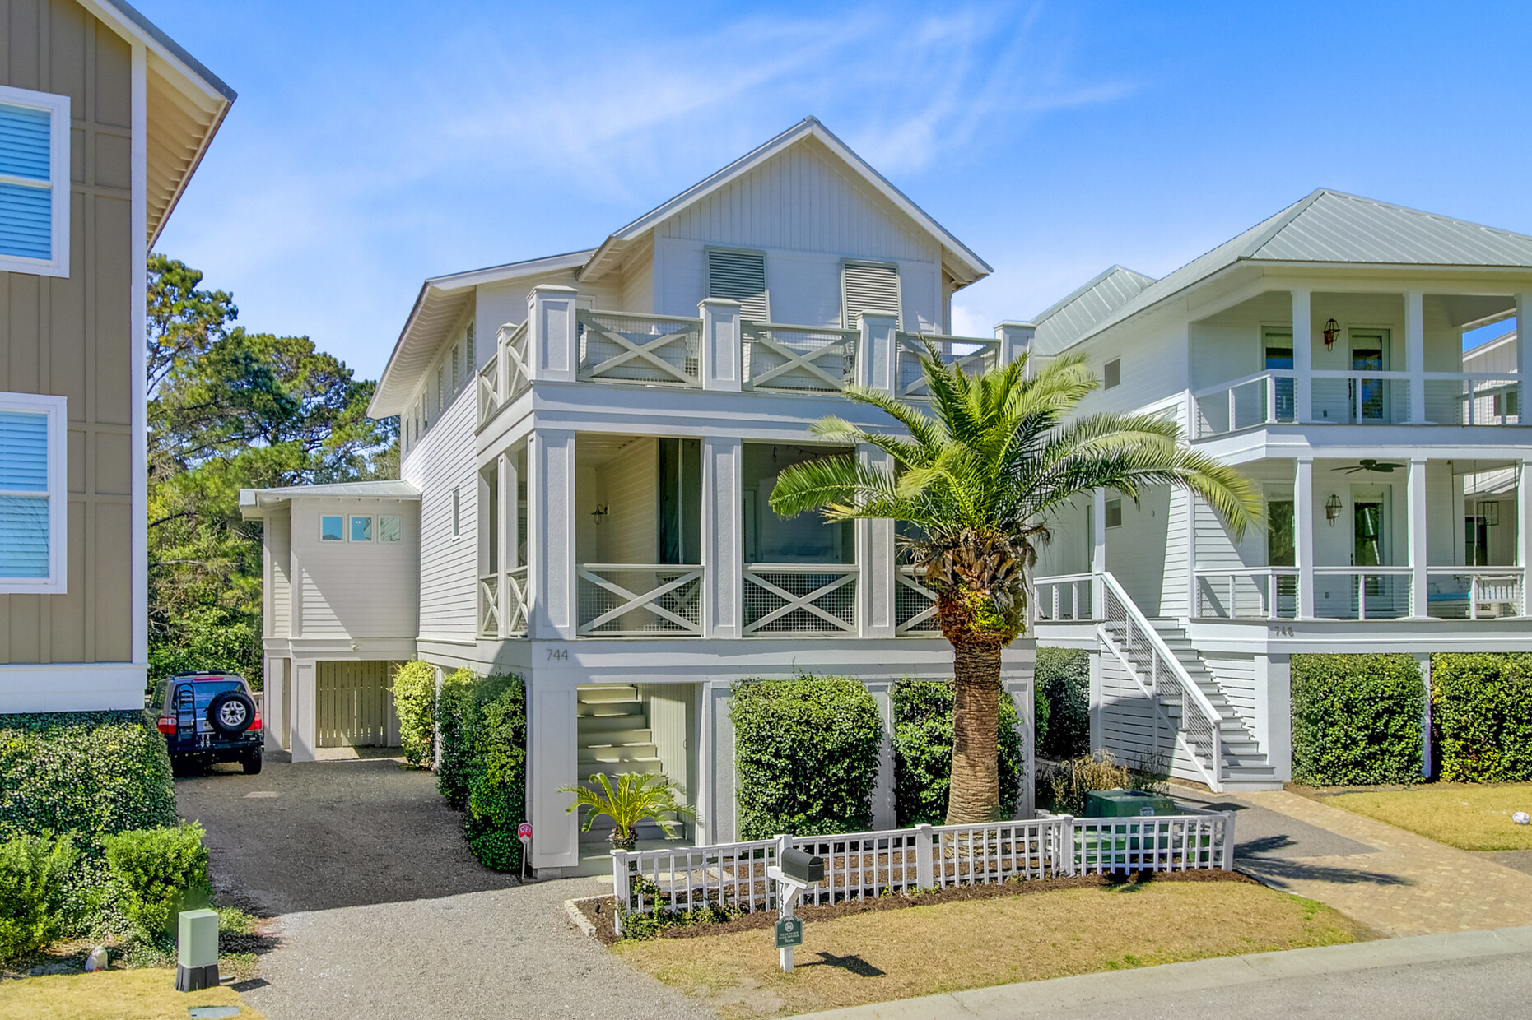
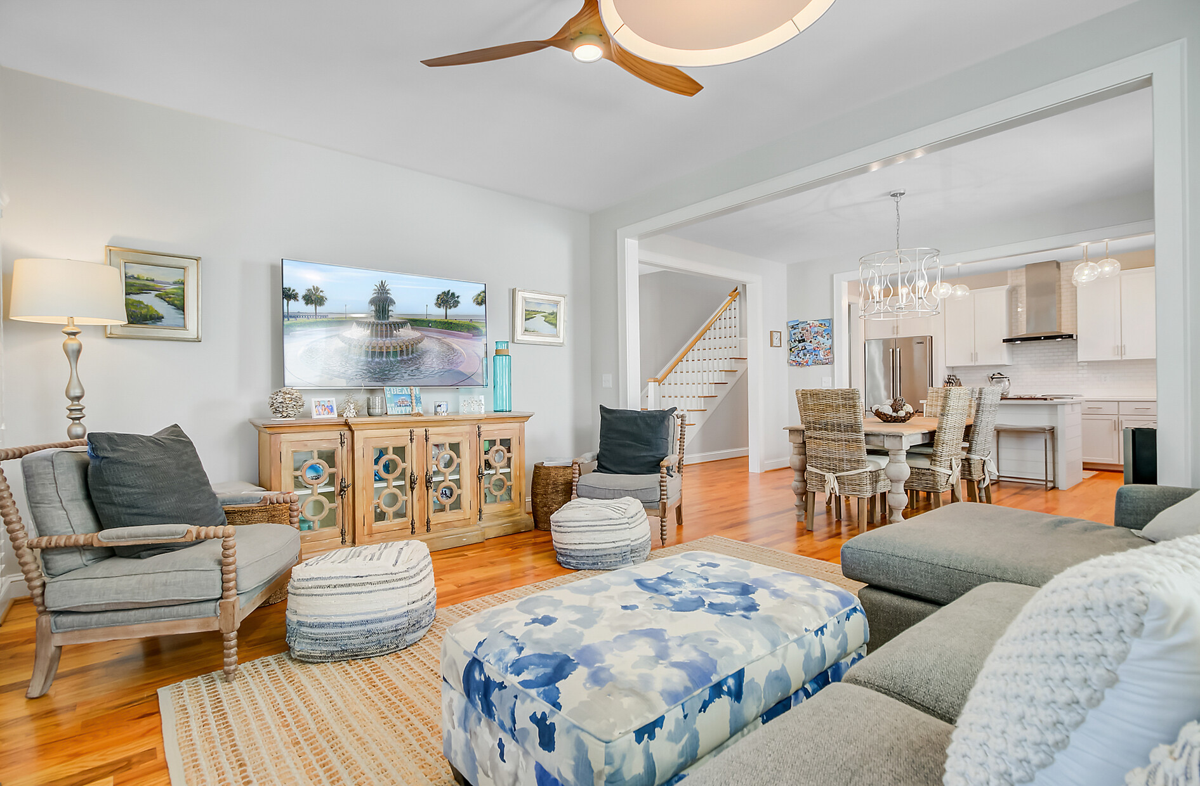


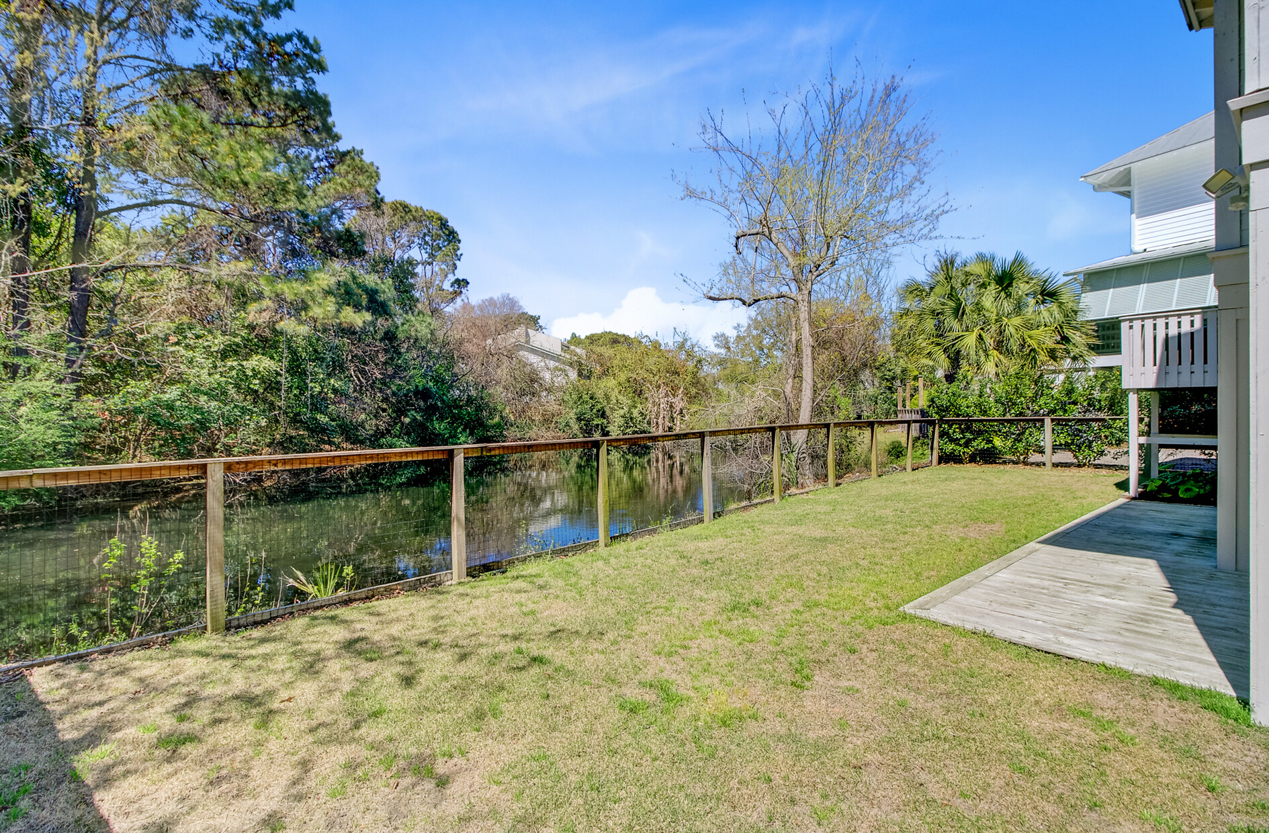



NEW LISTING | OPEN HOUSE SUNDAY 12 - 3PM
744 Gate Post Drive
Old Village Landing | Mount Pleasant, SC 29464 | MLS# 25006882 | $1,875,000
Video Tour
Virtual
Tour
Brand-New Listing in Mt. Pleasant's most coveted neighborhood. Enjoy living near Old Village and being a golf cart ride away from Shem Creek, Pitt Street Bridge and Sullivan's Island.
This 4 bedroom custom home is move-in ready just in time for beach season. This home offers dual primary suites. The owners retreat on the main level offers a spa-like en-suite and dual closets. Pond views in both the front and rear of the home make this one of the best lots in Old Village Landing.
Video Tour
Ellen O'Neil
Broker/Owner, ABR, e-PRO, CNE
Charleston Realtor of Distinction
843-300-8530
www.EllenONeilProperties.com

