Slide 1
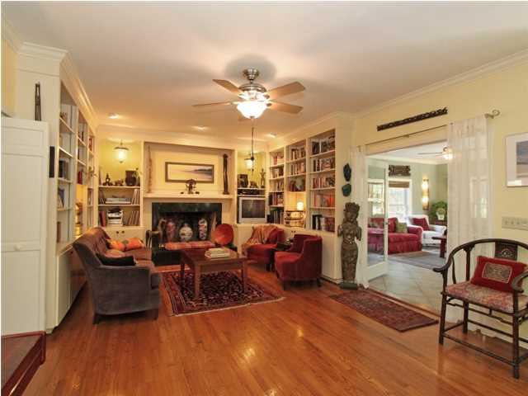
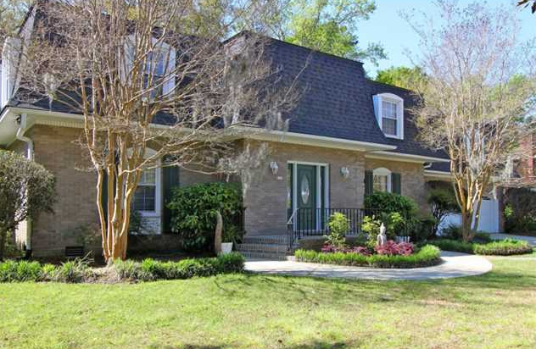
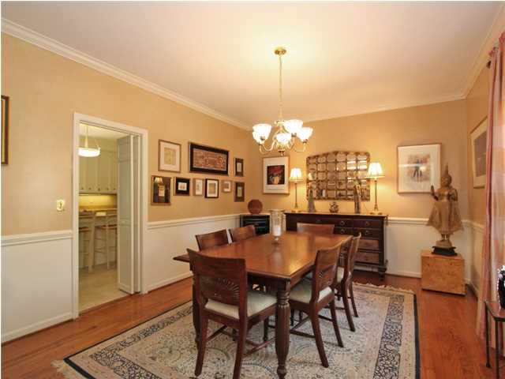
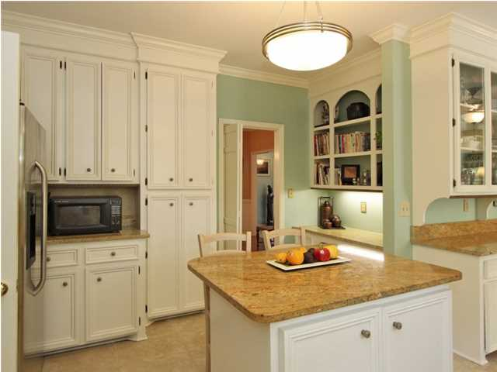
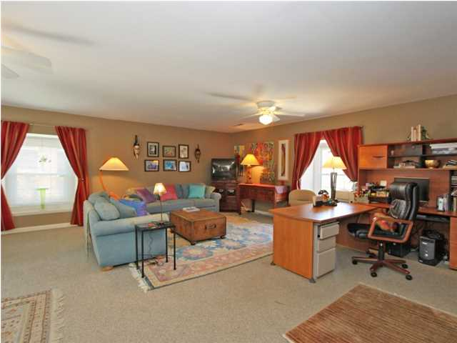
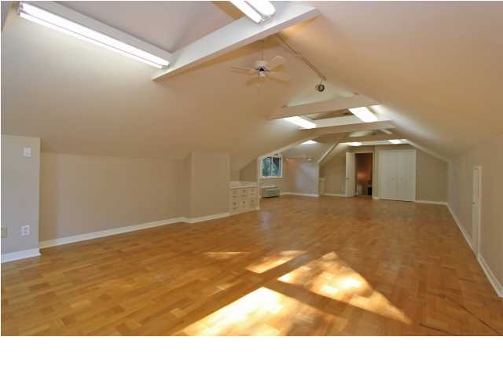
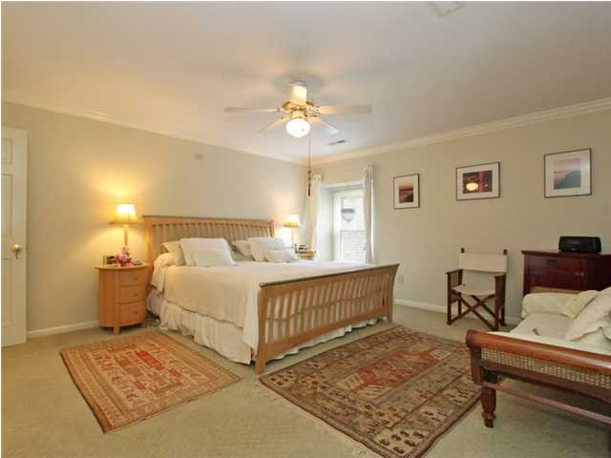
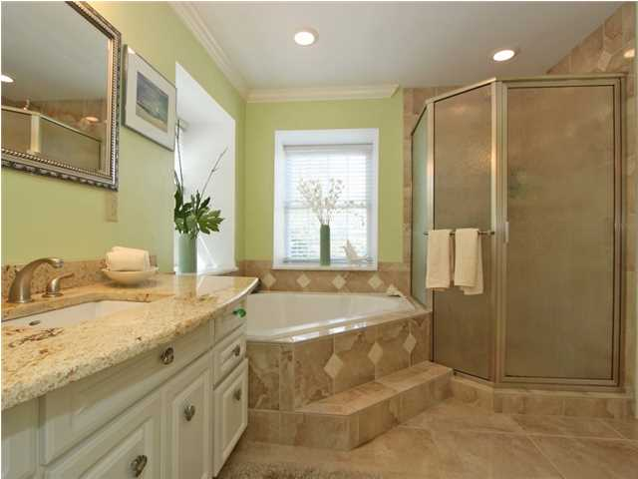
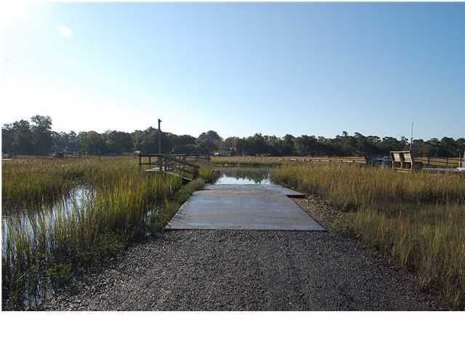

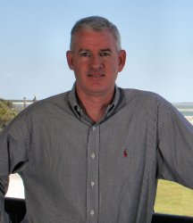
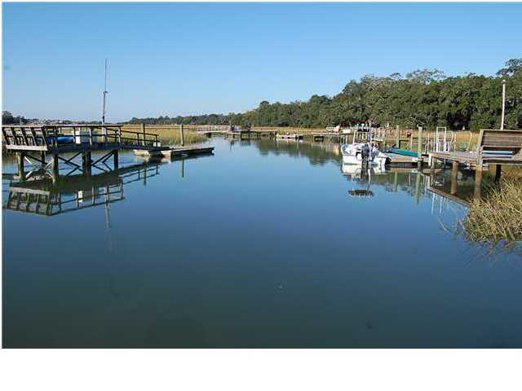
745 Dragoon Dr ~ Creekside Park ~ Mt Pleasant
MLS# 1410016 ~ $975,000
See more at www.745dragoon.com
Wonderful Executive home in sought after Creekside Park conveniently located in center of Mt Pleasant with easy access to downtown etc. This brick home has large entry foyer, separate living and dining room, great room with fireplace (gas optional) with plenty of built ins. The large kitchen boasts breakfast area and wet bar ,granite counters, an island, a gas range , Fisher Paykel dishwasher, pantry and desk area. The open and airy sunroom allows for the natural light with access to the backyard oasis. The master suite is spacious with sitting area and new bath with corner tub, separate shower and his and her walk in closets. There are three additional bedrooms plus a large finished room over the garage with a lot of storage. Hardwood and tiled floors throughout most of the house. The backyard is truly unique with stoned patio and fish pond along with other landscaping and beautiful oak trees and backs up to the neighborhood park. This property was extensively renovated in 2007/2008 with the addition of the sunroom, wet bar, expanded breakfast area and a new master bath. All windows replaced with dual pane energy efficient windows, all baths upgraded with new fixtures, granite counters, tiled floors. New roof with copper flashing and new gutters, HVAC units upgraded in 2007 . Neighborhood amenities are wonderful to include tennis club, swimming pool, volley ball courts, community park and boat landing on Shem Creek.
Clay Cunningham
Office - (843) 886-8110
Cell - (843) 345-4647
Fax - (843) 202-2921
clay@carolinaone.com
Carolina One Real Estate
1400-E Palm Boulevard
Isle of Palms, SC 29451

