Slide 1
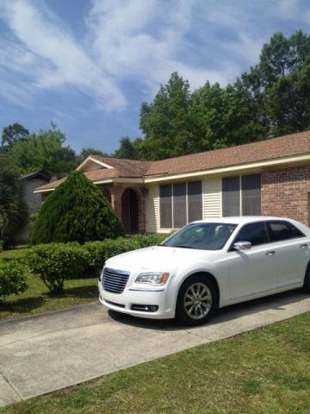
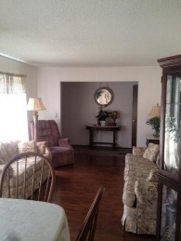
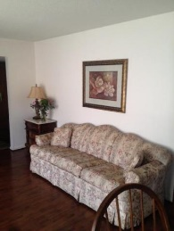



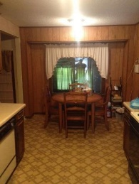
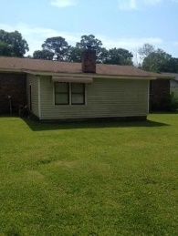
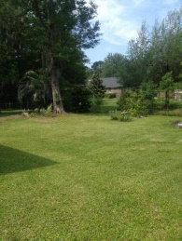
New Listing With Potential! Great Property With Good Bones.
745 Wexford Road
Long Branch On The Creek
Charleston, SC 29414
MLS# 16013097
$217,997
Attention all property buyers and investors alike. Are you ready to start filming that next episode of your HGTV Original. This property is right at the verge of being a great show house. This house has strong bones and is ready for that buyer to come and update this property to their dream home. This property is a great opportunity to purchase in Long branch on the creek. Don't miss out on this chance to purchase in West Ashley and walk into instant equity. Touch up the kitchen and bathrooms and your property is spruced up as if it were on HGTV.
Henry Wolfe, Realtor
wolfeorg1@yahoo.com | Mobile (843) 609-5039
Brand Name Real Estate | 4 Carriage Lane Suite 106 | Charleston, SC 29407

