Slide 1
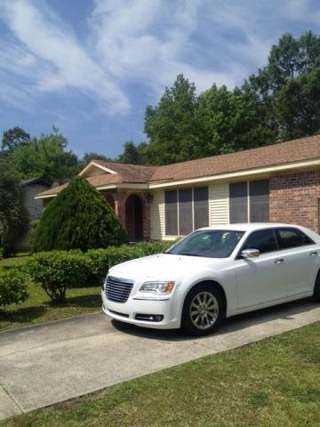
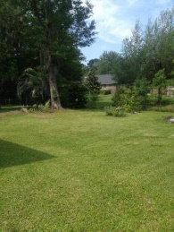
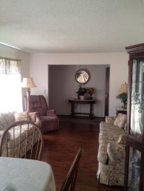

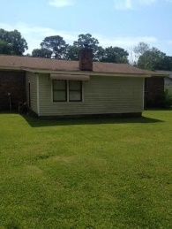
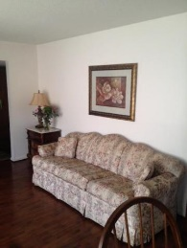
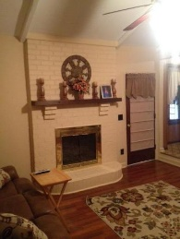
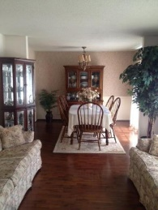
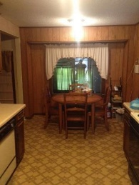
Motivated, Motivated, Motivated!!!
745 Wexford Road
Long Branch On The Creek ~ Charleston, SC 29414
MLS# 16013097 ~ $199,997
Price Reduced and the owner is ready to sell. This is your chance to purchase a home and walk into instant EQUITY. This property is ready for your personal touch. If you are afraid of a little work, this may not be the house for you. If you are willing to put in a little elbow grease and hard work this is your diamond in the rough. This property is right at the verge of being a great show house. This house has strong bones and is ready for that buyer to come and update this property to their dream home. Don't miss out on this chance to purchase in West Ashley for under $200k. Touch up the kitchen and bathrooms and your property will be a great asset for you, your family and friends to enjoy. This may be your last chance to grab a great West Ashley gem.
Henry Wolfe, Realtor
wolfeorg1@yahoo.com | Mobile (843) 609-5039
Brand Name Real Estate | 4 Carriage Lane Suite 106 | Charleston, SC 29407

