Slide 1
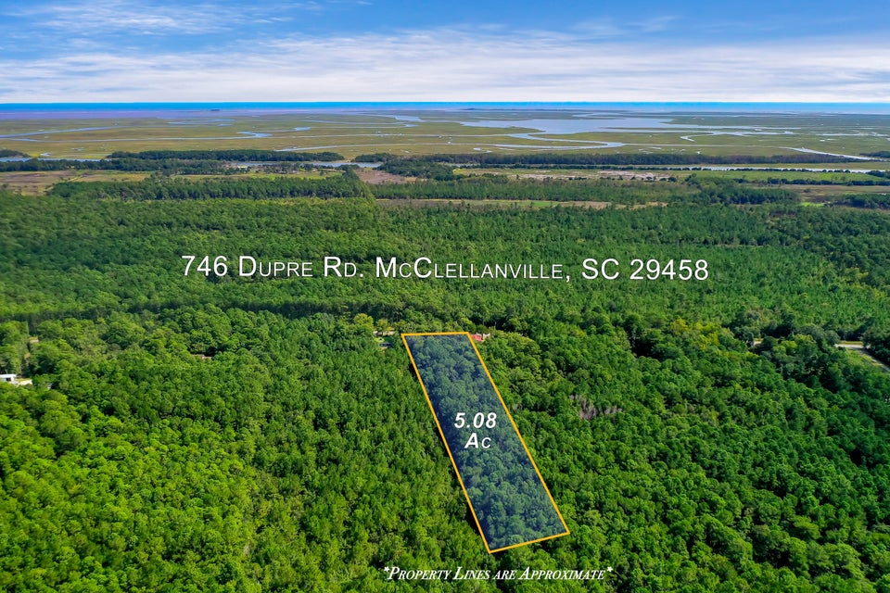
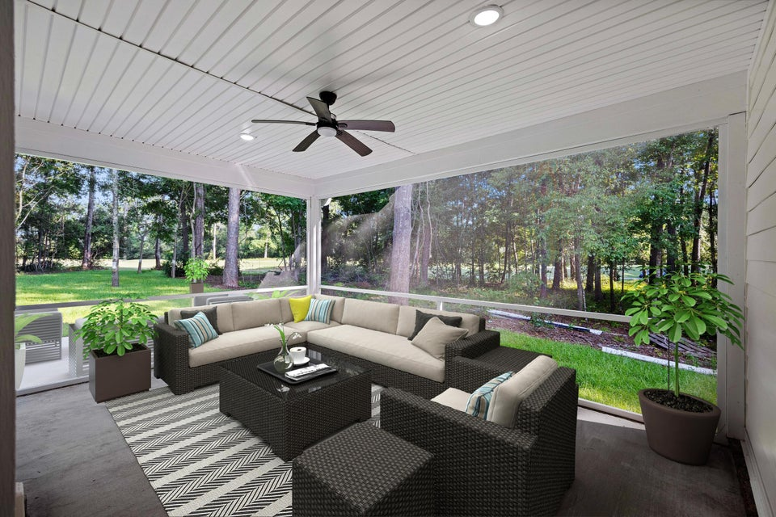
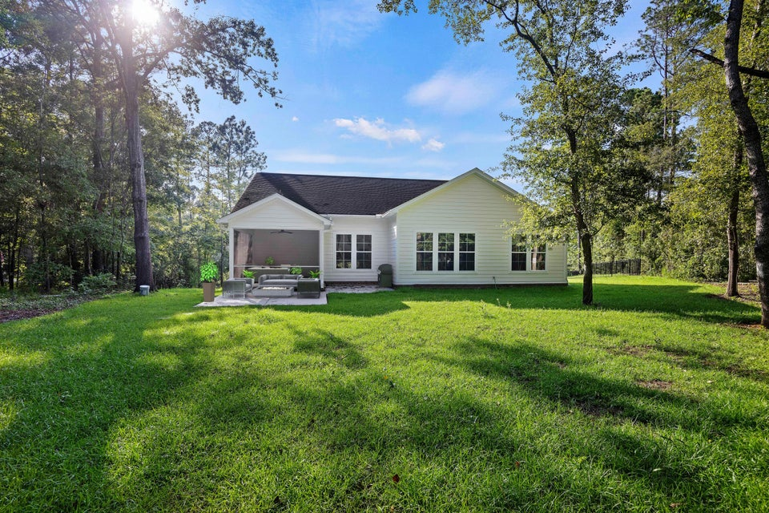
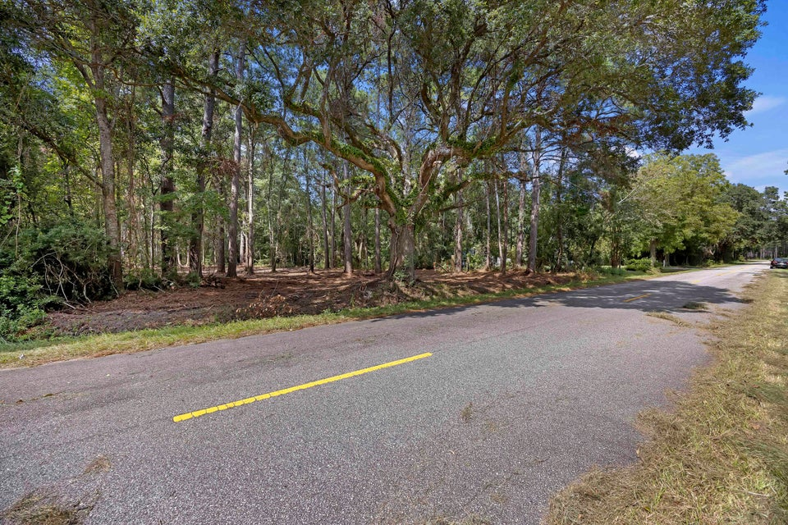
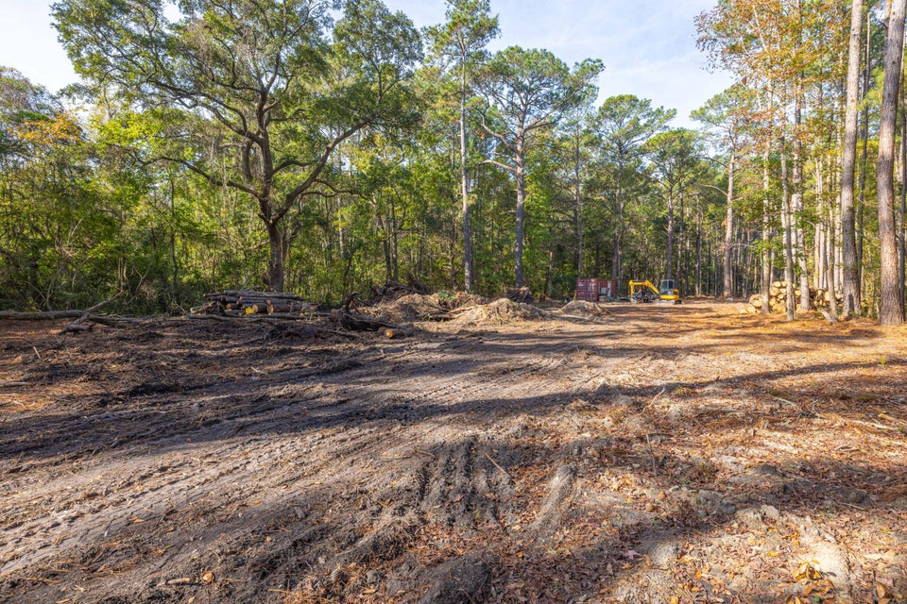
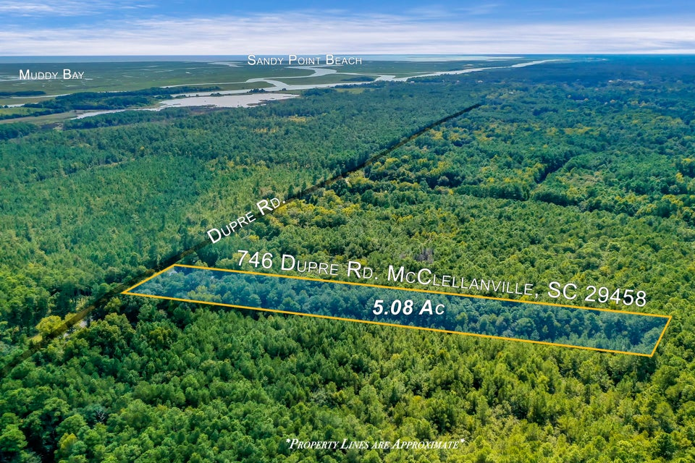


Holiday Land Sale + Agent Bonus!
MLS# 24023607 | $349,800
5 Acres
2 Homesites Available!
Homesite Already Cleared
Septic Permit In Hand
“Done-for-you” Lot
$2,000 BONUS Commission Is Offered For Any Offers Submitted Before Dec 9th 2024
Atlas Fathalla
The Home At Last Team
843-779-5613
atlas.home.expert@gmail.com

