Slide 1
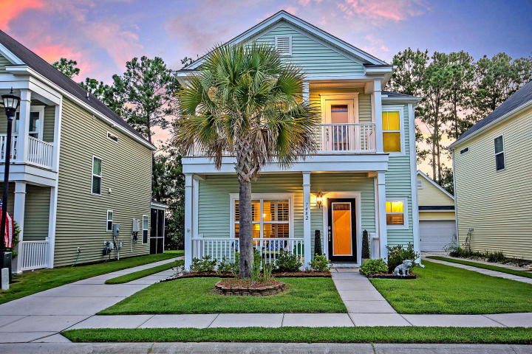



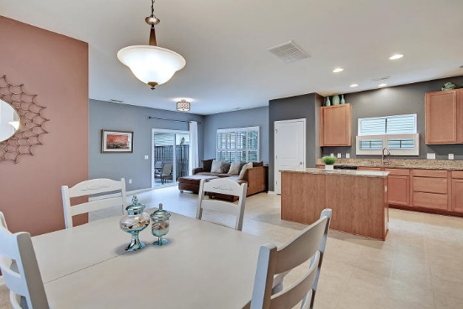
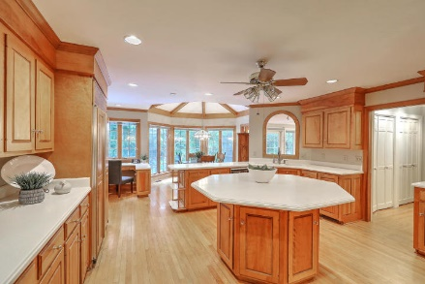
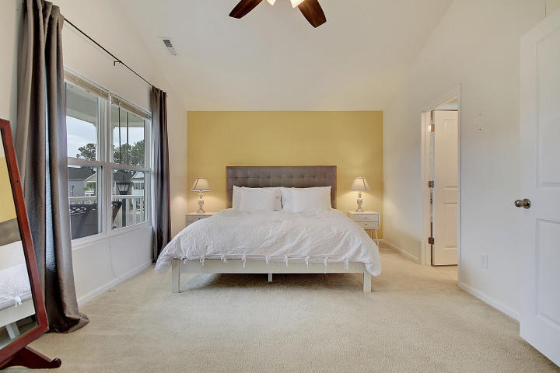



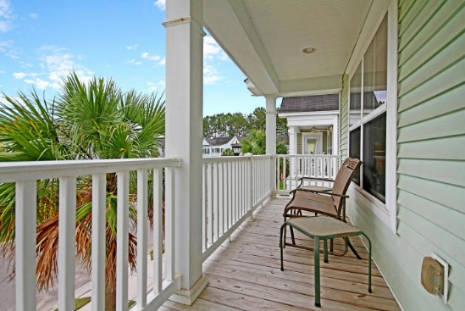

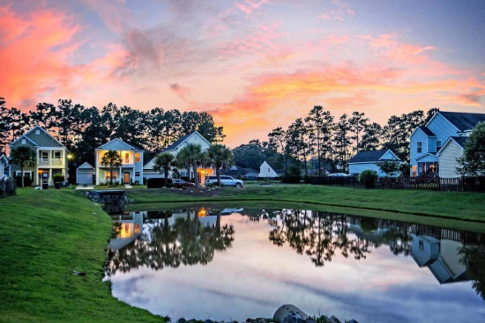
Parkshore Marshfront
Beautiful
Community
7482 Northgate Drive
Tanner Plantation ~ Hanahan, SC 29410 ~ MLS# 19017244 ~ $269,000
Known as "the Rainbow Row" of Hanahan, this Charleston single style home in the South Cove section of Tanner Plantation is stunning & move-in ready. If you have been searching for an open concept floor plan, it doesn't get any more open than the layout of the first level. From the foyer you are brought into the living room with its cozy fireplace which flows right into the spacious dining area, great room & kitchen with its center island. From here you can access the patio, fenced-in backyard & detached garage. The upstairs boasts a roomy loft area & the master suite which has a sitting area, en-suite full bath & access the balcony. Be sure to take advantage of the community amenities which include a playground, walking trails & beautiful ponds throughout the neighborhood.
Additional features include:
The functional kitchen includes granite countertops, stainless steel appliances, and abundant cabinet and countertop space
Master bedroom includes vaulted ceilings and a large walk-in closet, and the master bathroom includes a step-in shower, a large soaking tub, and dual vanity
Lots of natural light
Lovely curb appeal
Detached garage
Pond views from the front
Book your showing today!
Christopher Smith christopher@mattoneillteam.com 843-267-0735

