Slide 1

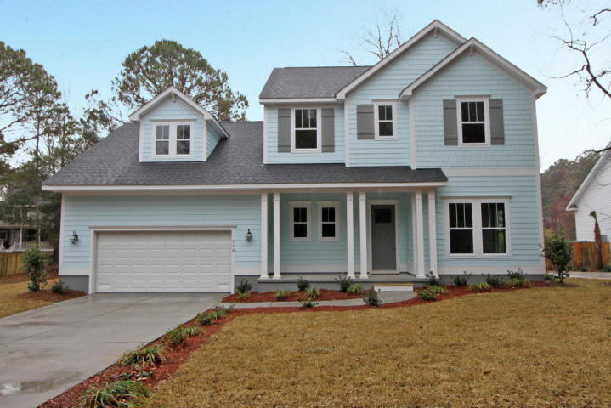
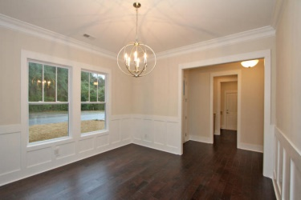
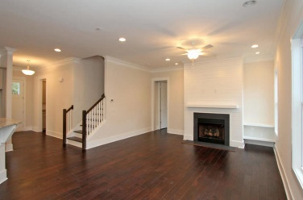
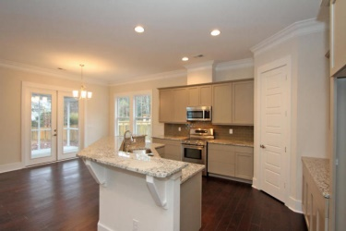
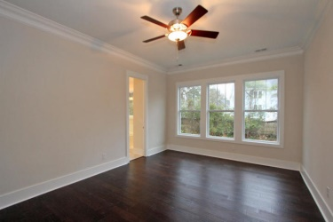
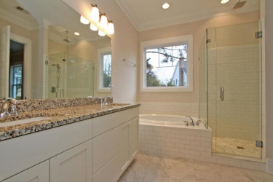



Move-in Ready New Construction. Big price drop!
750 Old Plantation Rd
Stiles Point Plantation
Charleston, SC 29412
MLS# 15004240
$514,900
3,062 SF
5 Bedrooms :: 4/2 Baths
HIGHLIGHTED FEATURES:
CUSTOM cabinets with NO SLAM drawers (kitchen)
Can lighting
Hardi Plank exterior
TANKLESS water heater
Outside gas hookups for your gas grill (say goodbye to switching out tanks)
HUGE hidden STORAGE area
Powder room
Large back yard
Walk to the Neighborhood park in less than 3 minutes
Zoned for Stiles Point Elem.
Easy access to the new Harris Teeter grocery store. Drive to downtown with NO STOPLIGHTS!!!!
Great Value for NEW Construction in Stiles Point. Be sure to check the comps!
NEW CONSTRUCTION-FINISHED
From the second you enter you immediately feel warm and welcome. You are greeted by an abundance of natural light. A formal dining room with chair rails sits at the front of the home. Just beyond the formal dining room lies the heart of the home, the Great Room. Within the uninterrupted flow of this room are the large upscale kitchen, a casual dining area and the family room, a screened porch & step down patio beyond. The kitchen features BOSCH STAINLESS appliances, GRANITE countertops, CUSTOM cabinets and a large WALK IN pantry. The family room has a nice large gas FIREPLACE. Other features of the great room include gorgeous HARDWOOD floors,10 Ft. ceilings, crown molding, natural light galore, prewired for surround sound. MASTER DOWN Large master is located just beyond the great room. And features wardrobe room and crisp clean master bath. Bathroom is tiled and features double vanity, garden tub, stand up shower and separated water closet. The upstairs, which is a 2nd story split level, is where you will find the 4 additional bedrooms (all of large size) and 2 full baths. All baths have marble counters and tiled floors. Between the first and second floors (the split) is a HUGE bonus room with its own half bath and a closet. This would be an AWESOME media room or great playroom for children or game room for teens. Standing in the kitchen you can see up into this room...perfect for keeping an eye on playing children. When entering the home from the 2 CAR garage you will find 2 small rooms with unique features. In the laundry room there is built in granite counter folding table with storage underneath. Then there is the HOME COMMAND CENTER a truly unique space. A grand live oak tree graces the front of the property. There will be a full landscape installation with irrigation systems in both back and front yards. Charleston's Premier builder Port City Homes. Seller is offering a "2-10" builder warranty.
Lizzie H Ray
(843) 452-9298
lizzieray1122@gmail.com
Eric Draper
(843) 442-7118
eric.draper@gmail.com
www.charlestonrealestategroup.com
Charleston Real Estate Partners. LLC | 792 Folly Rd. C1 | Charleston, SC 29412

