Slide 1
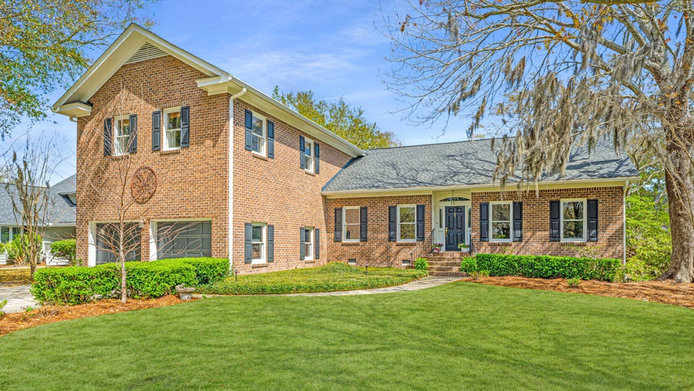
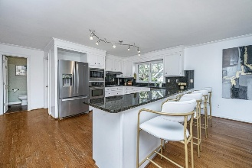
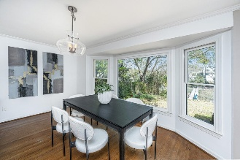
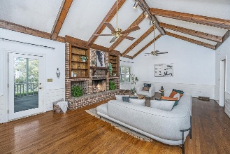
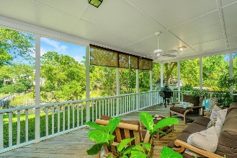
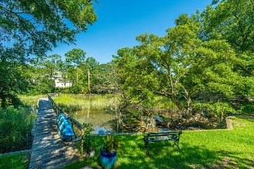

HUGE PRICE DROP!
READY FOR YOUR BUYERS PERSONAL TOUCH!
750 Lakenheath Drive
Point Pleasant | Mount Pleasant, SC 29464 | MLS# 25007612 | $1,650,000
The Lowcountry Home of Your Dreams! Welcome to 750 Lakenheath, a stunning brick home nestled in an established neighborhood just 15 minutes from both the heart of Downtown Charleston and the beach! This home boasts a NEW ROOF, NEW HVAC, and fresh exterior paint, ensuring both comfort and curb appeal. With two primary suites—one on the main floor and one upstairs—this home offers flexible living options for any lifestyle. The spacious, open-concept main floor features plenty of room for entertaining or simply relaxing in front of the fireplace on a cool evening. The kitchen, with a large picture window, overlooks a short dock leading into the tidal creek. Here, you can enjoy tranquil views of marsh birds, local wildlife, and beautifully lit yard spaces. The outdoor area is equally impressive, with a newly constructed retaining wall protecting the backyard and providing privacy and peace of mind.
Upstairs, you'll find three generously sized bedrooms and two bathrooms. The large upstairs primary suite offers a private retreat with a spacious en-suite bathroom, a walk-in closet, and spectacular views of the creek. The two additional secondary bedrooms also feature large walk-in closets and water views, creating a serene environment for all.
Convenience meets charm with shopping, dining, public services, and schools all located within a mile of the property. Don't miss the opportunity to own this exquisite Lowcountry gem in one of Charleston's most desirable neighborhoods.
Carolina One Real Estate
195 W Coleman Blvd
Mt Pleasant, SC 29464-3495
Kathy Ware
843-830-3804
Kathy.ware@carolinaone.com
www.katherineware.com

