Slide 1
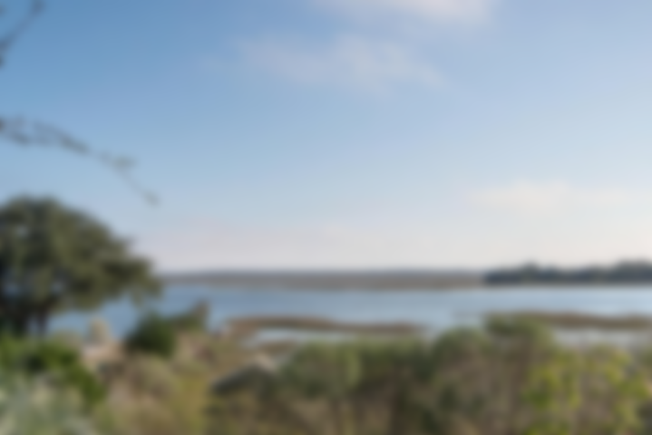
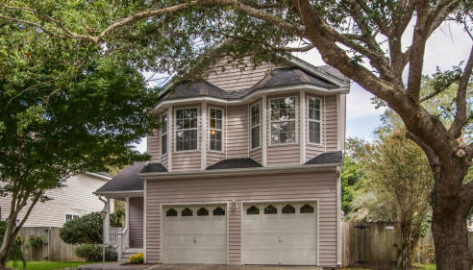
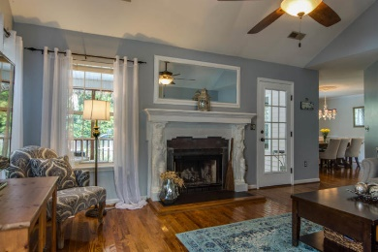
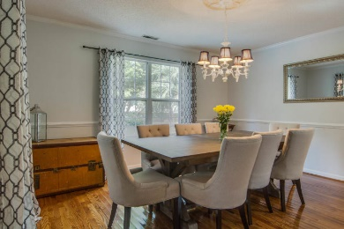
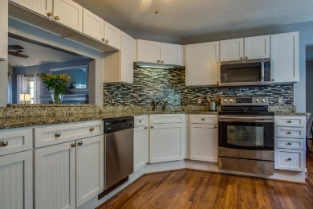
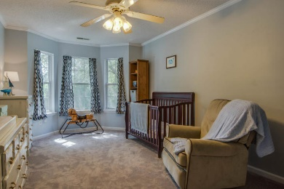
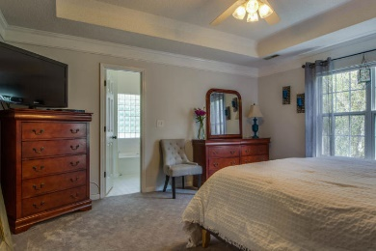
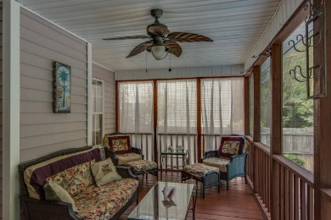
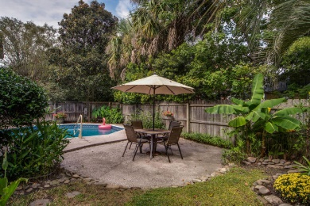
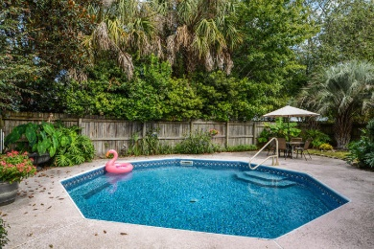


Motivated Seller!
752 Shell Sand Road
Harbor Oaks
Charleston, SC 29412
MLS# 18026468
$425,000
This Charming Home is located on a cul-de-sac just 10 minutes from downtown Charleston. It has Three Bedrooms, Two and One half baths and POOL, in a private, tropical setting. Screened in porch overlooks the pool. Cathedral Ceiling in Great room, with a fireplace, Large separate dining room and large kitchen with room to dine in. All bedrooms are upstairs and the owners bedroom is large with a roomy bath & and walk in closet. Very desirable neighborhood with all of the conveniences. Recreation Center, Shopping, Dining ,again, all SO Close to Downtown, MUSC, I-26 and not far to Folly Beach! This Pocket community is a perfect location and this home is Ready to move in!
Jan Miller Cell (843) 345-9719 | Jan.Miller@nvrealtygroup.com
NV Realty Group | 91 Broad St, Ste A | Charleston, SC 29401
janmiller.nvrealtygroup.com

