Slide 1
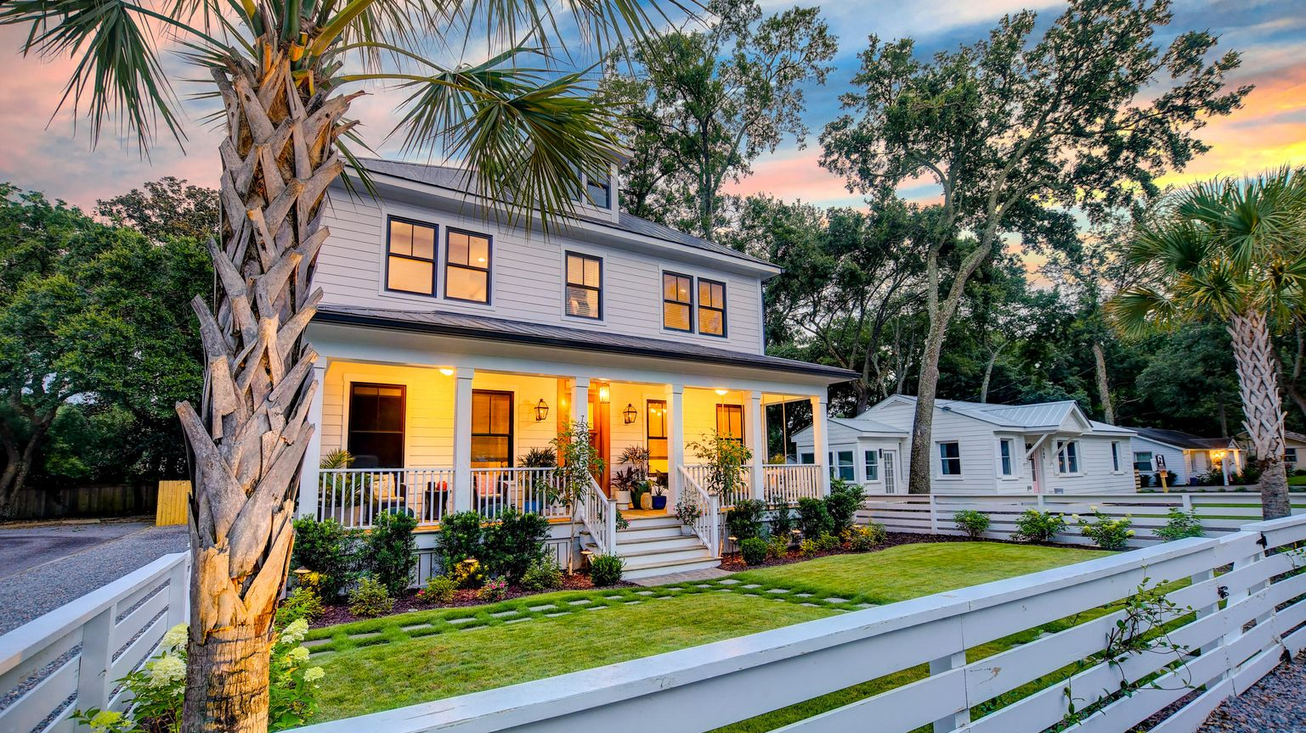

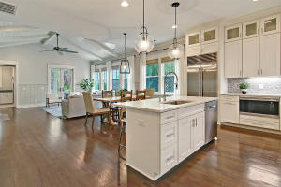
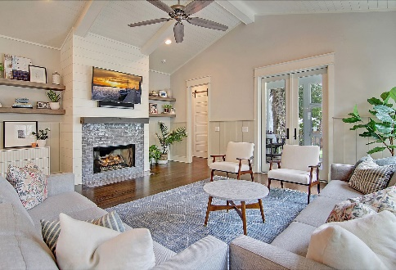
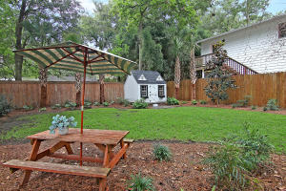
In the Heart of Old Mt Pleasant
Price Reduced
For Quick Sale
Open House Saturday 12-3
753 Mccants Drive
Old Mt Pleasant ~ Mount Pleasant, SC 29464 ~ MLS# 21021737 ~ $1,799,000
Situated in the highly sought after Old Mount Pleasant neighborhood, this stunning, 2018 built home is the total package. From the moment you see this modern coastal home, you will fall in love with the incredible curb appeal, the impeccably groomed yard, and the inviting full front porch. Head inside to discover timeless, wow-factor features including hardwood floors, wainscoting, 10 ft ceilings, crown molding, and great natural light. The entry boasts a convenient ''drop zone'' for bags and coats, and the formal living room/den can be found to the right of the foyer. Down the hall, you'll find the open family room with a ship lap cathedral ceiling with beams, a gas fireplace with subway tile and ship lap surround, and access to the screened porch and backyard. A dining area is conveniently located by the gourmet kitchen with mosaic tile backsplash, Wolf and Subzero stainless steel appliances, breakfast bar seating at the center island, a huge pantry, and a butler's pantry with lots of cabinets and counter space. The first floor owner's suite boasts a ship lap tray ceiling, a custom walk-in closet with built-ins and a relaxing en-suite bath with a dual vanity, a free standing garden tub, and incredible tiled, walk-in shower. A laundry room with a sink and a powder room completes the first level. The second level is sure to please and offers three bedrooms, two full baths and an office with a built-in desk and cabinets. The outdoor living spaces include a fenced-in front yard with a white picket fence, a screened-in back porch, and fenced-in backyard with a detached one car garage, storage shed, and stone walkway. There is off-street parking available in front of the home as well on the deep driveway. The yard was recently upgraded with new, lush landscaping and sod, has irrigation, and uplighting. This amazing location is approximately 1.4 miles from Pitt Street Bridge and Shem Creek, approximately 0.9 miles from Alhambra Hall, approximately 1.2 miles from the Old Village Historic District, and approximately 3 miles from Sullivans Island. There is so much to love about this home and location!
Book your showing today!
Katie Wishneff kwishneff@mattoneillteam.com 843-870-8784

