Slide 1
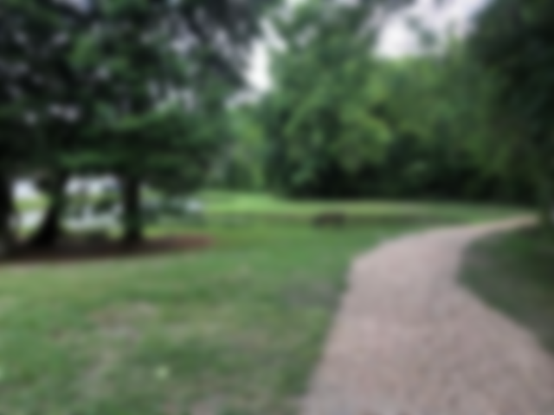
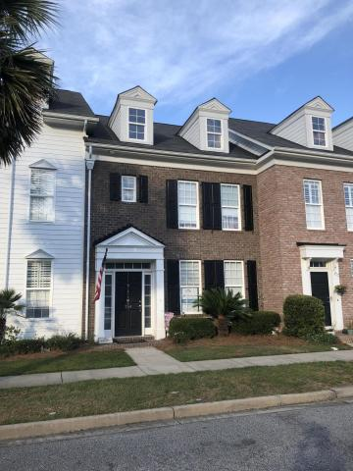
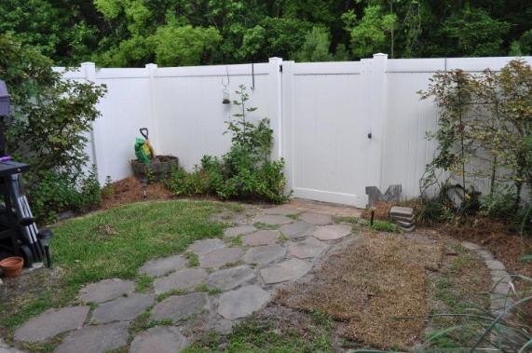
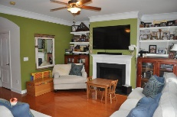
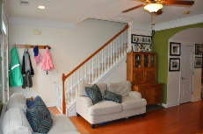
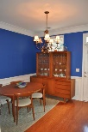
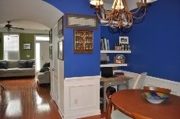
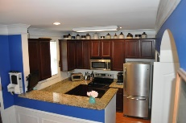
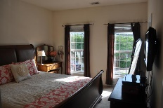
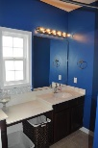
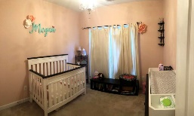
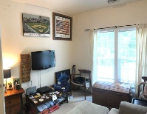
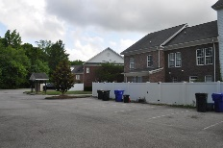
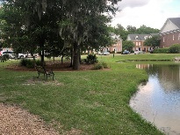

Great West Ashley Townhouse Value
754 Certificate Court
Grand Oaks Townhomes ~ Charleston
MLS# 19014844 ~ $227,500
Come see this fantastic townhouse in Grand Oaks today! It offers a great location, modern finishes, spacious floorplan, new (2018) HVAC, and so much more! Monthly regime fees cover exterior insurance, cable, internet, termite bond, trash pickup, annual pressure washing, annual pine straw, and common area maintenance. The unit has a privacy fenced-in backyard, and owners are just responsible for maintaining inside the fence. Heaps of additional parking out back, and the neighborhood mailbox is a stones-throw from this unit! *The sellers and GLR will be donating 25% of our commission to Families of the Wounded Fund at closing.*

