Slide 1
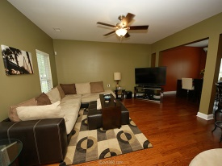
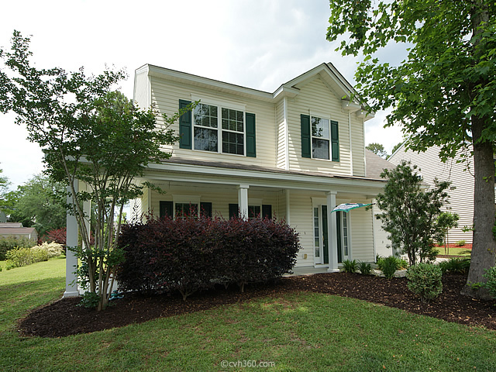
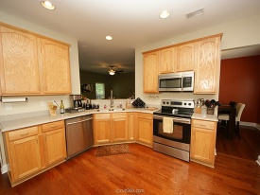
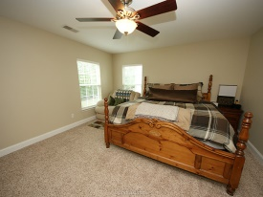
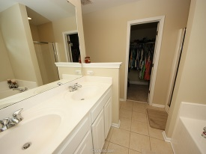
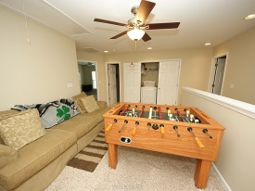
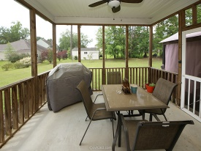

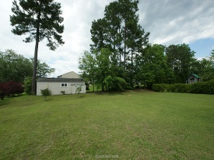


New Listing!
Great Upgrades Throughout
7551 Hawks Circle
Tanner Plantation
Hanahan, SC 29410
MLS# 15010983 | $225,000
3 Bed / 2½ Bath
One of the prettiest homes in The Reserve! Sellers are serious and have made this home move in ready! Features include open floor plan, wood floors, gorgeous choice of paint colors, granite counter tops, 42'' cabinets, stainless appliances and more. Upstairs you will find beautiful upgraded carpet with 3 large bedrooms, open loft, upstairs washer and dryer and a master suite with separate tub and shower. Home features a wrap around porch, screen porch and sits on a large lot with great curb appeal. We have priced this home to sell fast!
Connie White, Broker
C: 843-532-3356
conniesyouragent@gmail.com
Charleston Homes
111 Spring Hall Dr
Goose Creek, SC 29445

