Slide 1
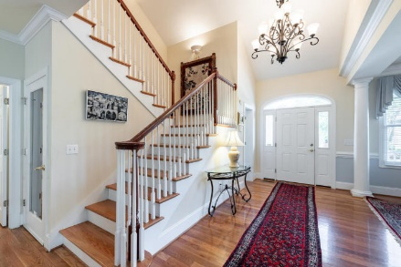
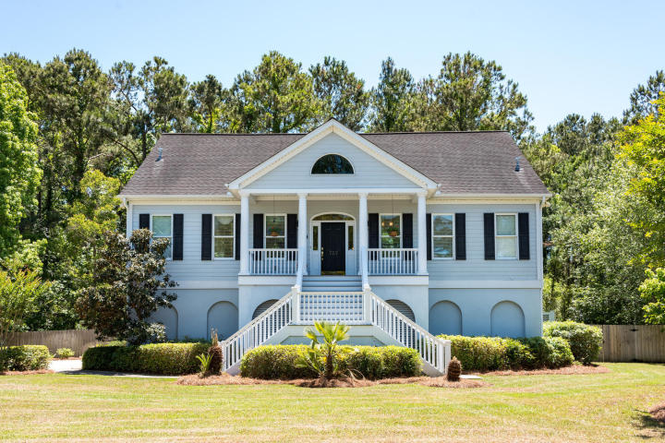
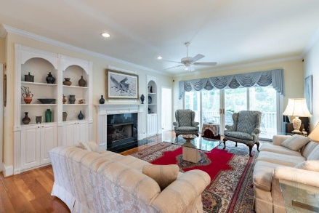
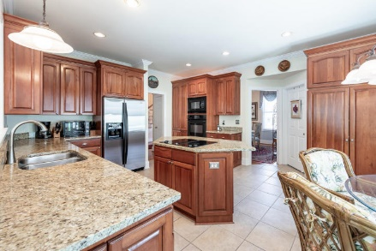
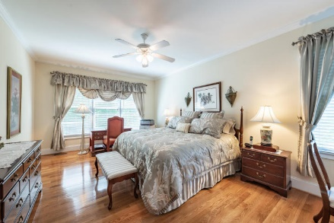
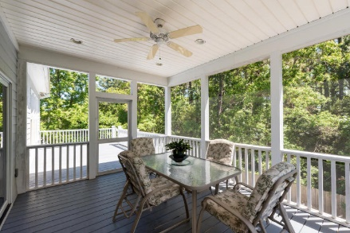
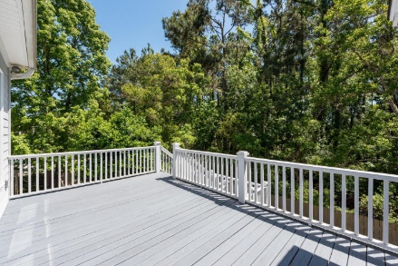
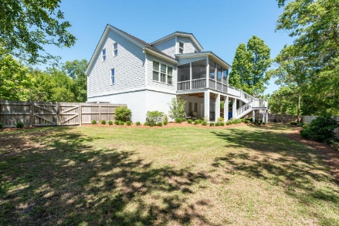


757 Whispering Marsh Drive
Stiles Point Plantation ~ Charleston, SC 29412
MLS# 18012861 ~ $723,000
Welcome Home!
Make yourself at home at this move in ready Lowcountry stunner in the highly sought after Stiles Point Plantation just 10 minutes from Downtown Charleston and 15 minutes from Folly Beach. This roughly 3000 sq ft elevated 4bd, 3.5ba situated on over a 1/3 of an acre lot features upgrades throughout. Upon entry into you are greeted by a 2 story foyer, spacious family room featuring builds on either side of the large gas fireplace with granite surround, and a formal dining room flanked by large columns leading into a breathtaking dining area. Adjacent you have large kitchen with solid cherry cabinets, large center island, granite countertops, and eat in breakfast area. Connecting the kitchen and family room is a bright enclosed sunroom leading to screened as well as open air porches.
Also on the main level is a large master suite which includes his & hers walk-in closets, an oversized Kohler spa tub, and a 4 x 4 tiled stand up shower. Upstairs you have 3 oversized bedrooms each have their own walk in closets for maximum storage and 2 additional full baths. Finally don't miss seeing the massive 3 car garage that would allow for multiple vehicles, boats, a utility room, and additional personal storage. Seller has done a magnificent job maintaining this home for you to move right in!
Mary Beth Bennett
(843) 367-1774
marybeth.bennett@agentownedrealty.com
www.chsarealiving.com
AgentOwned Preferred Group | 824 Johnnie Dodds Blvd | Mt Pleasant, SC 29464

